Slide 1


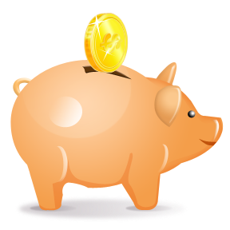
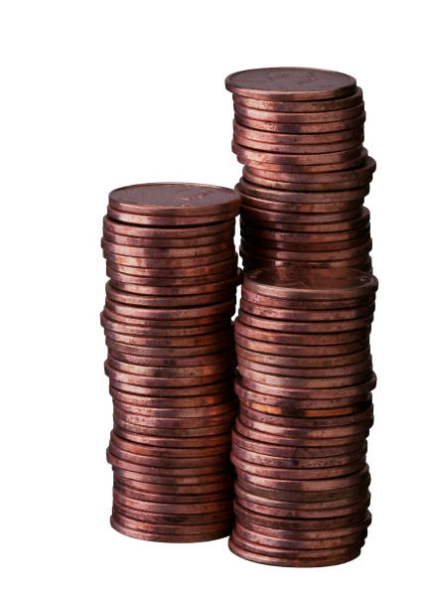
Money

Slide 2
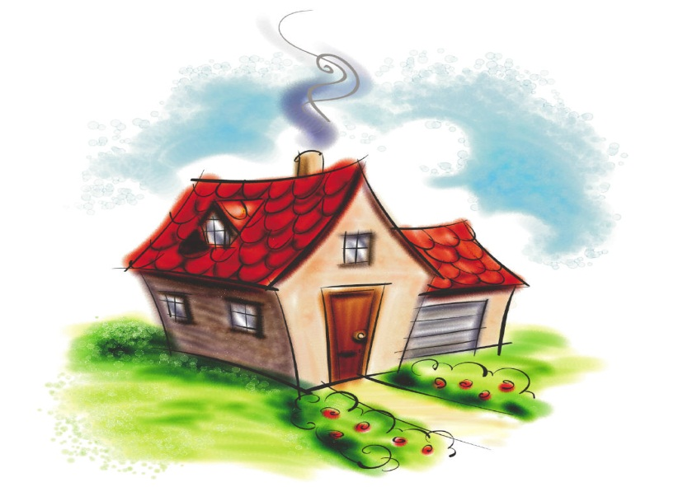
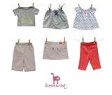
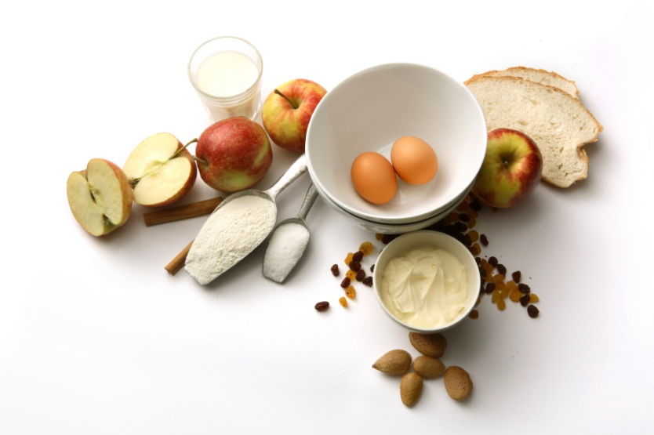
What is money used for?
We use money to pay for things we need.

Slide 3

At the shops
What will I buy?

Slide 4


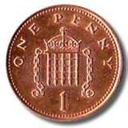

Look at these coins.
p is short for pence
1p
2p
5p

Slide 5
At the toy shop
5p
2p
How much?
1p

Slide 6



At the food shop
How much?
1p
2p
5p

Slide 7
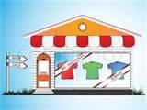

At the clothes shop
How much?
2p
5p
1p

Slide 8
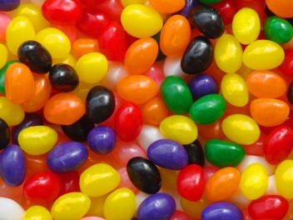
At the sweet shop
How much?
5p
1p
2p

Slide 9


How much is in each purse?
2p
2p
Chip has 2p.
Biff has 2p.
They both have the same amount.

Slide 10
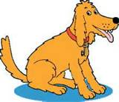
How much is in each purse?
3p
3p
No, Floppy!
I have 3p in my purse.
Biff has 3p in her purse too.
Is there a 3p coin?

Slide 11
How much is in each purse?
4p
4p
No, Floppy!
I have 4p in my purse.
Biff has 4p in her purse too.
Is there a 4p coin?

Slide 12
How much is in each purse?
4p
4p
No, Floppy! You are a silly dog.
I have 4p in my purse.
Biff has 4p in her purse too.
Is there a 4p coin?

Slide 13
How much is in each purse?
5p
5p
Yes, Floppy! Can you see my 5p?
I have 5p in my purse.
Is there a 5p coin?

