Slide 2
Aim
I understand that there are strategies and behaviours that support my mental health and wellbeing.
Success Criteria
I can think of ways I can be kind to myself.
I can list the things I can control and the things I can’t control.
I can think of ways to connect with other people for support.
This resource is fully in line with the Learning Outcomes and Core Themes outlined in the PSHE Association’s Programme of Study.

Slide 3
The Big Questions

Slide 4

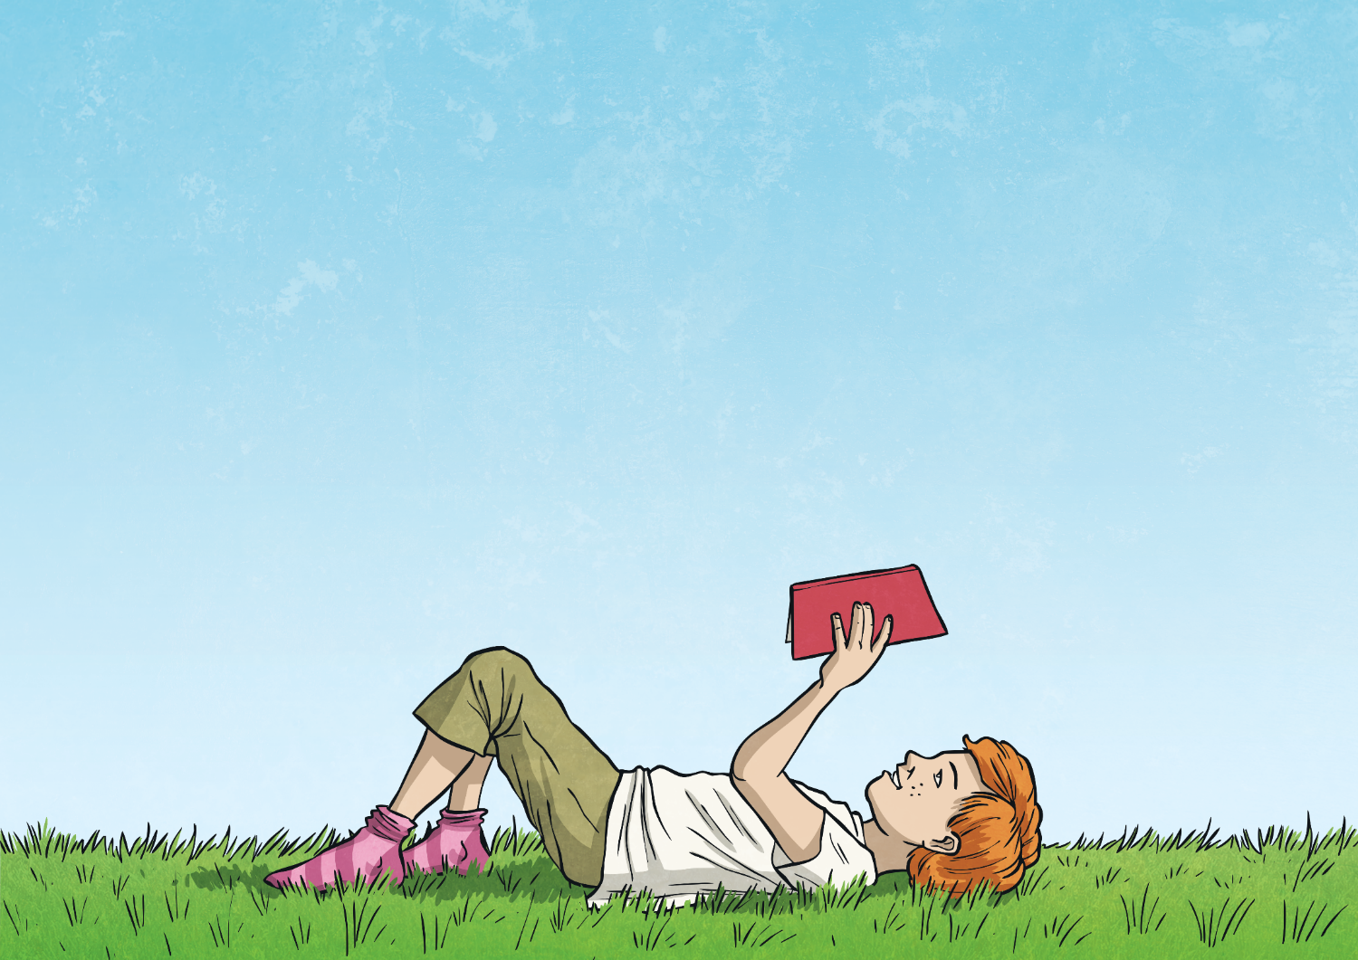
What is wellbeing?
How can I look after my own wellbeing?

Slide 5



What Is Wellbeing?
When you try to look after your own wellbeing, you think about:
how comfortable you are (both physically and mentally);
how healthy you are (both physically and mentally); and
how happy you are.
Wellbeing is explained as feeling…
comfortable,
healthy,
or happy.
If life changes, you may feel a lack of control, which can then make you feel unsettled. This can affect your wellbeing and how you feel. Changes can take you out of your comfort zone and make you see life a bit differently; all of which can be unsettling.

Slide 6
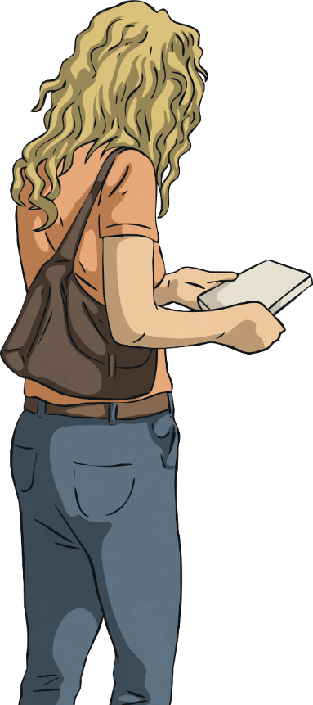
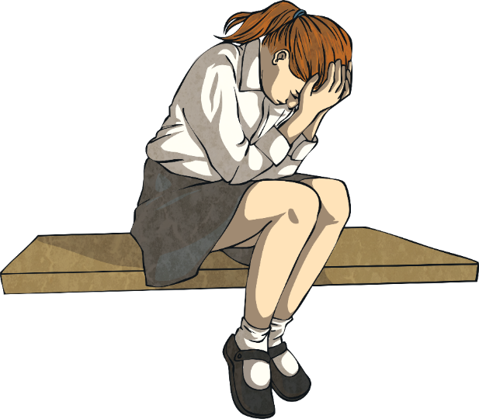
What Is Wellbeing?
When people feel anxious or worried about changes, they will try and control any areas of their life that they can.
This might not be the ‘right’ thing to do but it is often done by people trying to look after their wellbeing in the only way they know how.
When people are dealing with change, they often try and control the only things they can.
This might be what they buy from the shop or what their home looks like.
Today you will learn some other ways to look after your wellbeing, especially in a time of change.

Slide 7
Reconnecting

Slide 8
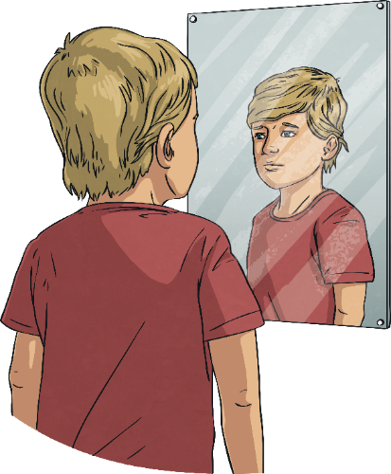
Be Kind
When change is happening in the world around you, or when things feel a bit more difficult, it is important to remember to be kind in what you think, say and do.
This includes being kind to others but also being kind to yourself.

Slide 9
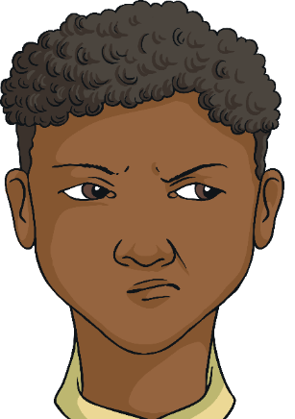
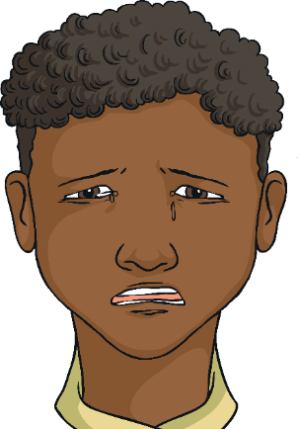

Be Kind
When choosing how to react and respond to other people, it is important to understand why they are behaving in a certain way, as well as their emotions or situation. This knowledge is important for helping you to understand their behaviour and words but also how to forgive and be kind, if necessary.
It is also important to have the same patience and understanding
with yourself.

Slide 10
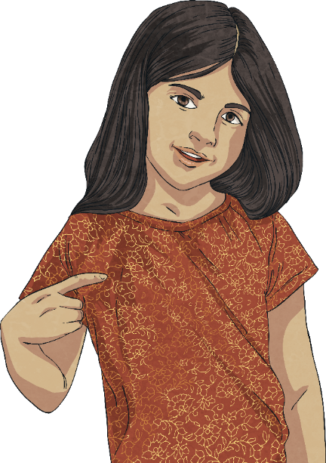
Be Kind
We often take the time to show gratitude to others but it is important, as part of self-care, that we show ourselves thanks and gratitude.
Remember to speak to yourself and about yourself in a way that you would with someone else you care about.
Often, people speak unkindly about themselves, in a way they would never speak about someone else.
It is important to know the effect we have on ourselves and our wellbeing when we do this.

Slide 11
Be Kind
The following checklist contains different ideas and suggestions of ways you can show yourself some self-gratitude.
Ask others to write a positive note about you and pop these in a jar to read to yourself
Plan a day for doing no homework at all and fill it with relaxing or fun games instead.
Surround yourself with people who motivate and inspire you. This is both in person, in the news and online.
Buy yourself a treat with your pocket money.
Which of these could you do today?
Ensure there is something or someone in your life that you care about and that needs your love and care; this could be family, pets
or plants.
Write down positive thoughts about yourself and say these out loud
If anyone says anything negative about you, or to you, try and think of a positive about yourself to balance that view.
Spend some time reading a book or listening to your favourite music.
When someone pays you a compliment,
make sure you say ‘Thank you’ rather than responding with a self-criticism or by ignoring it. It is important to accept
a compliment.
Massage your hands or have a bath.
Do something which relaxes you and allows you to rest.
Spend some time outside and enjoy the world around you.

Slide 12
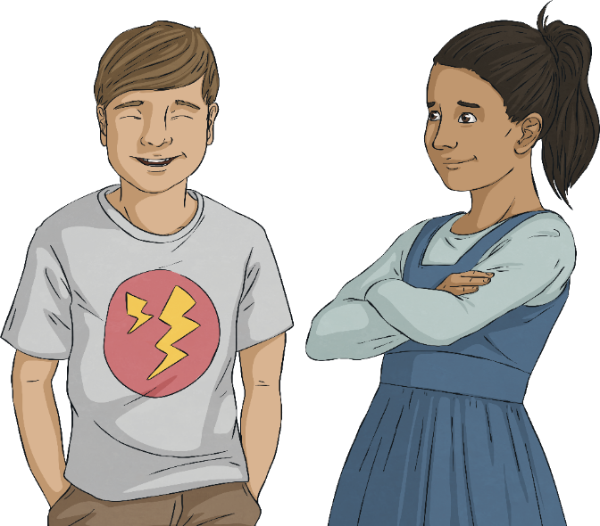
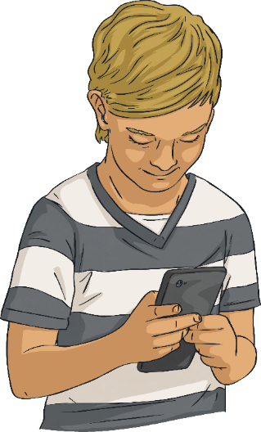
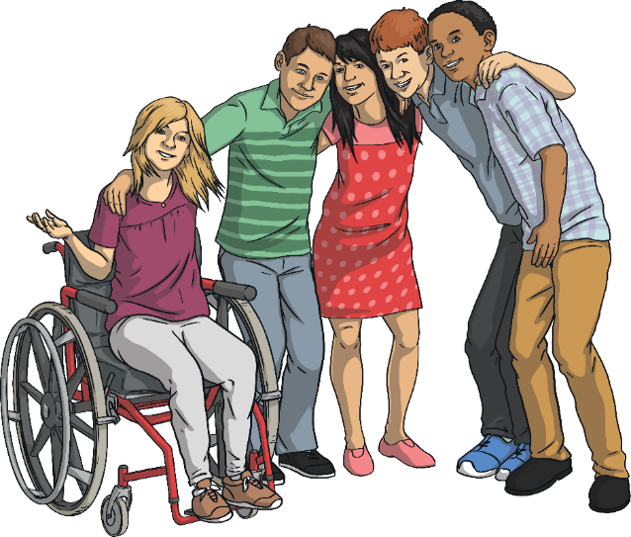
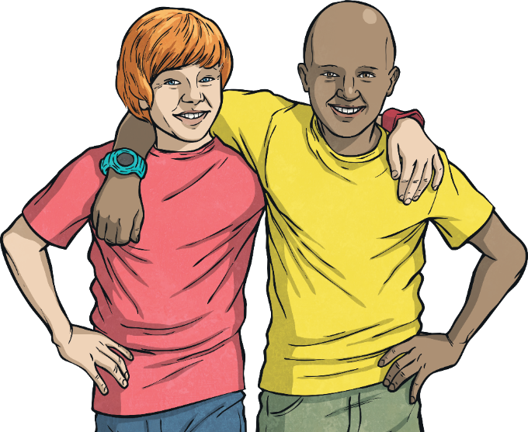
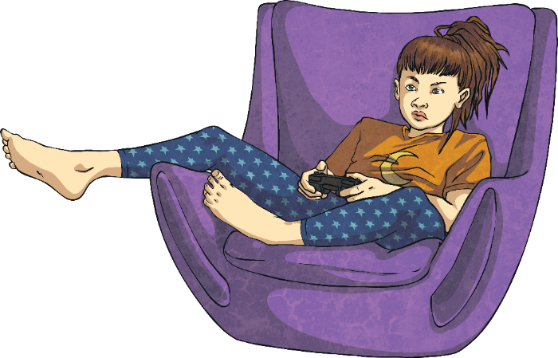
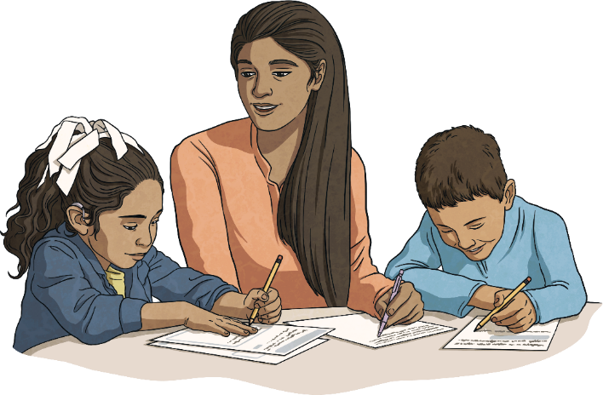
Connect with Others
An important part of wellbeing is being connected with other people. This is called a support network. You will be part of other people’s support networks, where you will support their wellbeing, and other people will be in your support network. This might include family, friends, teachers at school and members of the community.
If you are having difficulties with your wellbeing, it is really important to reach out and connect with someone in your support network.
Connections are a really important part of your wellbeing and for these to be strong, you need to put time and energy into creating and keeping these. It isn’t always easy but it is important for you to have others that look out for your wellbeing and support it.
This might be through face-to-face interactions or, if this is not possible or you’d prefer it a different way, it could be through letters, messaging, telephone calls, video calls or playing games together on the Internet (always check with your parents or carers first if you want to go online).

Slide 13
Exploring

Slide 14
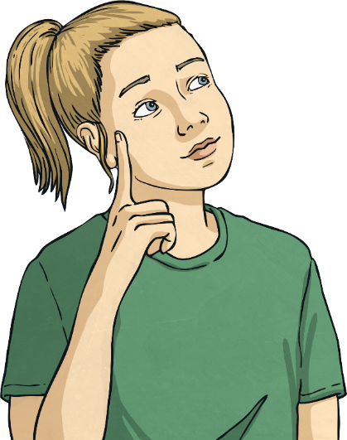
Positive Mindset
Part of coping with times of change or stress is ensuring that the way you see the situation is through a positive mindset.
This means looking for opportunities in every situation, no matter how challenging or difficult they are.
This approach can help you to:
see life in a different way;
think about the priorities in your life;
value people over ‘things’;
remember what is important in your life;
know how important your health and wellbeing are; and
know how important it is to love others and be loved.

Slide 15
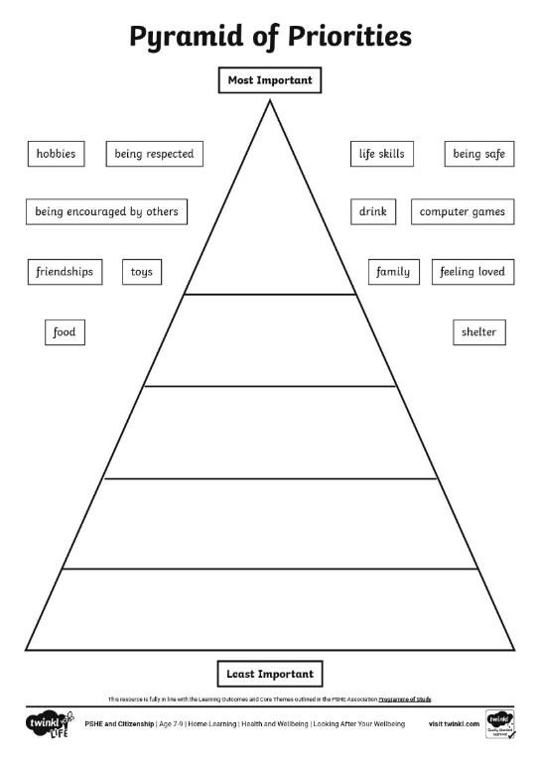
Positive Mindset
Look at the pyramid. Think about where you would put each of the different things in your own pyramid.

