Slide 1
Flowers

Slide 2
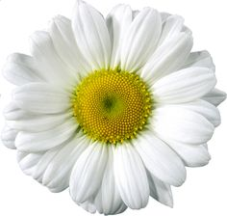
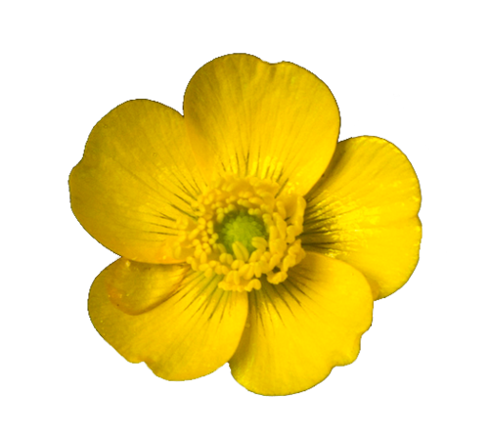
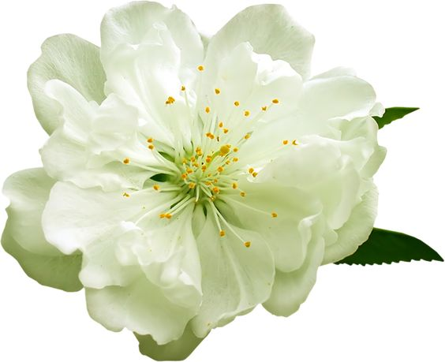
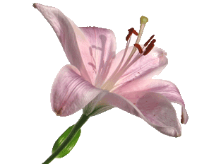
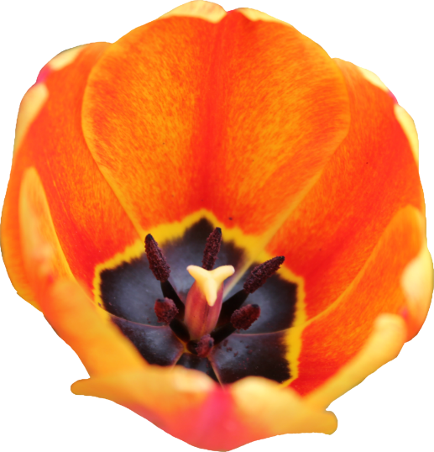
The structures in the centre of flowers are the reproductive parts
Remember - reproduction means making babies or offspring

Slide 3
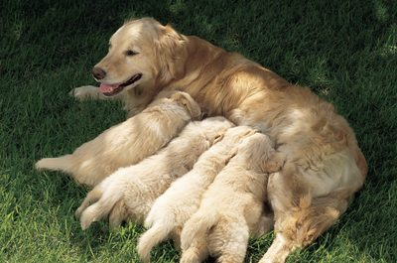
When animals have babies, a male and female will have mated first. It takes a male and a female to make animal babies.
Most plants make babies by producing seeds. A flower usually contains both male and female parts.

Slide 4
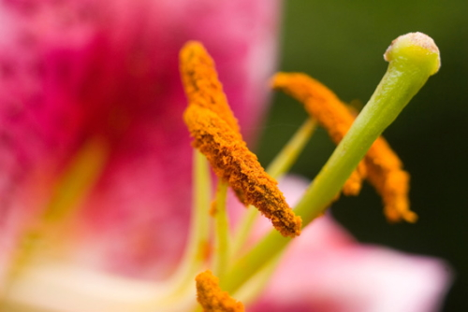
In some flowers it is very easy to spot the male and female parts because they are large. A good example is this lily.
The female part is the sticky top (called a stigma) and the stalk holding it up (called a style)
There are 6 male parts on this flower and each one is called a stamen.
It is the job of the stamens to make pollen

Slide 5
Watch this video all about pollen: https://www.bbc.co.uk/bitesize/topics/zgssgk7/articles/zqbcxfr

Slide 6
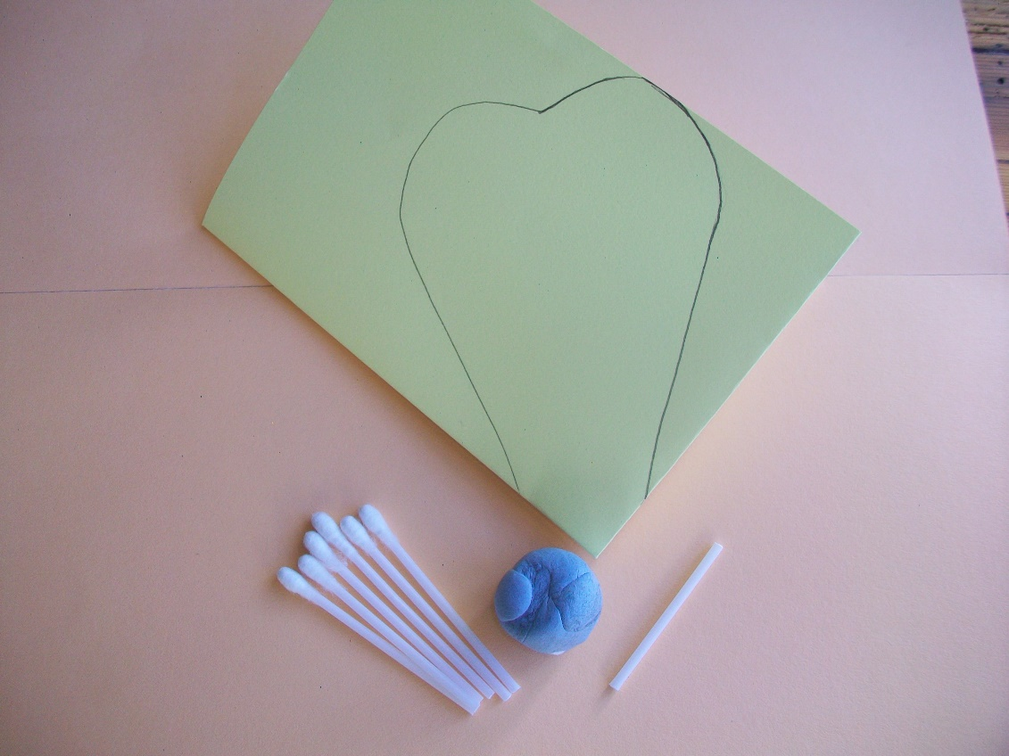
You will need:
A sheet of A4 coloured card folded twice with a petal shape drawn on it
A piece of Plasticine or sticky tack about the size of a conker
A cotton bud with both ends cut off
6 cotton buds with one end cut off

Slide 7
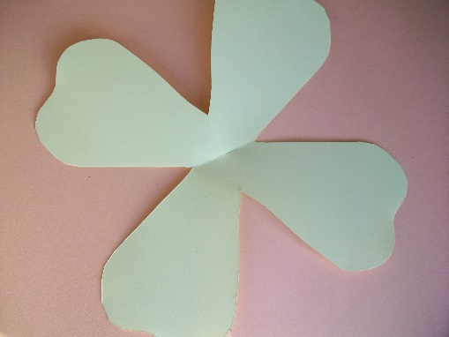
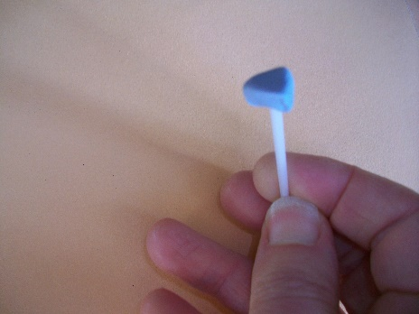
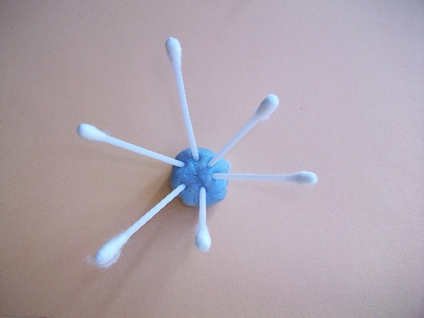
Cut around the petal shape on the folded card. Take care to leave the corner uncut. When you open it out, it will look like this.
Break off a small piece of Plasticine (or blue tack) and model it into a stigma. It should have a flattish top. Press it onto the cotton bud with no ends (the style).
Next, you should roll the remaining Plasticine into a ball and stick the 6 cotton buds in to form a ring of stamens that splay out like this.

Slide 8
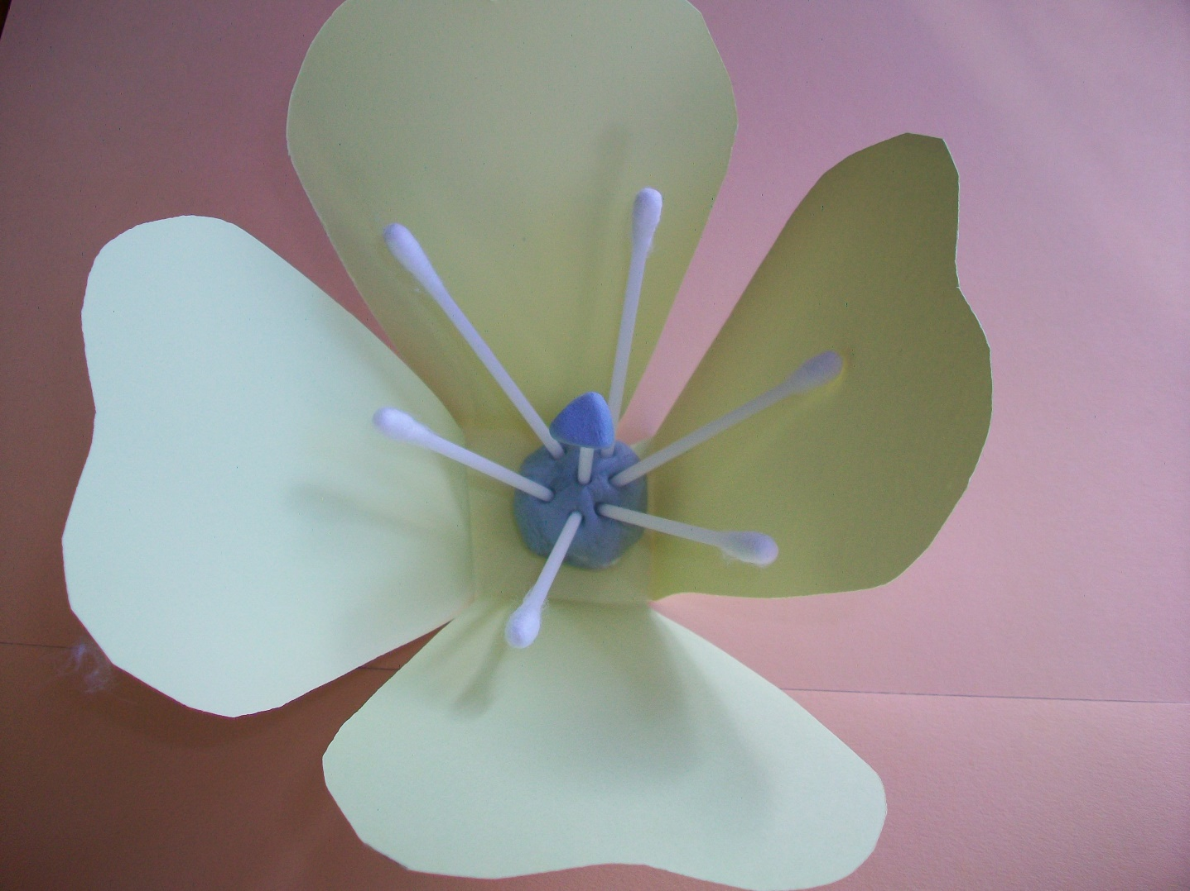
Now assemble your flower by putting all the parts together. Can you point to …
The stigma on top of the style
Is this male or female?
Female
These male parts are called …
The stamens

Slide 9


