Slide 1
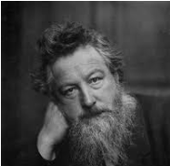
William Morris
By Alfie , JJ and Iris

Slide 2
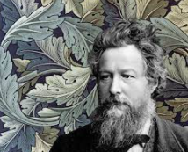

Who Is William Morris?
William Morris was a designer in the Victorian era. We still have his fantastic company today [Morris.co].

Slide 3

Morris’s Early Life.
William Morris was born in 1834 and wanted to be a priest. He trained up to be an architect at Oxford University and he also had 8 siblings.

Slide 4
Morris’s art career.
He hung out with famous artists who influenced his work. He decorated his house with his own art designs . He made curtains, carpets , wallpaper and stained glass windows.

Slide 5
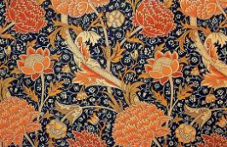


Thank you

