Slide 1
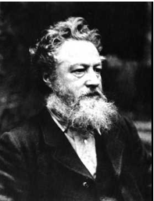
William Morris
By Daniel, Kaitlin, Enija

Slide 2
Who was he?
William Morris was a carpet and curtain designer and creator. He was born 1834 in Essex and sadly passed on October 3rd 1896. At the time he died, one of his doctors is said to have remarked that Morris carried out the work of 10 men.

Slide 3
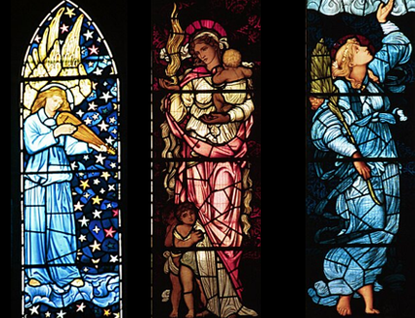
What he did:
This brilliant designer and creator designed carpets all the way to curtains. Instead of using different things to design those creations, he used the same technique. He used pieces of nature to design them. He even designed stain glass windows.

Slide 4

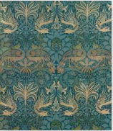
What was his job?
Weirdly enough, Morris was going to be a priest but instead he designed fabrics. He then did this as a job and did it with Philip Webb. Morris was also friends with poets and artists of design.

Slide 5
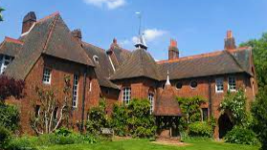
Where did he live?
When he started to design fabrics, he married Jane Burder. Then He moved the Red house just 10 miles away from central London.

Slide 6
What was his Legacy?
His design of curtains, Carpets, Wallpaper designs, tiles, tapestries, tableware, furniture and stained glass windows are still used today. His company is called Morris & Co. (Just in case you want to buy his designs)

Slide 7
Thankyou for Reading this PowerPoint.
(If you can't remember about Morris please read this PowerPoint over 3 times)

