Slide 1
William Morris
By Harry Lola and Isla

Slide 2
Early Life
William Morris was born into this world in 1834 to a wealthy family along with his 8 brothers and sisters.
William wanted to become an architect so he decided to train to be an architect. He learnt these skills at Oxford.
When he was young William had his life set out for him to be a priest but soon enough that changed when he was decorating his house and couldn’t find wallpaper that suited his house. Consequently, he decided to make his own and discovered he enjoyed it.

Slide 3
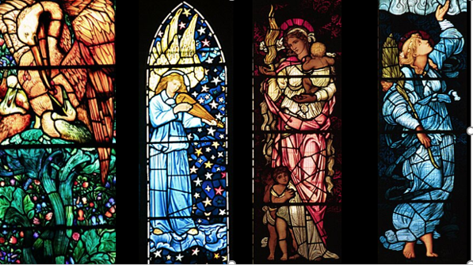
What did he do?
William Morris was a legend of the Victorian times and created many patterns for furniture and accessories. For example, Morris made lots and lots of samples for rugs. During, the Victorian times everything was very plain but Morris thought outside of the box and enjoyed to cover every single bit of space in material. He decorated things such as:
Curtains
Wallpaper
Furniture
Stained glass windows
And many more stuff.
William Morris had a unique style of art and used many different techniques such as : Block Printing, Repeated Patterns and all of his artwork was based on nature examples of these are the pictures below
William soon found many friends that were also famous such as writers and poets.

Slide 4
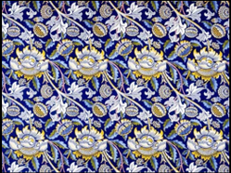
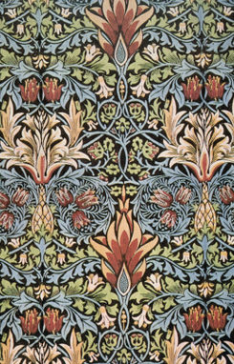
Where did he live and other facts.
Morris’s house (which is called The Red House) was absolutely covered in all of his artwork. His house was designed with one of his many friends Phillip Webb who in fact was also famous.
One of his other friends was Rossetti.
He had his own interior designs factory which is 10 miles away from central London and was called Morris and Co.

Slide 5
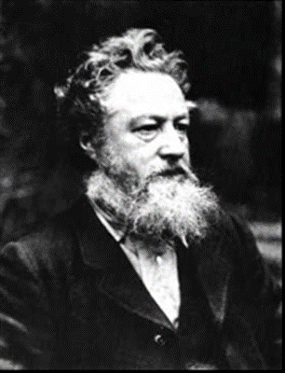
William Morris unfortunately passed away 1896 leaving a legacy of creations behind him.

