Slide 1
William morris
Presentation

Slide 2
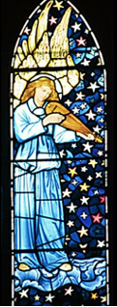
What did he do?
He :
made materials
made wallpaper
made furniture
designed his own house
designed curtains
made tiles
designed carpets
created stained glass
designed tablewear

Slide 3
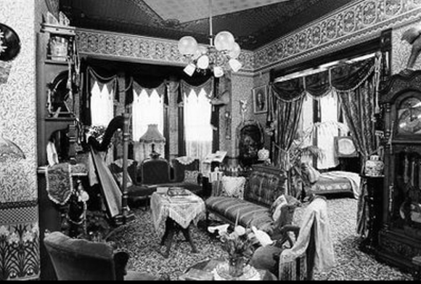
Times of his life
He was born in 1834 and died in 1896.The doctor said to him , you have carried out the work of 10 men in your lifetime.
His house

Slide 4
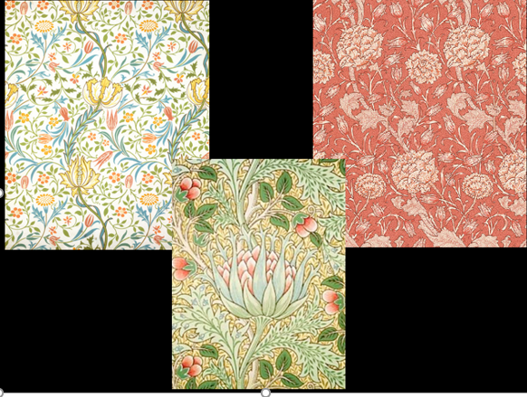
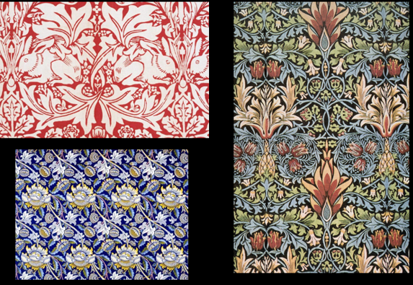
His designs
His designs always involved nature and animals like: birds, plants, leaves, fruits, flowers . He also did block printing and did a repeated pattern .

Slide 5
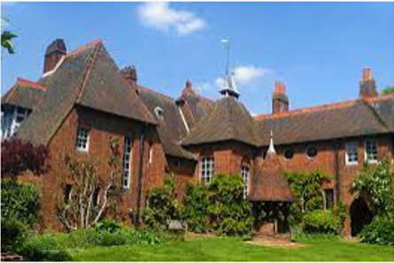
His house
He called his house The Red House and a person called Philip Webb helped him design his house but the interior was his own design .

Slide 6
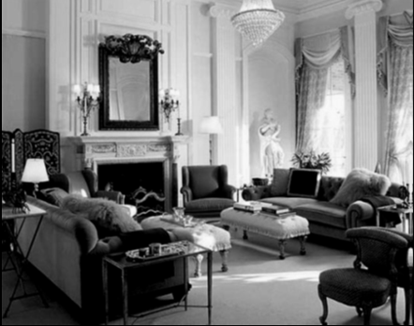
His friends
He was friends with lots of artists, poets and more . In 1859 he married a woman called Jane Burden .

Slide 7
Thank you for listening

