Slide 1
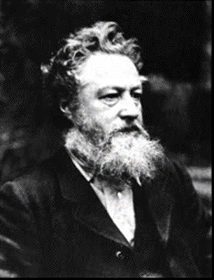
WILLIAM MORRIS
By Jack , Shivam and Brooke

Slide 2
Birth and Death
William Morris was born in 1834 and died in the 3rd of October 1896 at the age of 65. When he died the doctor said that he carried out the work of 10 men in his lifetime. When he was a child he was going to be a priest but instead he became a designer. He also had 8 siblings when he was a child.

Slide 3
Who was he?
He was trained to be architect at Oxford University. His friends were architects and poets. Two of them were called Rossetti and Phillip Webb. He made curtains, carpets, wallpaper, tiles, stained glass, tableware and tapestries. His designs were about Nature and they were repeated patterns.

Slide 4
Where Did He Live?
William lived in the Red House and Phillip Webb made it with him. He and his wife named Jane Burdan live with him at the Red House. His house is 10 miles from central London. His company is called Morris and Co.

