Slide 1
William Morris
A Victorian Genius

Slide 2
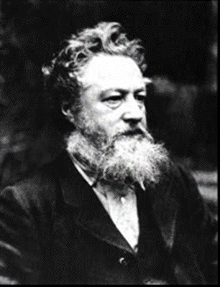
Who Was He?
William Morris was born on the 24th March 1834. He designed :
Carpets
Curtains
Cushions
Wallpaper
Stained Glass Windows
Furniture

Slide 3
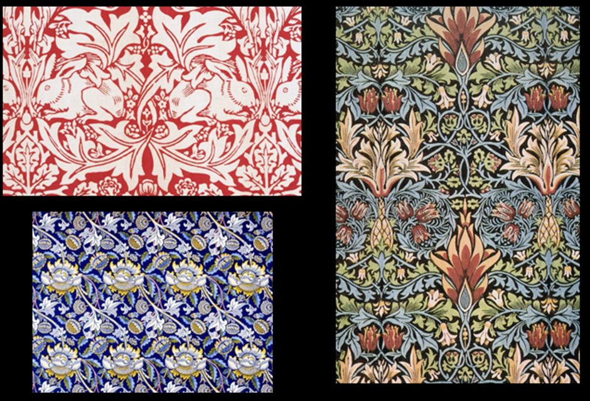
His Designs
Most of his designs are natured themed like birds,
plants, leaves, fruit and flowers. He repeated his
patterns and used block printing just like Hokusai.

Slide 4
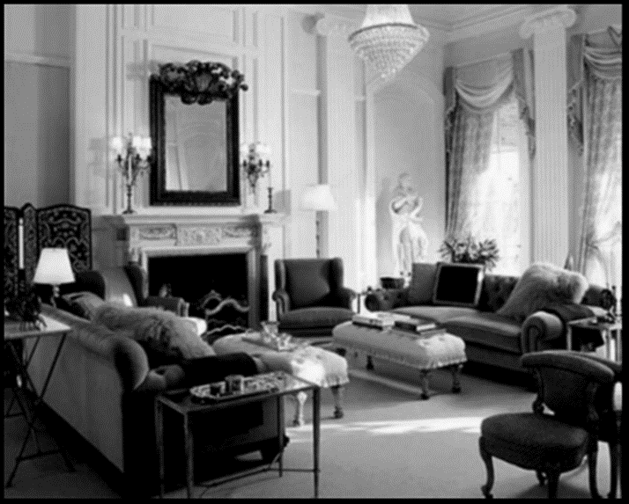
His Company
In April 1861, Morris, Marshall, Faulkner & Co.
was established and it produced a range of
original domestic furnishings.

Slide 5
GOODBYE FROM SOHAM, JAMES & HARRIET

