Slide 1
William Morris
By Lacey, Aiden And Jasmine

Slide 2
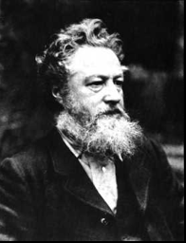
Young Life.
When William was young, he was born into a rich, wealthy family in 1834 and had 8 siblings.

Slide 3
His jobs.
William was firstly going to be a priest but he loved art and therefore wanted to become an artist . He began being an artist by decorating his house(The Red House)which he designed with Phillip Webb .

Slide 4
Marriage.
William married Jane Burden on the 16th of April 1859

Slide 5
His Famous Designs.
William designed lots of different materials : curtains , carpets , tiles , wallpaper , stained glass and furniture covering.

Slide 6

Thanks for watching!

