Slide 1
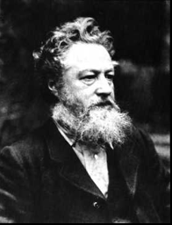
William Morris
The man who revolutionised interior decoration.

Slide 2
Early life
In 1834, William Morris was born and Originally wanted to be a priest but eventually he went to Oxford university and trained to be an architect.

Slide 3
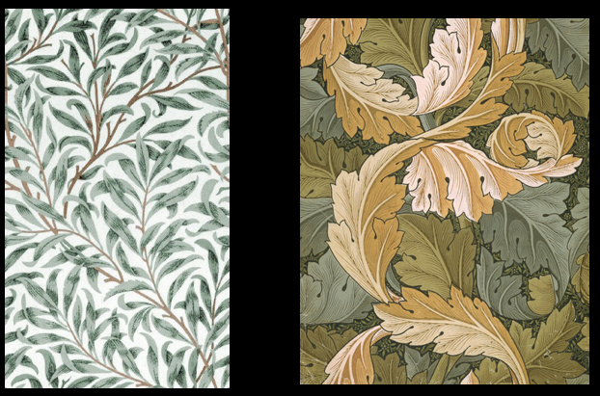
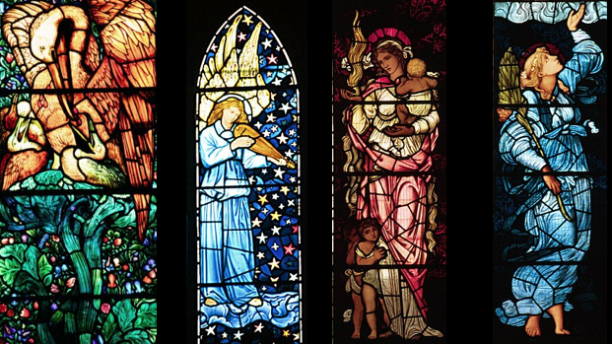
What Did He Do?
He became a an interior designer and worked on curtains, carpets, wallpaper, furniture covering, stained glass, tiles, tapestries and table wear. The theme of all of them was nature.

Slide 4
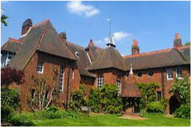
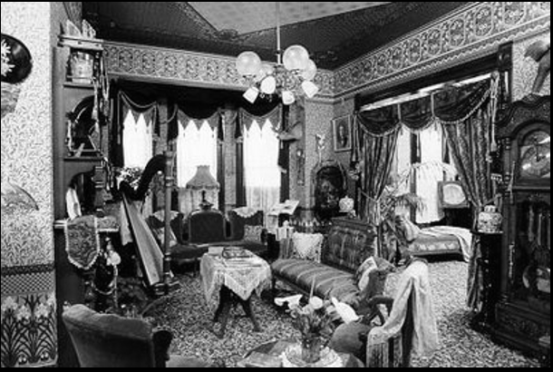
Where Did he Live?
He lived in a house called the Red House he helped design the interior with Philip Webb. This was 10 miles from central London.

Slide 5
Who Was He Friends With?
He was friends with lots of Artists, poets and writers like Rossetti.

Slide 6
Late Life
He was married to a women called Jane Burdon.

Slide 7
Legacy
His legacy was that he left behind his decorative designs .

