Slide 1
William morris

Slide 2
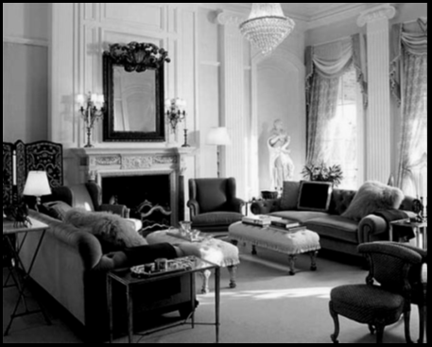
Early life
William Morris was born in 1834 .he originally wanted to be a priest but decided to be a designer . In 1859, he married Jane Burden and they spent 2 years decorating their home .

Slide 3
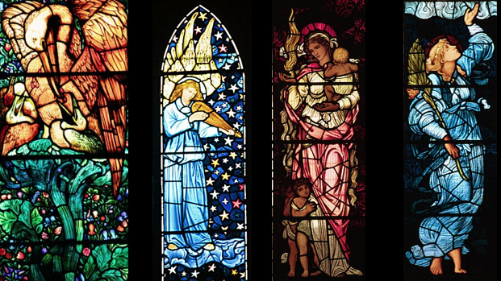
WHAT DID HE DESIGn ?
William Morris designed wallpaper, furniture, stained glass and tiles. This is some of his art .

Slide 4
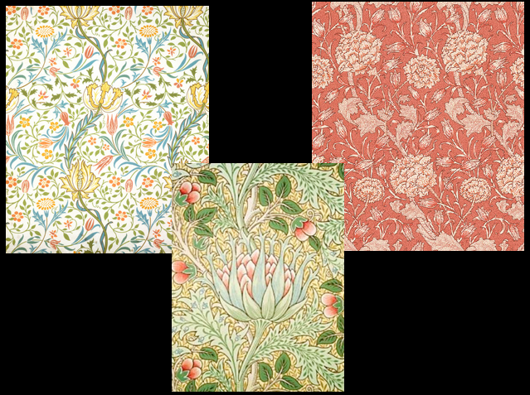
HIS COMPANY
In 1875, he made a company called Morris and co . At this time, it was considered Morris` most important and creative as a pattern designer.

Slide 5


