Slide 1
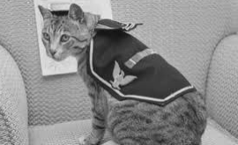
Welcome to ‘The Animals Of The War’

Slide 2
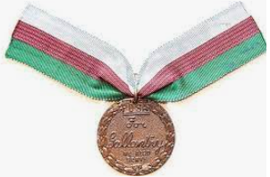
The Dickens medal
The Dickens medal is a special award is a special award given to animals for their bravery.

Slide 3
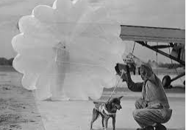
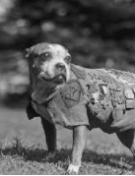
Dogs
There were many dogs in WW1 and ww2 serving Britain. Sergeant Stubby was one of the 20,000 dogs in WW1. Stubby warned of impending gas attacks. Another dog was the parachuting dog called Rob who was a Border Collie - he also won the Dickins award. He also did 20 parachute jumps. After Rob died,in 1952, his owners built a stone memorial to him.
Dogs were the first domesticated animals used in the war throughout history.
Did you know!
Stubby even his own gas mask

Slide 4
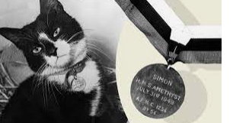
Cats
In the war there were as many moggies as dogs. Approximately, 500,000 died in the war. They were used as morale boosters and rat catchers. Simon the champion rat-catcher was awarded the Dickin Medal the only one ever awarded to a cat.

Slide 5
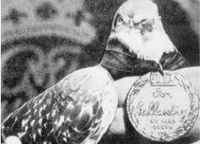
Pigeons
Pigeons have been used as message carriers for over 5,000 years. Some of them were used as spies by carrying around cameras. Mary of Exeter was a carrier pigeon in the WW1. She got awarded the Dickens medal.

Slide 6
Horses
Horses were a main part in WW1.It was hard work for them because the mud was so deep and they would get stuck in it and the soldiers would have to get them out.

Slide 7
THANK YOU FOR LISTENING

