Slide 1
Animals in ww1
(different animals)

Slide 2
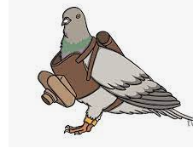
Pigeons
Pigeons have been used as message carriers for over 5ooo years . their vital messages saved the lives of thousands in ww1 and ww2 . Cher ami was given the croix de guerre for her heroic message delivery that saved many soldiers’ lives , despite being shot at and terribly injured.

Slide 3
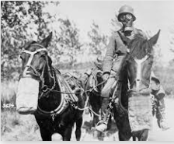
Horses
Humans began to domesticate horses in central asia around 4000BC
AND they’ve been used in warfare for most of recorded history.
They are prey animals as so their first reaction to threat is to startle and flee.
Despite this , against their natural instincts , they’ve raced into countless battles , carrying their riders . over 8million were killed in WW1.

Slide 4
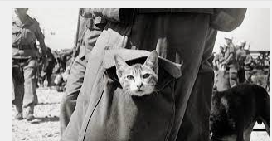
Cat
Morale boosters and rat catchers. Trench life was a little more bearable thanks to the moggies at the front.

Slide 5
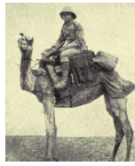
Camels
1915 SAW THE FORMATION OF THE CAMEL BRIGADE, BUT CAMELS HAVE BEEN USED SINCE THE ROMAN EMPIRE. A BONUS WAS THAT THE SMELL of the camels spooked the enemy’s horses .

Slide 6
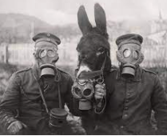
Donkeys
From simpson and his donkey at Gallipoli to jimmy’s ‘the sergeant’, born at the battle of the somme , donkeys have saved soldiers lives and gave their own. more suited to green fields than battle fields , donkeys have been to war as long as horses have.

Slide 7
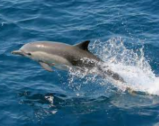
Dolphins
Military trained dolphins are able to find under water mines and rescue lost navel swimmers .their training is similar to how military dogs are trained. for a dog or a dolphin, mine detection is simply a game rather than a matter of life and death.

Slide 8
Tortoise
tortoises were used as mascots before ww1. timothy who turned out to be a female , served as a ship mascot in the Crimean war and Jonathan, a giant tortoise , was a mascot for prisoners in the boer war.

Slide 9
Thanks for listening
Goodbye

