Slide 1
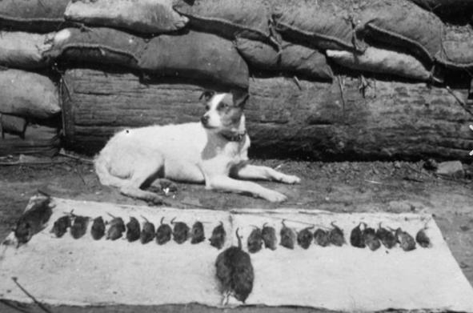
Animals in War
From Lola, Ruben and Aiden

Slide 2
Dogs
What did dogs do in the war?
Dogs were important in the war because they warned soldiers when gas was near. There were over 20000 dogs serving Britain in WW1.

Slide 3
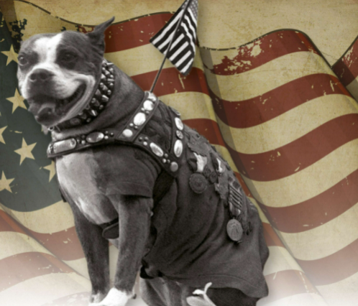
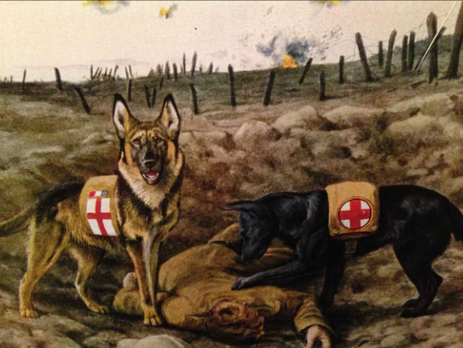
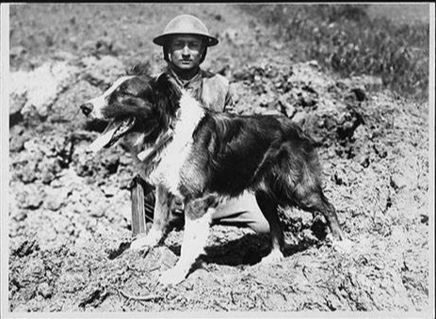
here are some pictures

Slide 4
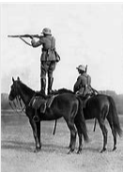
horses
Horses started to be domesticated around 6,000 years in 4000BC. As they are prey animals, their first reaction to threat is to startle and flee. Sadly, over eight million horses gave up their lives in the Great War (World War I.)

Slide 5
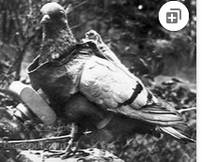
pigeons
Pigeons were used for taking photo so they could see what was going on in the enemies’ trenches. They also sent messages that saved thousands of vital lives in WW1 and WW2.

Slide 6
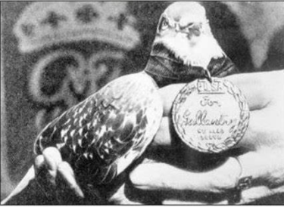
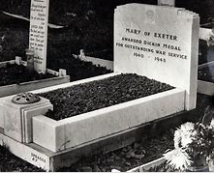
The story of Mary of Exeter
Mary of Exeter was a carrier pigeon who transported many important messages during WW2. In November 1945, Mary was awarded with a Dickin medal. Mary died in 1950 and is buried in Ilford Animal Cemetery.

Slide 7
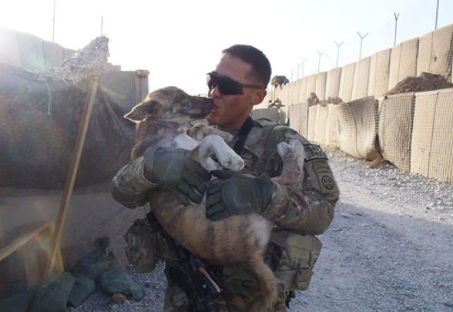
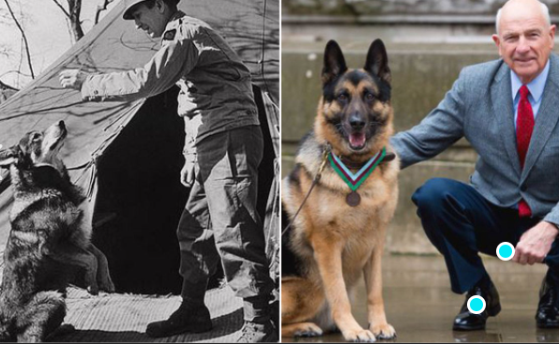
Thank you for listening.

