Slide 1

Animals who served in the Wars

Slide 2
The Dogs
Around 20,000 dogs did their part in serving Britain and their allies (France and Belgium). Here are 3 examples of dogs that served in the war: messenger dogs, mercy dogs and guard dogs.

Slide 3
Lucca the dog
Lucca was a search dog for the US Marine Corps that has completed 400 missions before she was hit by an explosion. She won the Dickin Medal on the 5th April 2015. She had her left front leg amputated. As you can tell she was a very lucky search dog.

Slide 4
cats
Cats were super useful because they would kill the mice and rats. Rats did carry bacteria which is not good for the soldiers in the trenches.

Slide 5
Simon the cat
Simon was found wandering around the docks. One of the sailors found him and took him on board the Amethyst. Along the way up the Yangtze river to the Chinese town of Nanjing the ship came under attack from the Chinese rebel army. Simon went missing and his owner was dead. Two days later Simon returned badly burned and injured by shrapnel.

Slide 6
The pigeons
Pigeons have carried messages across countries for over 5000 years. Their messages saved the lives of thousands of people in WW1 and WW2.

Slide 7
Cher ami the pigeon
Cher Ami was a messenger pigeon. She was shot by a bullet, went down and flew back up and dodged the bullets. She was shot through the breast, blinded in one eye and one of her legs was almost lost. The people treated her wounds and made a wooden leg to replace her injured one.

Slide 8
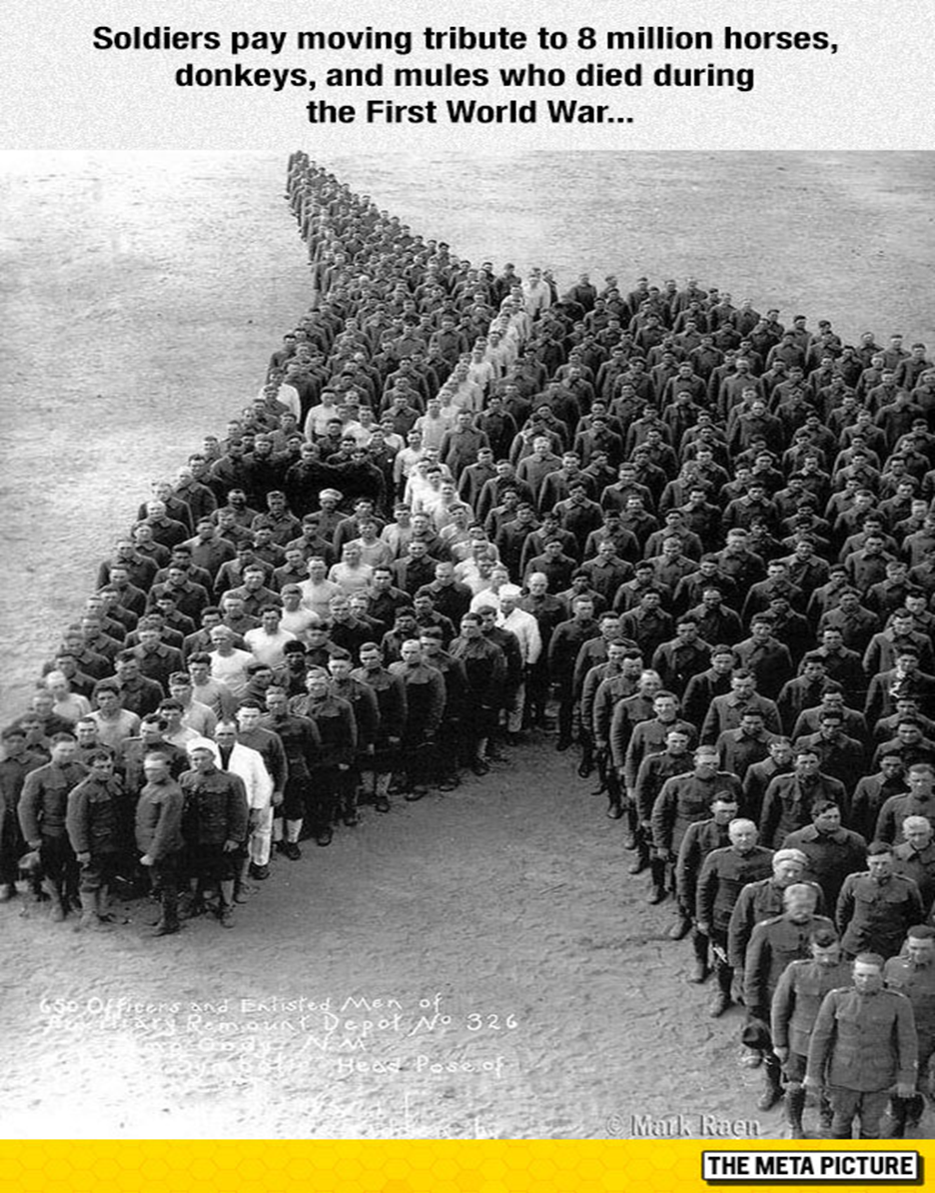
horses
Horses have been used since 4000BC over 8 million horses died. The horses also carried shells on their sides.

Slide 9
Thanks for watching our slide show
Please remember the soldiers and animals that lost their lives to bring peace to the world.

Slide 10
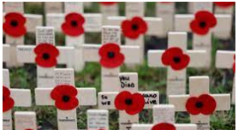
Remembrance day

