Slide 1
War Animals

Slide 2
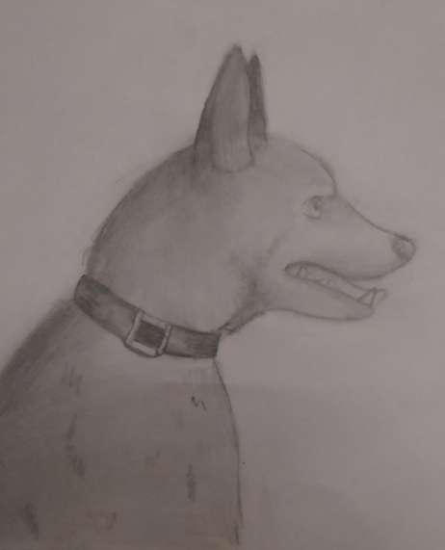
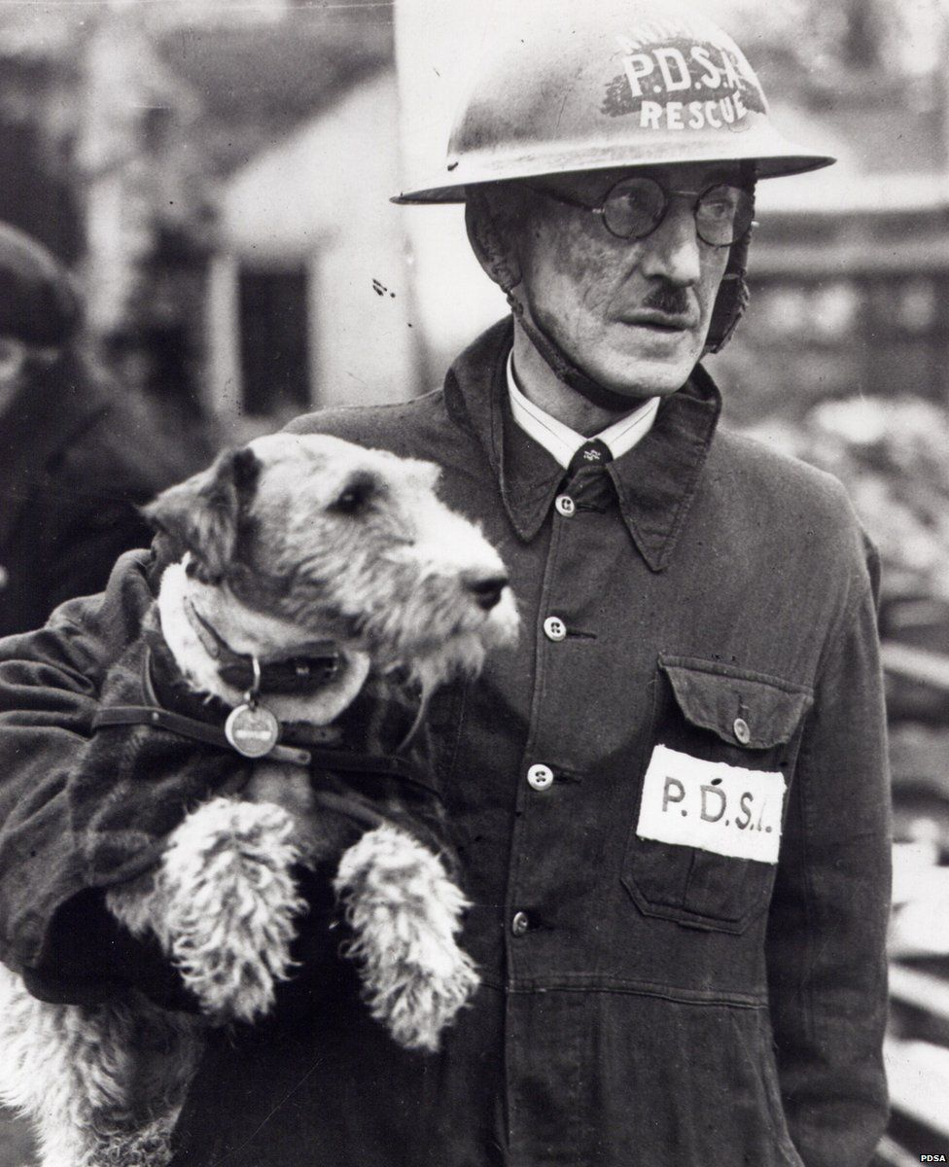
Dogs
There were messenger dogs, mercy dogs, guard dogs
and mascots. Dogs were the first domesticated animal and have been used in battle throughout history. The Roman Army had whole companies of dogs wearing spiked collars around their neck and ankles.

Slide 3
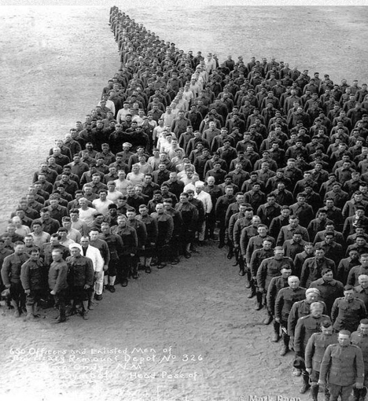
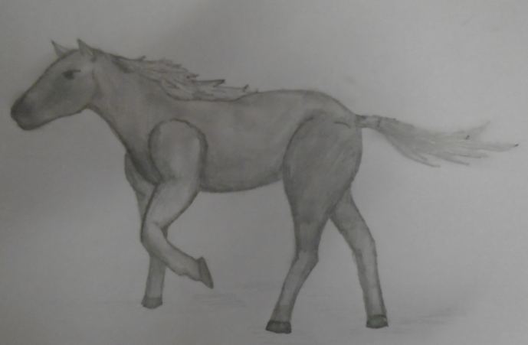
Horses
Humans began to domesticate horses in Central Asia around 4000 BC and they’ve been used in warfare for most recorded history. They are prey animals and so their first reaction to threat is to startle and flee. Despite this, against their natural instincts, they’ve raced into countless battles, carrying their riders. Over eight million died in WW1.

Slide 4
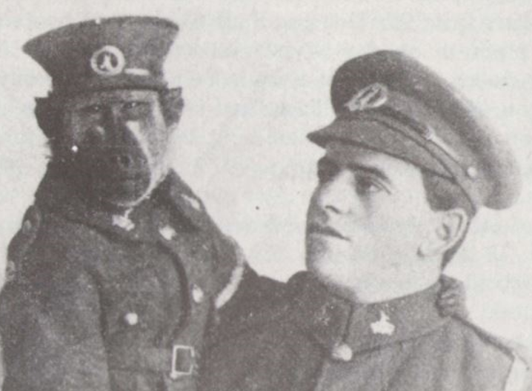
Baboons
The baboon drew rations, marched and drilled,
and went to the nightmare of Delville Woods and Passchendale.

Slide 5
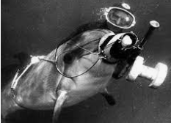
Dolphins
Military trained dolphins are able to find underwater mines and rescue lost naval swimmers. Their training is similar to how military dogs are trained, and for a dog or a dolphin mine detection is simply a game rather than a matter of life and death.

Slide 6
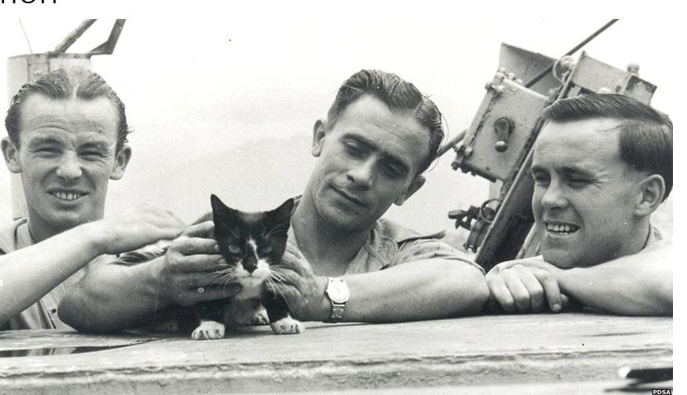
Cats
Morale boosters and rat catchers. Trench life was a little more bearable thanks to the moggies at the front.

Slide 7


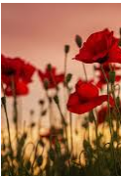
Thanks for watching!

