Slide 1
War Animals
By jasmine and shivam
Notes:
Jasmine and Shivam have struggled allot.

Slide 2
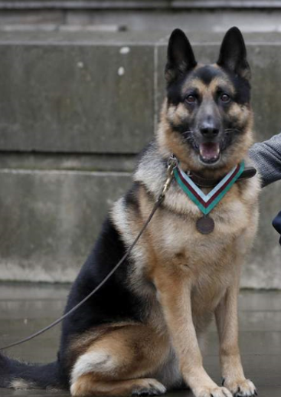
Dogs:
Over 20,000 dogs in WW1 served Britain and their allies .Dogs were the first domesticated animal and have been used in battle for hundreds of years.

Slide 3

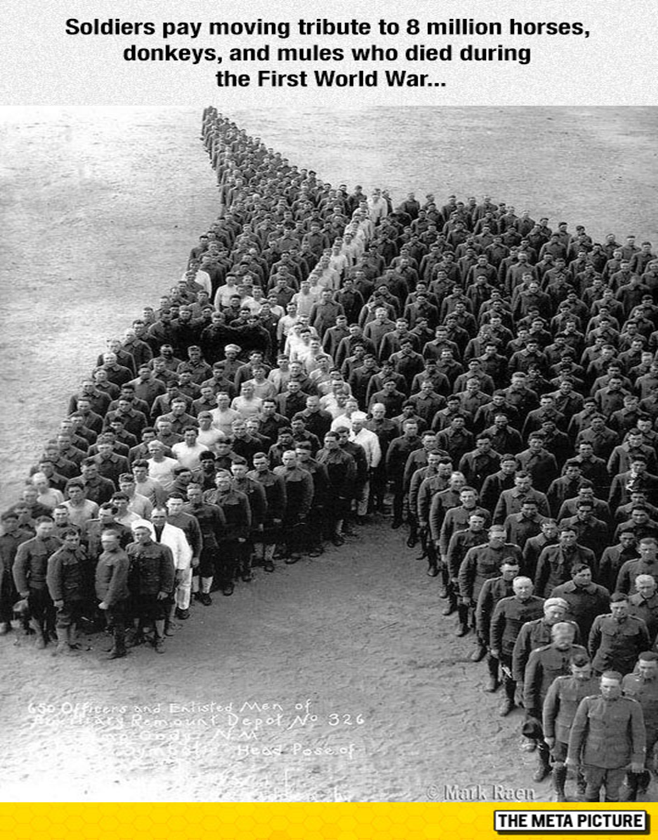
Horses:
Humans domesticated horses in Central Asia and they’ve been used in warfare a long time. They sank in the mud quite a lot.

Slide 4
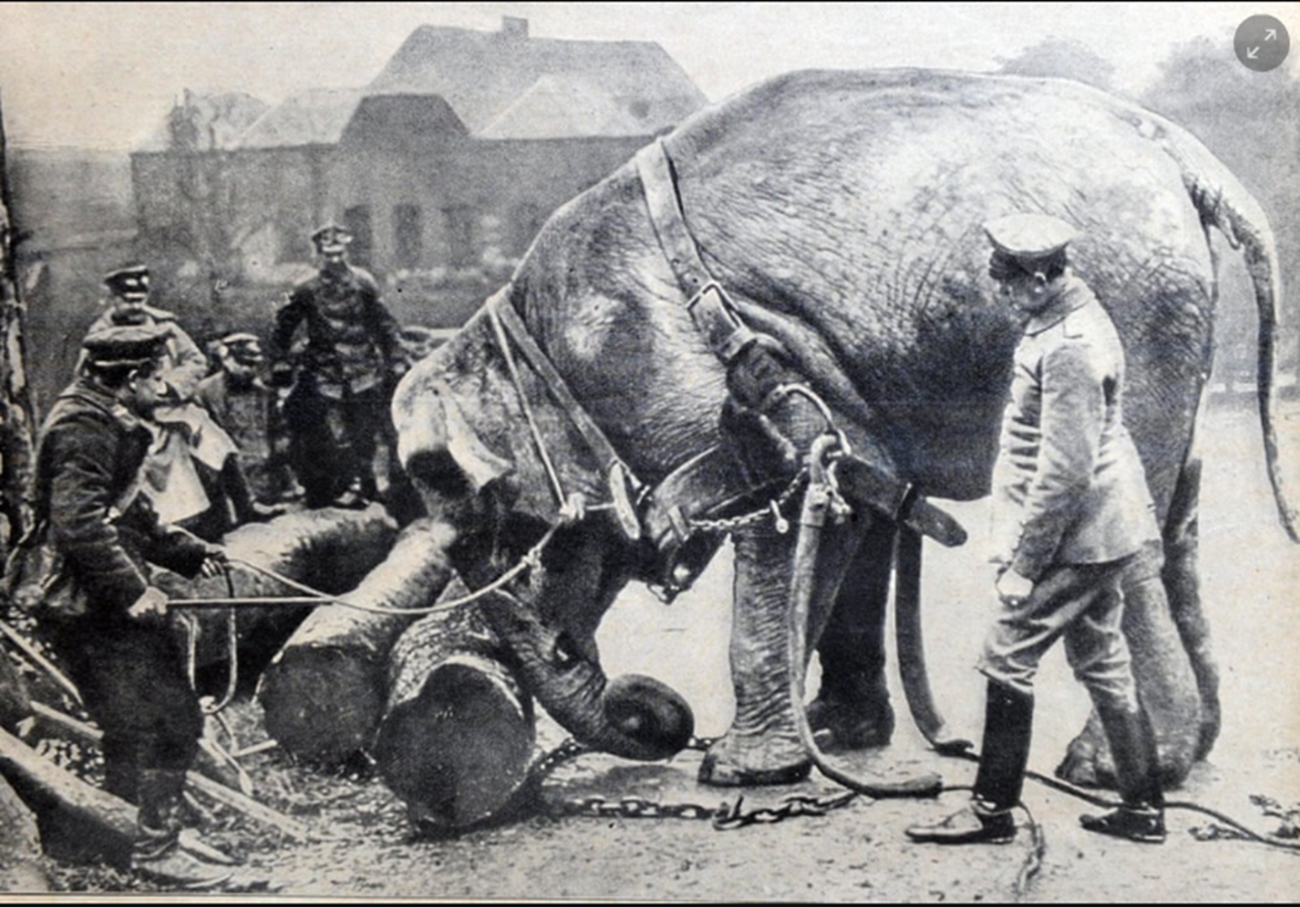
Elephants:
During WW1 elephants were often used to move logs and other heavy things that soldiers couldn’t lift . They were usually used on streets or the countryside because they would sink on the battle fields, as the mud was so thick!

Slide 5
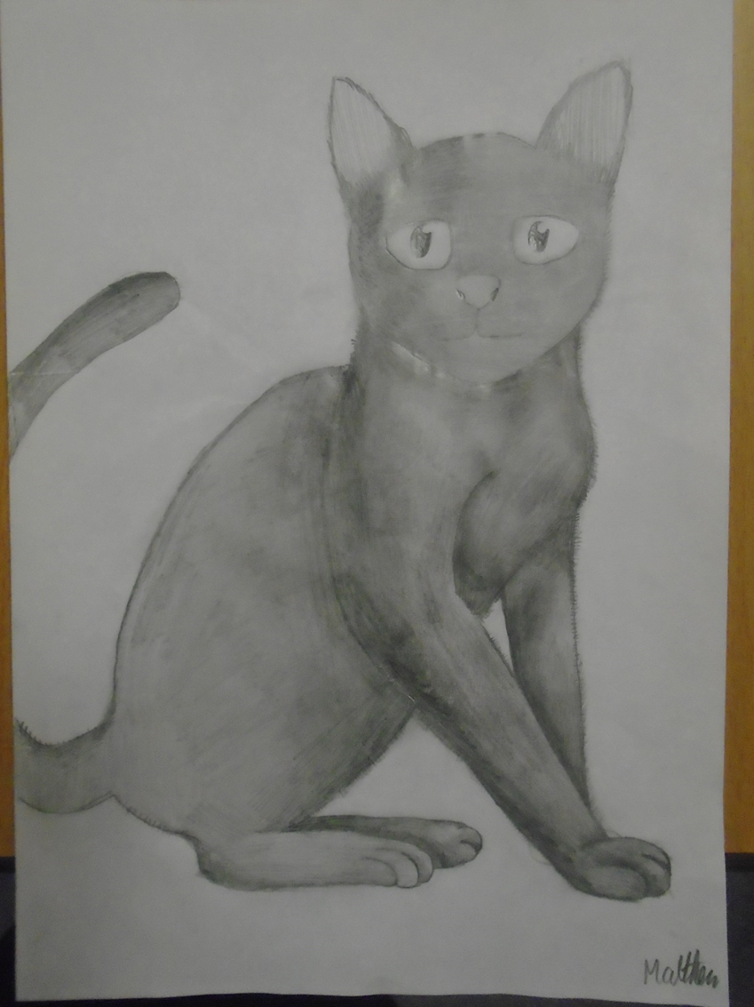
Cats:
Soldiers brought cats along with them in the trenches to catch the mice . Over 500,000 cats sadly lost their lives in the war.

Slide 6
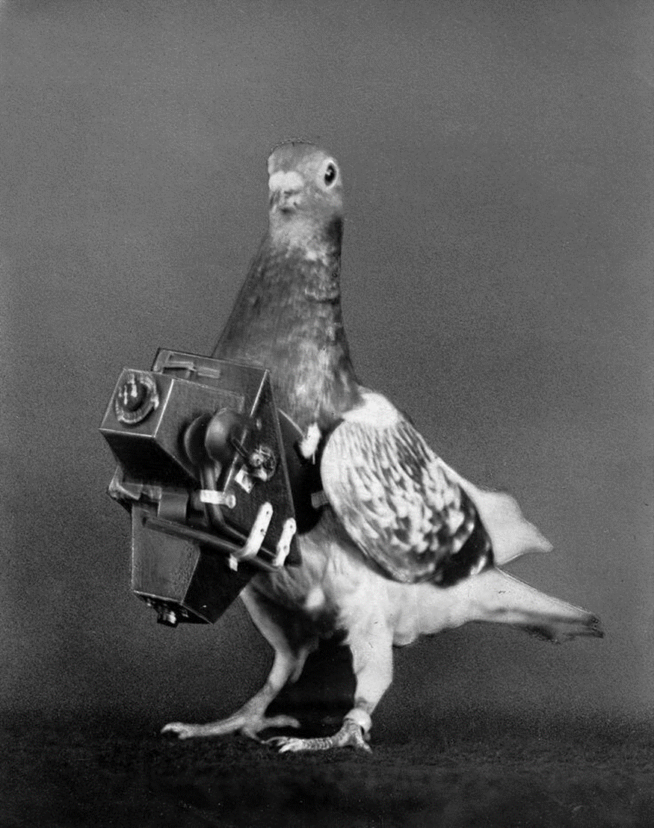
Pigeons:
Pigeons were used to take pictures from in the sky (Pigeon Drones!) They were also used to send messages to other people.

Slide 7


Thanks for listening!

