Slide 1

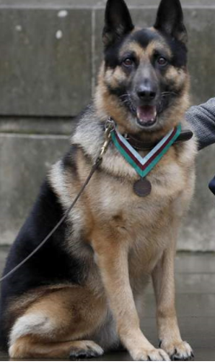
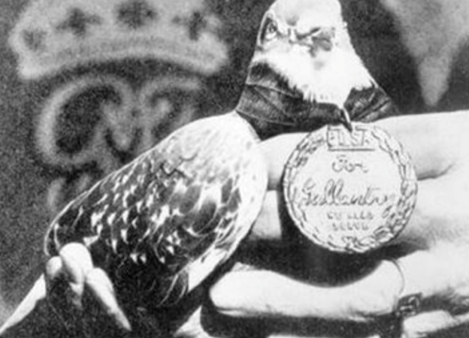
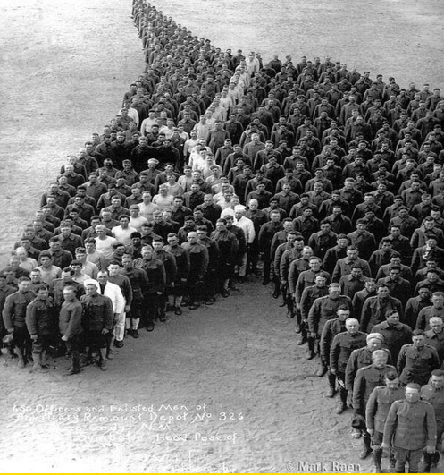
War Animals
By Oliver + Shelby + Enija

Slide 2
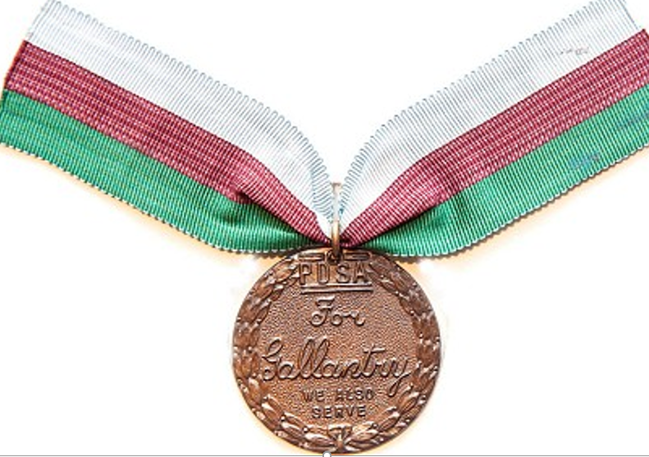
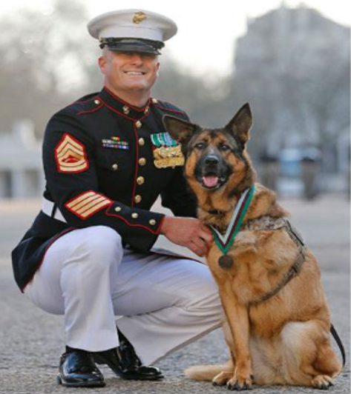
Lucca:
(The dog of 400 missions)
Sergeant Lucca (who was a dog) fought in the war. She was a brave German Shepherd, who unfortunately lost one leg whilst saving people who were injured. On patrol with the marines she would walk off in front off the leash. She searched roads, buildings and vehicles using her sensitive nose to sniff ammunition and explosives. She suffered a very bad leg injury but still went on in the war, that is why she won a Gallantry medal (gallantry means bravery).People say that ‘ Few dogs were as clever as Lucca, or as brave’. Here is a picture of her.

Slide 3
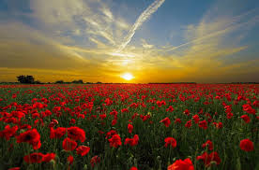
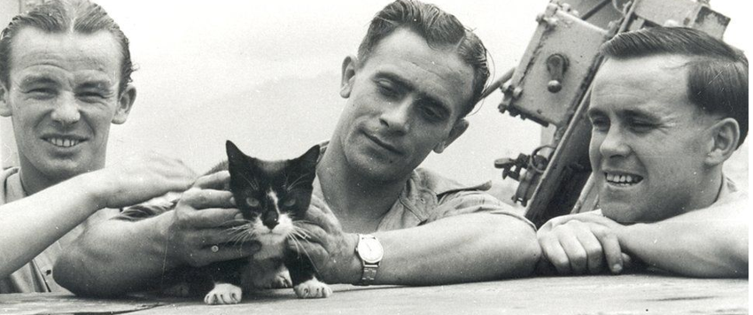
Simon:
This cat is very special. He started WW2 when he was very small. He may look like he doesn’t know or do anything, but he does plenty. This cat was brought on ship to chase mice and rat so the sailors don’t have to catch them. Also one time after a barrage gunfire, 56 members of the ship’s crew lay dead or wounded. Simon was missing. When Simon returned he had wounds all over him. After a few weeks he retuned back to his normal self. Simon was very happy indeed.

Slide 4
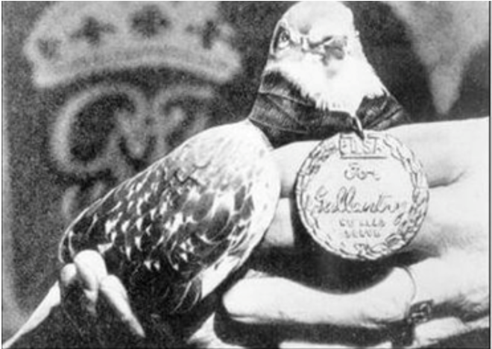
Mary the Miracle Pigeon:
This pigeon is not like any other animal who we described in this PowerPoint. Mary completed many missions. She went and found other people who were injured. Those people sent messages by attaching them onto the pigeon. Then she flew all the way back home. She never gets lost because she always knows where she is going. On one occasion she was attacked by German-kept hawks stationed in Pas-de-Calais returning home with wounds to her neck and right breast. She recovered sufficiently and was put back in service two months later.

Slide 5

Thankyou for listening to our PowerPoint and us too. Bye!!

