Slide 1

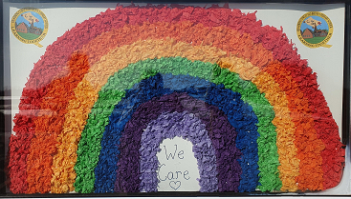
Quadring Cowley and Brown’s Primary School
Wellbeing Guide
Taking care of yourselves and getting through tough times.
Stay safe. Stay healthy. Stay strong.

Slide 2


Taking Care of Yourself
◦ Coping with Social Distancing
◦ Health and Nutrition
◦ Stress and Sleep
◦ Maintaining a schedule
◦ Make time to laugh and have fun

Slide 3





Coping with Social Distancing
Staying physically away from other people does not mean you have to totally isolate yourself.
Maintain friendships as you would on a normal day, except do this remotely and not in person.
Set up phone calls and video chats with friends and family.
Share your anxieties with someone; keeping your fears bottled up in the effort to remain positive will not help in the long run.
Seek help if your feelings of anxiety or hopelessness get out of control.

Slide 4
Healthy bodies help to support healthy minds
Make a plan when shopping for groceries to avoid panic buying, now is the time to try new recipes!
Buy fruits, vegetables and meat, cut them up (or cook) and put in the freezer as an alternative to canned goods.
Boredom and stress eating is a common reaction; plan out your meals and keep yourself busy to avoid it.
Go for one walk or run outside as permitted under Government Guidelines.
Or stay at home and complete an online workout for at least 30 minutes a day, 3-4 times a week.
Yoga is good source of exercise and a great tool for managing stress.
Some exercise companies offering free workouts.

Slide 5
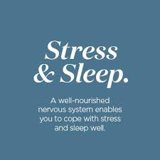
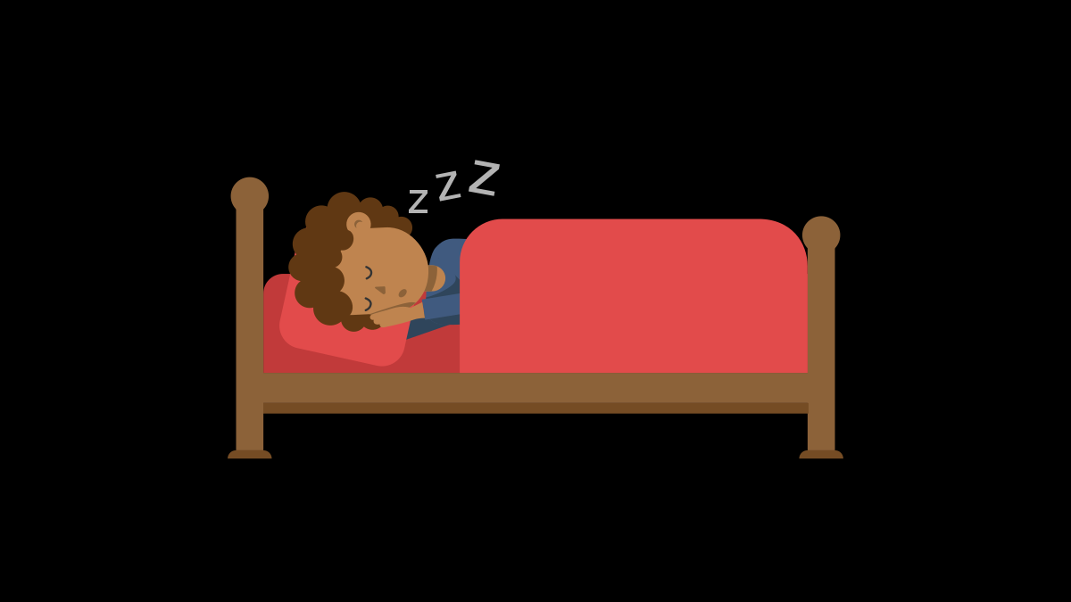
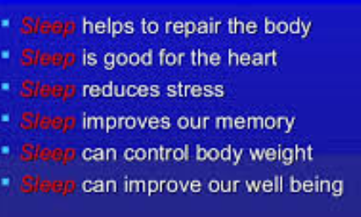
Stress and Sleep
◦ Take breaks from watching, reading, or listening to the news.
◦ Still stay informed to avoid stress that you are missing something.
◦ Do something relaxing before bed like meditation or mindfulness
Simple Habit App
Headspace App
◦ If you can’t sleep, get out of bed and do something to break the cycle.
◦ Complete a journal of your feelings and experiences.
◦ Now more than ever, it’s important to give yourself a “phone curfew” if you’re having sleeping problems.

Slide 6
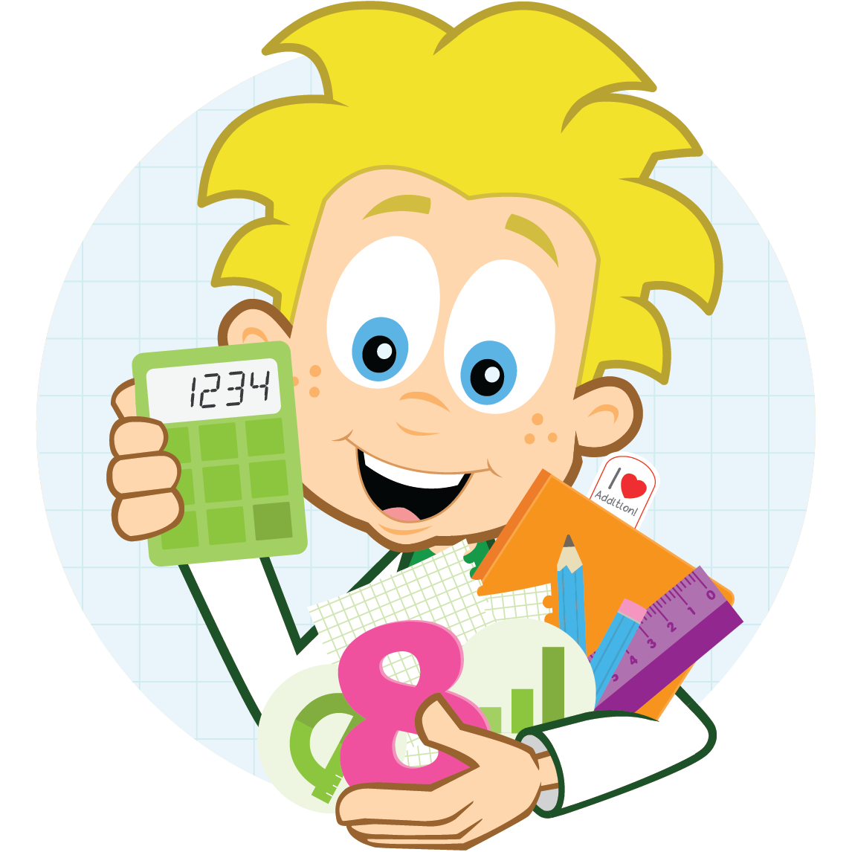
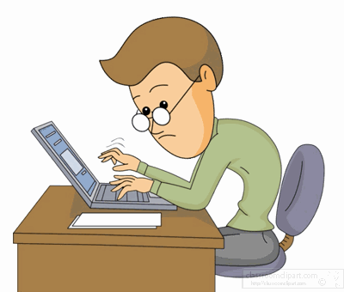


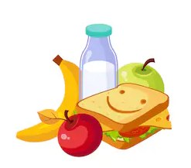
Maintaining a schedule
In order to feel as “normal” as possible, try to set a daily routine.
Get up at the same time every day and set a bedtime.
Have regular breaks and a snack and a drink.
If working from home, make sure you have a lunchbreak and a set time for the end of the working day.
If staying at home caring for children, make sure you have regular breaks and a lunchtime and set an end time for all learning activities.

Slide 7





It’s okay…
To acknowledge that this isn’t normal, despite trying to keep a routine
To be disappointed about cancelling plans you made
To worry about yourself and your family
To be angry that you have to live through this
To feel anxious
To feel sad
To need support from others
To need some alone time
To want to leave social media or block out the news
To want to read the news all day
To still laugh
To cry sometimes
To hope

Slide 8
Your experience is unique
Everyone reacts differently during difficult times.
Your own feelings may change over time. Notice and accept how you feel.
Cope in whatever way works best for you. Make sure to take care of your emotional health during this time in order to be able to think clearly and avoid panicking.
Self-care during an emergency will help with long term healing.
Stay Safe. Stay Healthy. Stay Strong.

Slide 9

“I wish it need not have happened in my time.” “So do I, and so do all who live to see such times. But that is not for them to decide. All we have to decide is what to do with the time that is given to us.”
The Fellowship of the Ring, J.R.R. Tolkien

Slide 10








Things to remember
These tough times will end.
Our lives may change as a result of what’s happening, but we are able to adapt.
You have the strength to get through this.
Take care of yourself first.
Use this time to cultivate skills and hobbies you don’t normally have time for.
You can still laugh and find enjoyment out of life even when bad things are happening.

Slide 11
Stay Safe. Stay Healthy. Stay Strong.

