Slide 1

Welcome to Barn Owls!

Slide 2

“Education is not the filling of a bucket but the lighting of a fire”
Yeats

Slide 3
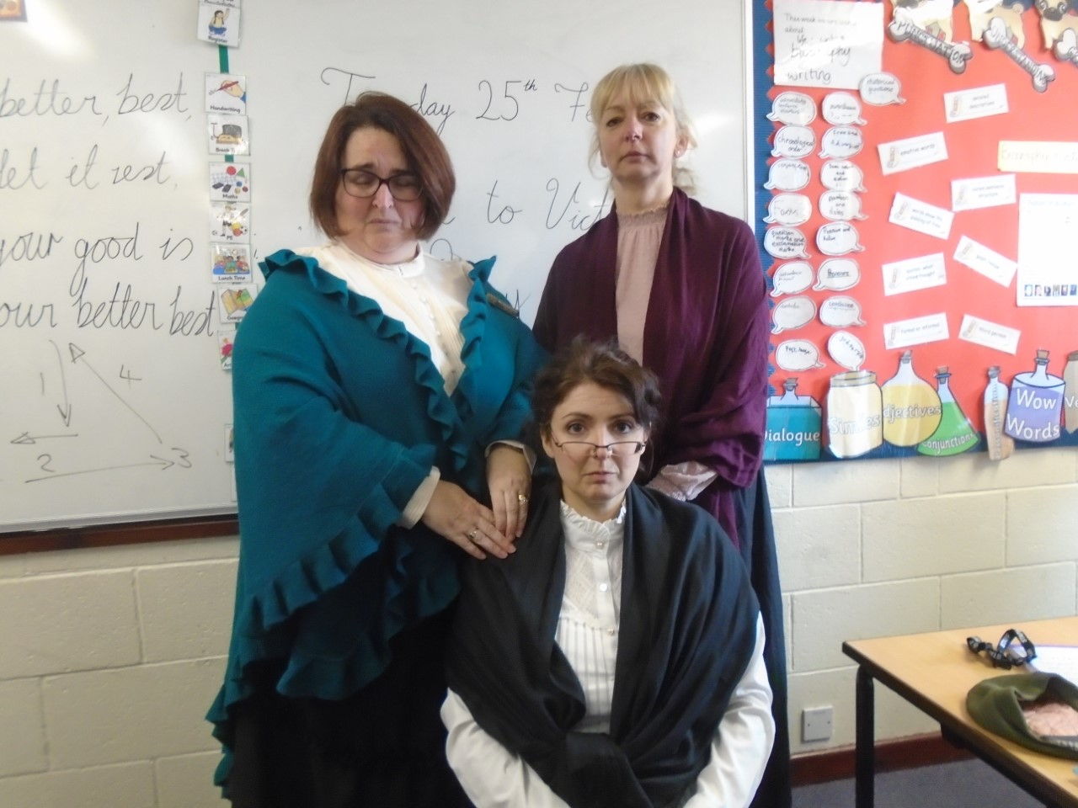
The Barn Owls Team
Mrs Wood – class teacher
Mrs Sharman - interventions, mornings in class and cover for Mrs Wood on Fridays
Mrs Jones – interventions, additional maths support and cover for Mrs Wood on Fridays

Slide 4


Slide 5
Our expectations
We have high expectation in Barn Owls.
We expect Barn Owls to be kind and respectful.
We have high expectations of behaviour.
We expect the children to try their best.
We focus on personal improvement from whatever starting point a child is at
We expect children to present their work neatly.
We work hard and play hard in Barn Owls!

Slide 6
Curriculum
Writing – eg newspaper articles, diary writing, perspective writing, biographies, information writing, narrative. Use experiences, books and video clips as stimuli. Links to topic.
Maths – arithmetic and reasoning. They must have instant recall of timestables. We have a timestable test each week.
Grammar, punctuation and spelling – we have a grammar and punctuation focused lesson each week and a spelling test each week
Sports – including opportunities to represent the school at a range of sports
Other topics: linked together in a ‘creative curriculum’

Slide 7
Topics
This year our topics will include:
Japan
The Victorians
Ancient Greece

Slide 8

Reading
This is one of my favourite things!
We have a very big focus on reading.
We have a reading challenge: for each book you read you gain points and these points are converted into prizes!
We have a fantastic selection of books to read and a large selection of brand new books that have been funded by the PTFA. I also love recommending children books to read.
We expect Barn Owls to read every night at home (at least 10 – 15 pages) and to have their reading records signed daily.
We encourage parents to read at home with their children (children are never too old for this!) – listen to them, ask questions about what they are reading, listen to audio books, recommend books to each other.
Being a good reader helps them in every single subject in school and it also makes their writing so much better!
We want children to want to read and read for pleasure. If they enjoy reading in primary school this will follow them throughout their lives.

Slide 9


Slide 10
Website
To get an idea of the kind of work we do in Barn Owls, please look on the website.
Throughout the year, we post lots of photos of what we have done in lessons and also good examples of the children’s work.
If you find that when you ask your child ‘What did you do today at school?’ and they reply ‘Nothing’ or ‘Can’t remember’ have a look on the website to find out!
This is the link to this year’s webpage:
https://quadring.secure-primarysite.net/barn-owls-4/

Slide 11

In Barn Owls we love to enhance the children’s learning by going on school trips – however this will be dependent on the Covid 19 situation this year. School trips link to the topic work we do.

Slide 12
HOMEWORK
This is given out on a Friday and we expect it to be handed in on the Wednesday.
Homework includes: spellings, timestables, recapping the maths studied that week in class, recapping the grammar and punctuation studied that week in class.

Slide 13
Year 6 SATs
Year 6 children take these in May. In 2022 these will be taken from Monday 9th May to Thursday 12th May.
Reading (1 paper)
Maths – arithmetic and reasoning (3 papers)
Grammar, Punctuation and spelling (2 papers)
Writing (teacher assessed)
Science (teacher assessed)

Slide 14
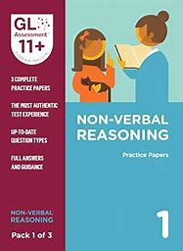
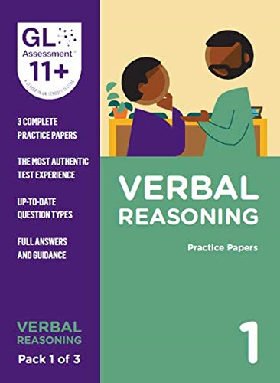
11+
2 papers:
Verbal reasoning
Non – verbal reasoning (includes spatial awareness)
USE GL ASSESSMENT PAPERS AS THEY SET THE LINCOLNSHIRE 11+
We do not deliver the 11+ in school; the children go to the grammar schools to take it.
We do not do any 11+ practice here but we do give the Y5 2 11+ practice papers in July.
You can familiarise your child with the 11+ test by practising the GL assessment papers shown on the left. These can be purchased from Amazon.
It is a multiple choice test.
The 11+ is separate to the national curriculum and therefore we do not teach it in school.

Slide 15
Working Together
We are looking forward to working with you and teaching and supporting your child(ren) in the most effective way possible.
Please let us know if you have any questions or comments or things that you feel we should know.
We will always make time to see you if you want to talk to us. Please email us or make an appointment at the school office and we will do our best to see you as soon as we can.
barnowls@quadringcowleybrowns.lincs.sch.uk

