Slide 1

O’s Lockdown Pentathlon
19.5.20

Slide 2
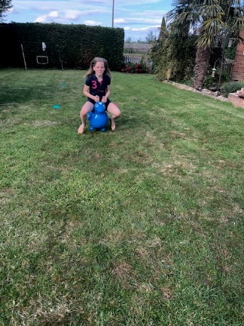
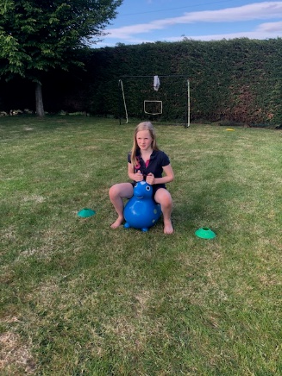
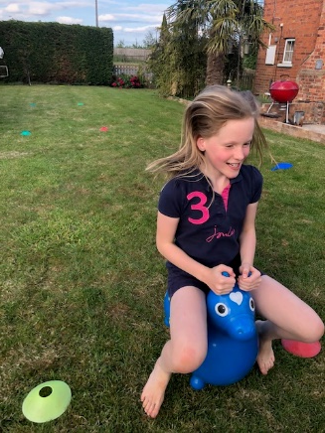
The 10m Bouncy Hop
Rules
You will need a tape measure, markers and a bounce hopper.
A 10 m area should be marked out on a flat area of grass.
Competitors should line up on the start line, sat on their bounce hoppers and wait for the start command.
When the command is given the competitors should remain seated and bounce in a straight line to the finish.
The competitors should be timed from the start to the finish.
The fastest to finish wins and their time is recorded.

Slide 3
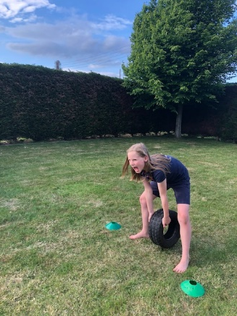
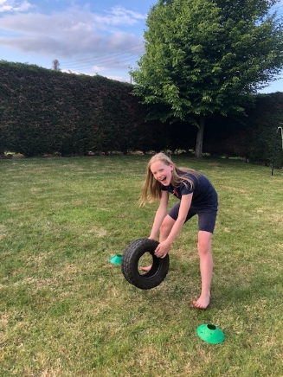
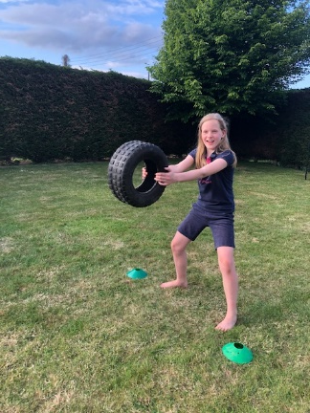
Tyre throw
You will need a tyre, a tape measure and some markers.
Place the markers at the start and measure out 10 meters.
The competitor must stand at the start position and the tyre must be held in both hands and swung between the legs to create momentum.
The tyre should be thrown forward.
The landing point should be measured from the start point.
The distance thrown is the result.

Slide 4
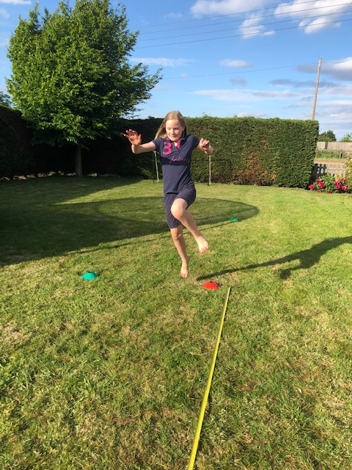
Running jump
You will need a tape measure and some markers.
Measure out a 10 meter distance with a tape measure and place a marker at the beginning.
The competitor should run up to the marker and make a jump as far a they can.
The measurement is taken at the landing point nearest to the start.
The length of the jump is the recorded result.

Slide 5
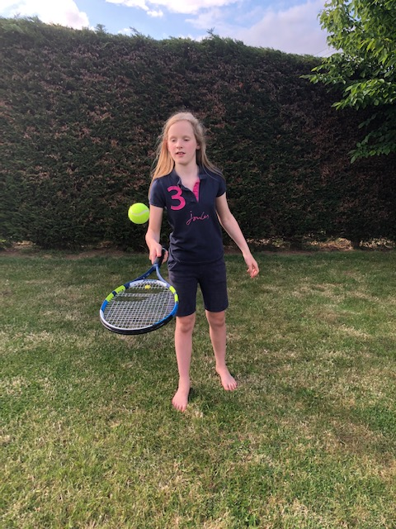
Tennis ball bounces
You will need a tennis racket and tennis ball.
The competitor must start with the ball at rest on the racket.
The judge starts the timer and the competitor starts to bounce the ball on the racket.
The competitor will be timed until the bounce is missed and the ball touches the floor.
The length of time the competitor can continuously bounces for is the recorded result.

Slide 6
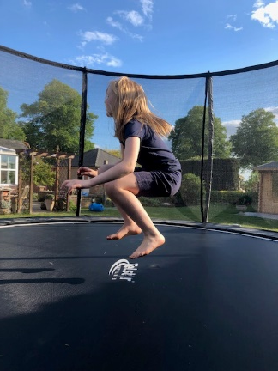
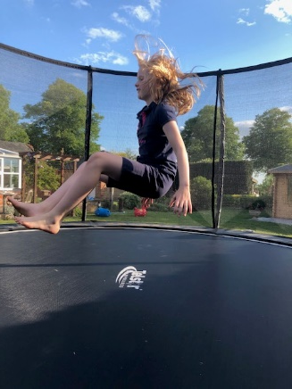
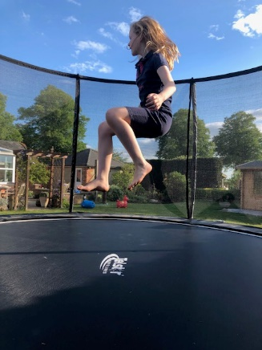
The sitting bounce
You will need a trampoline
The bouncer needs to take the starting position stood on the trampoline.
The judge starts the timer and the bouncer commences bouncing into a sitting position and back to an upright.
The bouncer is timed for 30 seconds and their result is how many bounces are completed within this time.

Slide 7
Games results for O
Event | Performance
10m bouncy hop | 28 seconds
Tyre throw | 6.50m
Running jump | 1.70m
Tennis ball bounces | 3.56 seconds (pb)
The sitting bounce | 25 bounces in 30 seconds (pb)

