Slide 1

William Morris
By Emilia

Slide 2
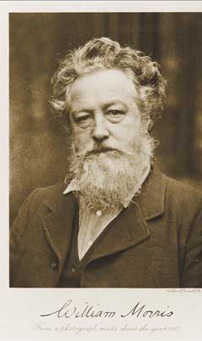
William Morris was born in 1834.
HE WAS BORN IN 1834 AND DIED IN 1896 THIS MEANS HE DIED WHEN HE WAS 62!
His birthday was the 24th of march and his death date was the 3rd of November.
He was born in the Victorian era!

Slide 3
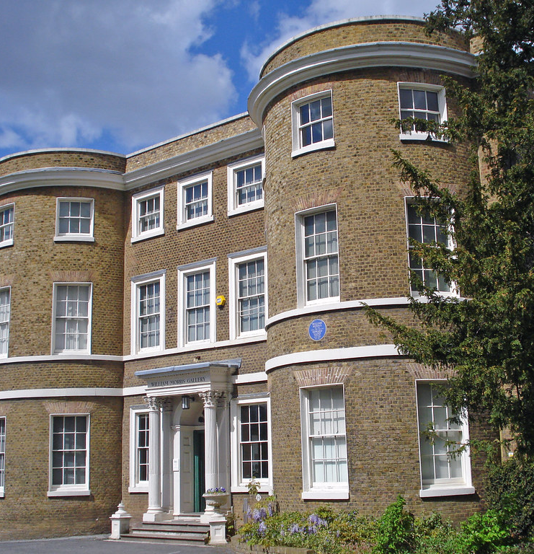
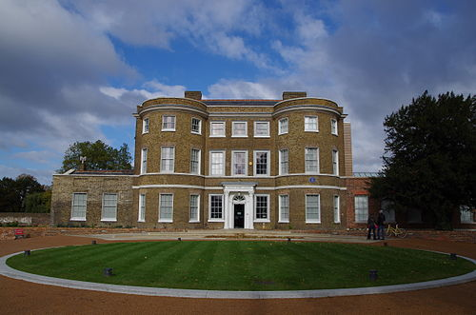
WHERE DID HE LIVE?
William Morris lived in the water house from 1948-1956 from the age of 14 till he was 22. he lived there with his mother and his 8 siblings!

Slide 4
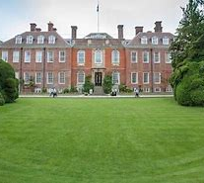
Where was he educated?
He was educated at Marlborough and Exeter College, Oxford. In 1856 he became an apprentice to gothic revival architect G.E. street. That year he founded the Oxford and Cambridge Magazine.

Slide 5
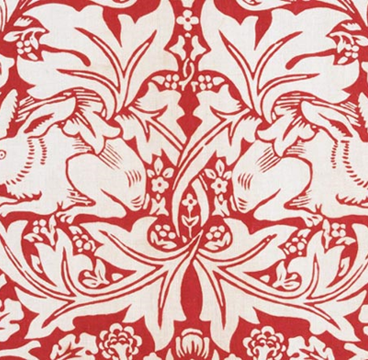
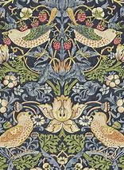
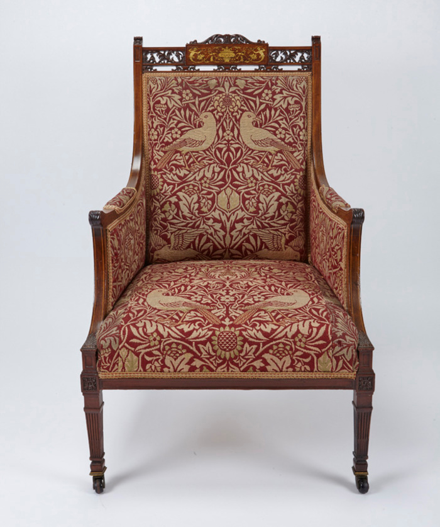
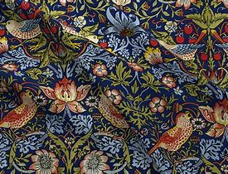
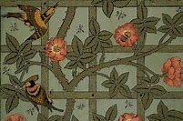
What did he do?
He was an English architect , furniture and fabric designer , artist , writer and a socialist.

Slide 6
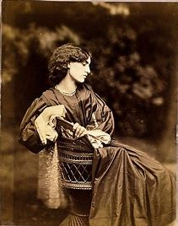

Who did he marry?
In 1859 he married Jane Burden.

Slide 7
Soon after they had a house built for them selves on in the Kentish hamlet of Upton near Bexleyheath, ten miles from central London this was called the red house which was designed by Philip Web. William and jane designed all the furniture and wallpaper there selves it took them about 2 years till it was just right doing so much of the work them selves. They were so happy with the results they decided to start there own fine art design company.

Slide 8
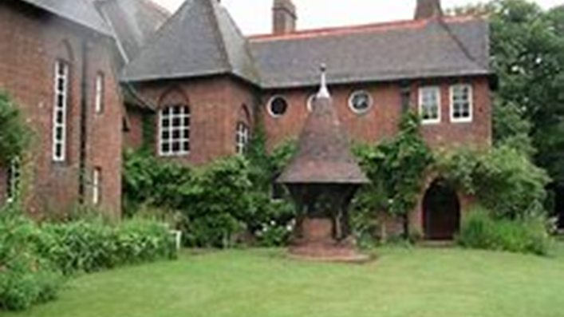
Red house

Slide 9
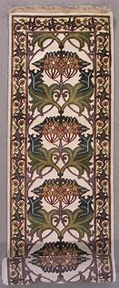

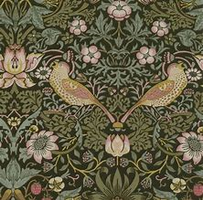
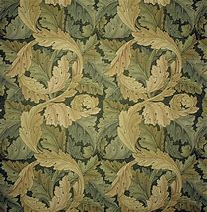
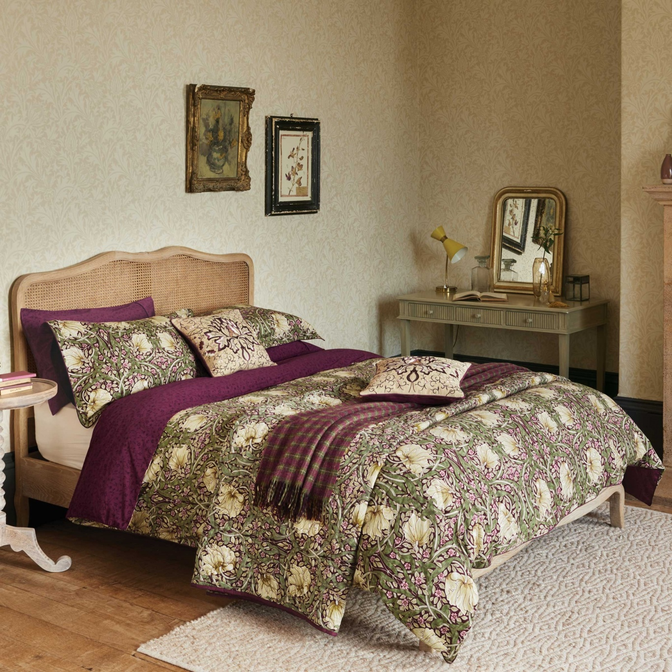
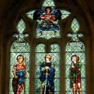
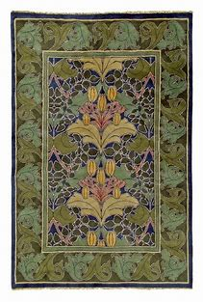
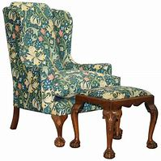
In 1861 their company called Morris Marshall and Faulkner and CO started to make furniture.

Slide 10
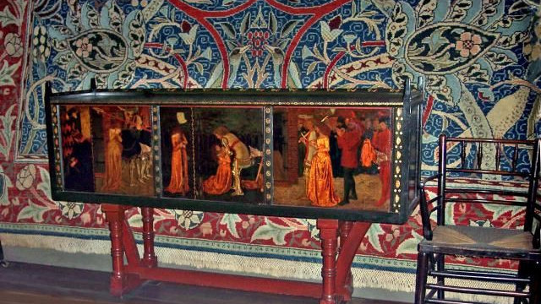
Table wear

Slide 11
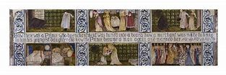
Soft furnishings

Slide 12
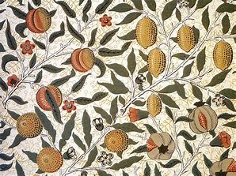
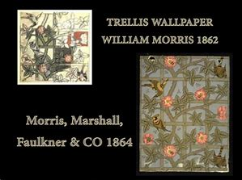
wallpaper

Slide 13
And all the items were all hand crafted !!!

Slide 14
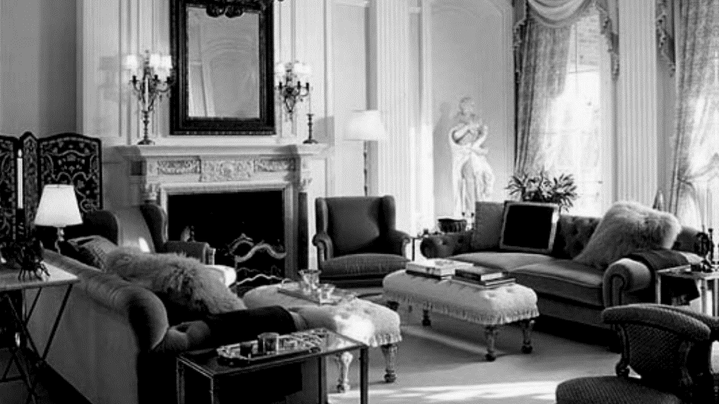
Rooms in the Victorian times without patterned wallpaper:

Slide 15
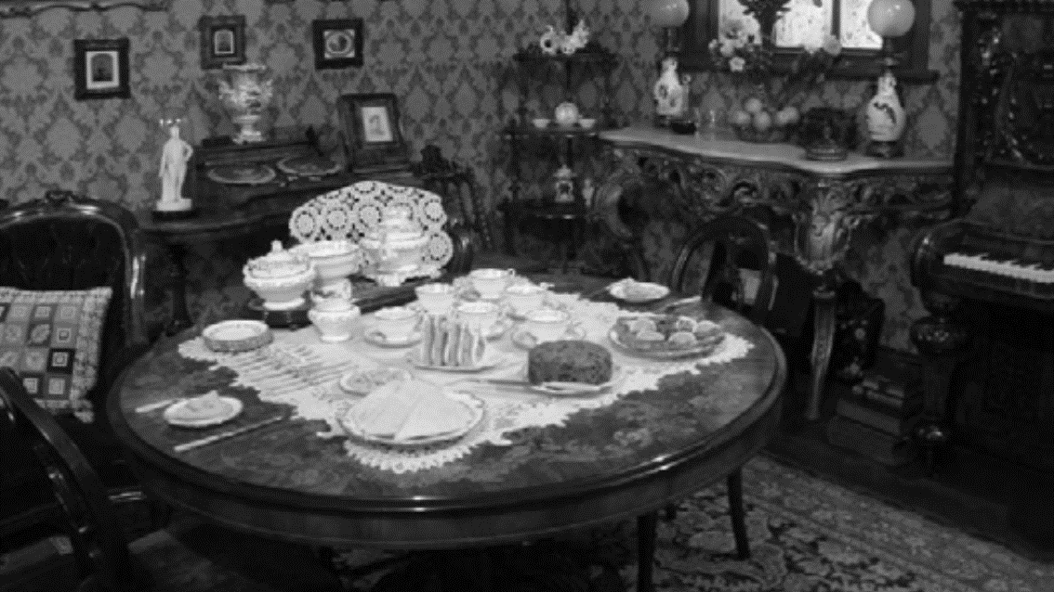
Rooms with patterned wallpaper.

Slide 16


