Slide 1
all about morris
By Ben Wood

Slide 2
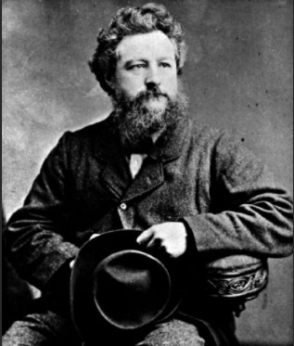
William Morris was born in 1834 and died in 1896.
He was a famous furniture designer, wallpaper designer and printer.

Slide 3
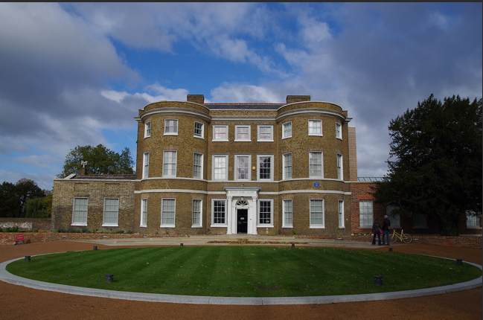
When he was a young boy
When he was younger, Morris lived in the Water House and trained as an architect at Oxford University.

Slide 4
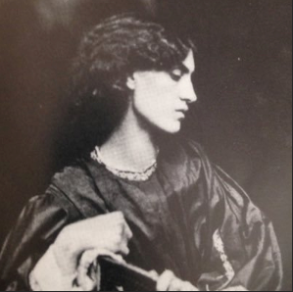
WHO HE MARRIED
In 1859, Morris married Jane Burden who was an embroiderer and artists’ model.

Slide 5
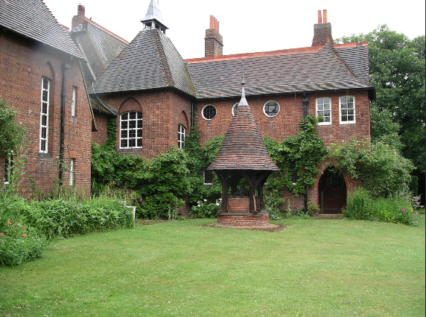
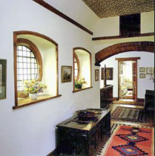
WHERE DID THEY LIVE?
William and Jane moved into the Red House. They spent two years furnishing and decorating their home.

Slide 6
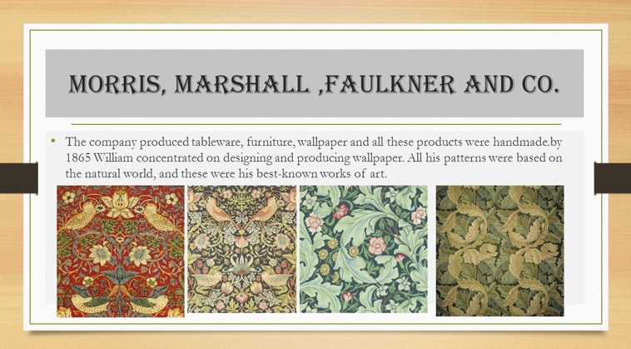
WHAT DID THEY DO AFTER FINISHING THE RED HOUSE?
Based on the success of the Red House, they set up their own design company called Morris, Marshall, Faulkner and Co. in 1861.

Slide 7
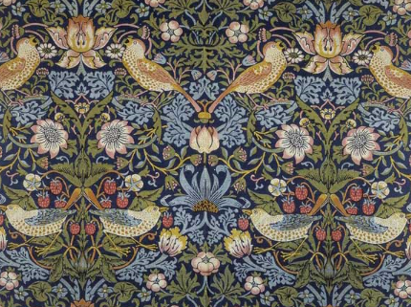
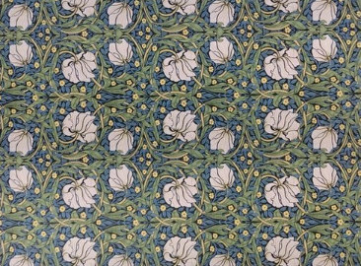
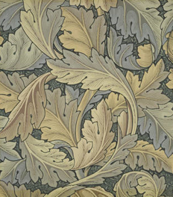
WHAT DID THEY MAKE?
They designed furniture, wallpaper, tiles, stained glass windows and other domestic furnishings. All of their designs were based on nature.

Slide 8
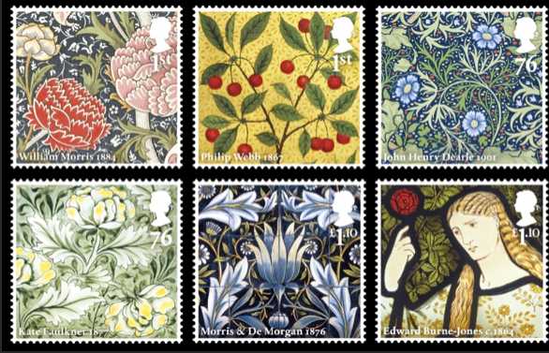
HIS LEGACY
William Morris’ designs are still used in homes around the world to this day.
The Red House is now owned by the National Trust and you can go and visit it anytime.
In 2011, to celebrate the 150th anniversary of the Morris company the Royal Mail released a set of stamps

Slide 9
DID YOU KNOW?
In his spare time, Morris was also a poet
His nickname was Topsy
To get inspiration for his designs, he travelled Iceland
He was going to be a vicar
His designs are still well know around the world
His designs can still be bought as wallpapers and fabric

Slide 10


