Slide 1
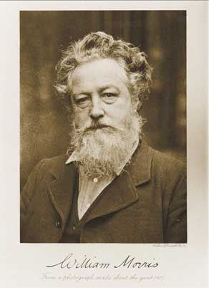
William Morris
The life of the famous 19th century artist
By Evie Dunning

Slide 2
His life
William Morris was born in Walthamstow on the 24th March 1834. He was one of the most influential designers of the 19th century. He worked as an artist that did wallpaper design and print; furniture; stained glass windows; tiles and tapestries. He also worked as a writer and campaigner for environmental and social change. When he was 13, he was privately educated at Marlborough College before he went to Exeter College, Oxford in 1853. After college, he trained as an architect and then married Jane Burden.

Slide 3
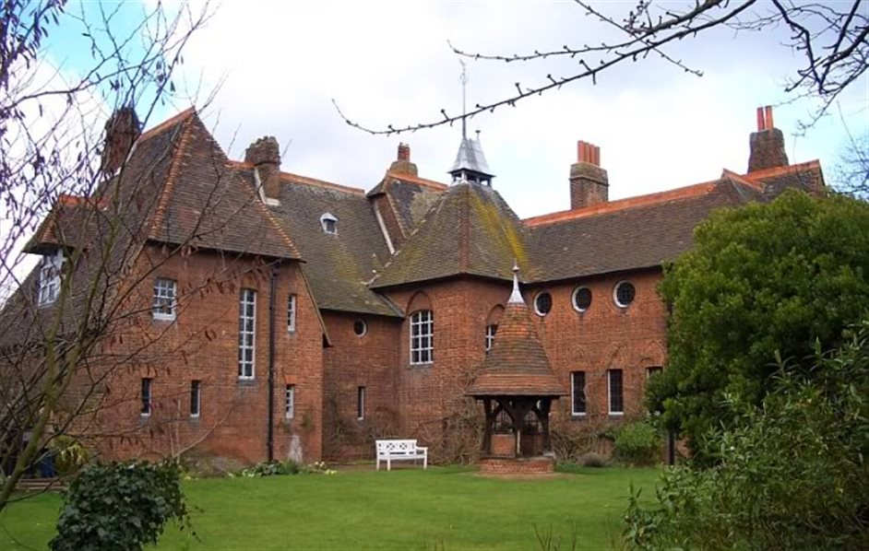
Red House
Red House was built by Philip Webb and was designed by Morris himself. He and his wife, Jane Burden, moved into it in 1860. They lived there for five years with their daughter, May Morris. In 1865 Morris put Red House on the market and later in 1865 the Morris family moved back to William’s old workshop. The family never went back to Red House again.

Slide 4
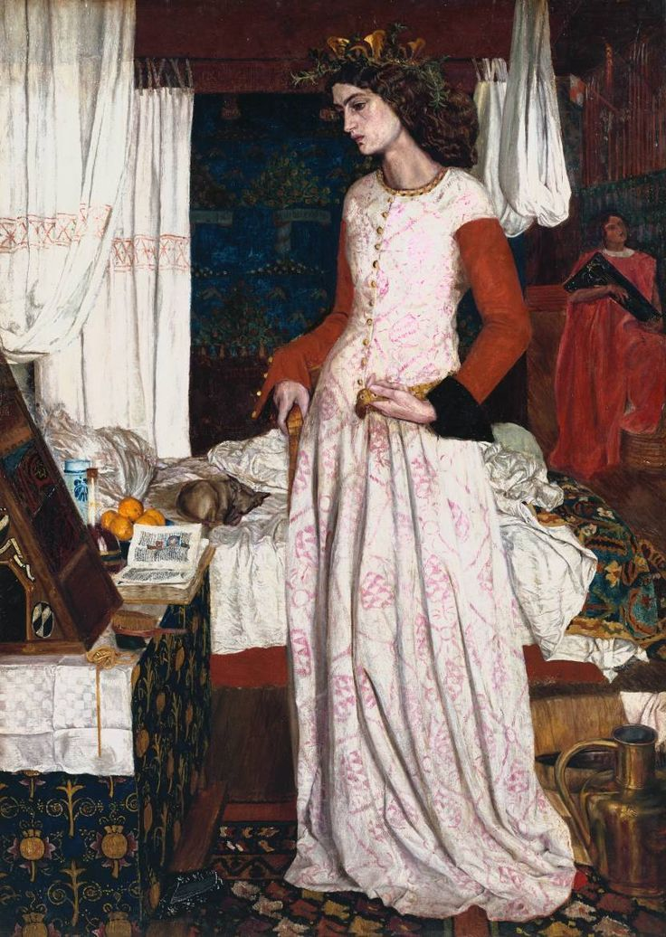
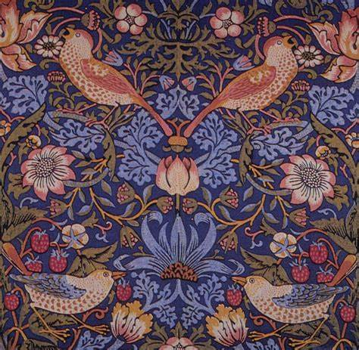
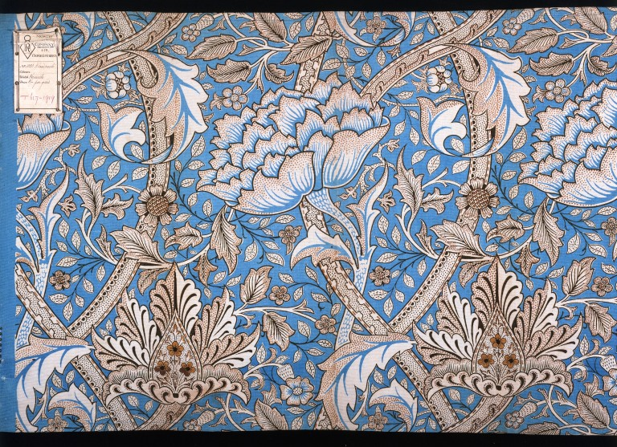
His pieces of work
“Strawberry Thief’’
“Windrush”
“La Belle Iseult”

Slide 5
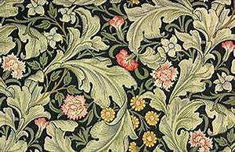
William Morris died on the 3rd October in 1896.

