Slide 1
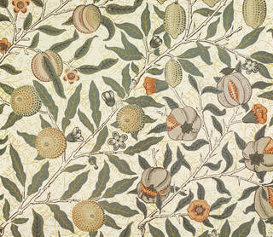

William Morris
19th century’s
most celebrated designer
Notes:
Welcome to my Powerpoint presentation on William Morris who was 19th Century most celebrated designer

Slide 2
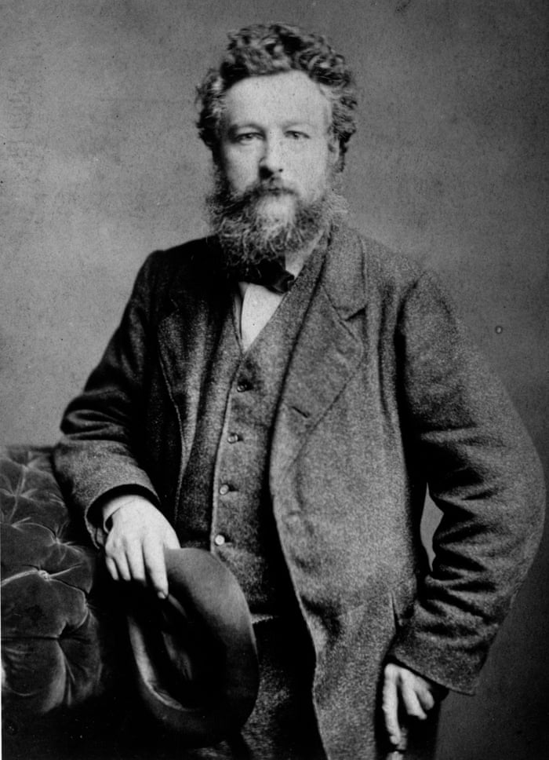
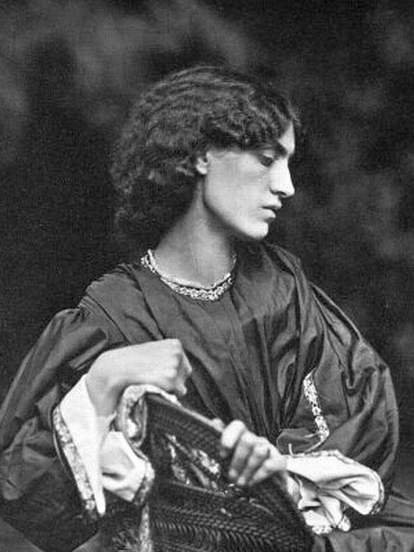
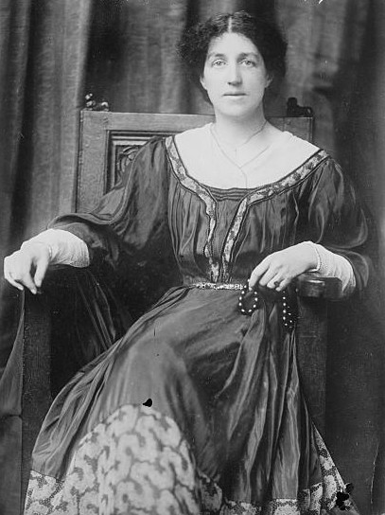
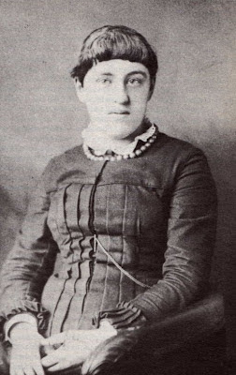
Personal life
Jane Burden Morris
Poet, artist, furniture and wallpaper designer
Born 1834
Studied at Marlborough and Oxford - Architecture
Wealthy middle class
Married Jane Burden and had two daughters
He was a Socialist, founded Socialist League 1884
William Morris
May Morris
Jenny Morris
Notes:
Slide One
William Morris was a poet, artist, furniture and most famously wallpaper designer.
He was born on 24th March 1834 in Walthamstow, East London.
William Morris went to Marlborough College and Exeter College at Oxford.
He studied Architecture.
His father was a stockbroker which meant their family was considered wealthy middle class.
William Morris married Jane Burden in 1859. Jane was a muse model and in Victorian times called a ‘Stunner’. Stunners were unusually attractive working-class women. William and Jane had two daughters together called Jenny and May. Jenny tragically died from epilepsy.
In 1965 Jane had a love affair with Rosetti one of William’s close friends and colleague.
William was a Socialist. He founded the Socialist League 1884.

Slide 3
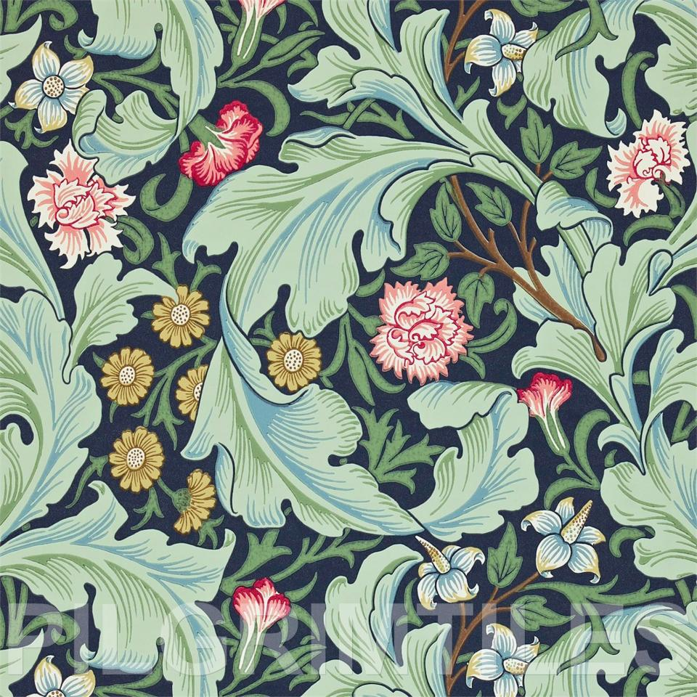
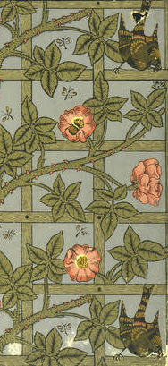
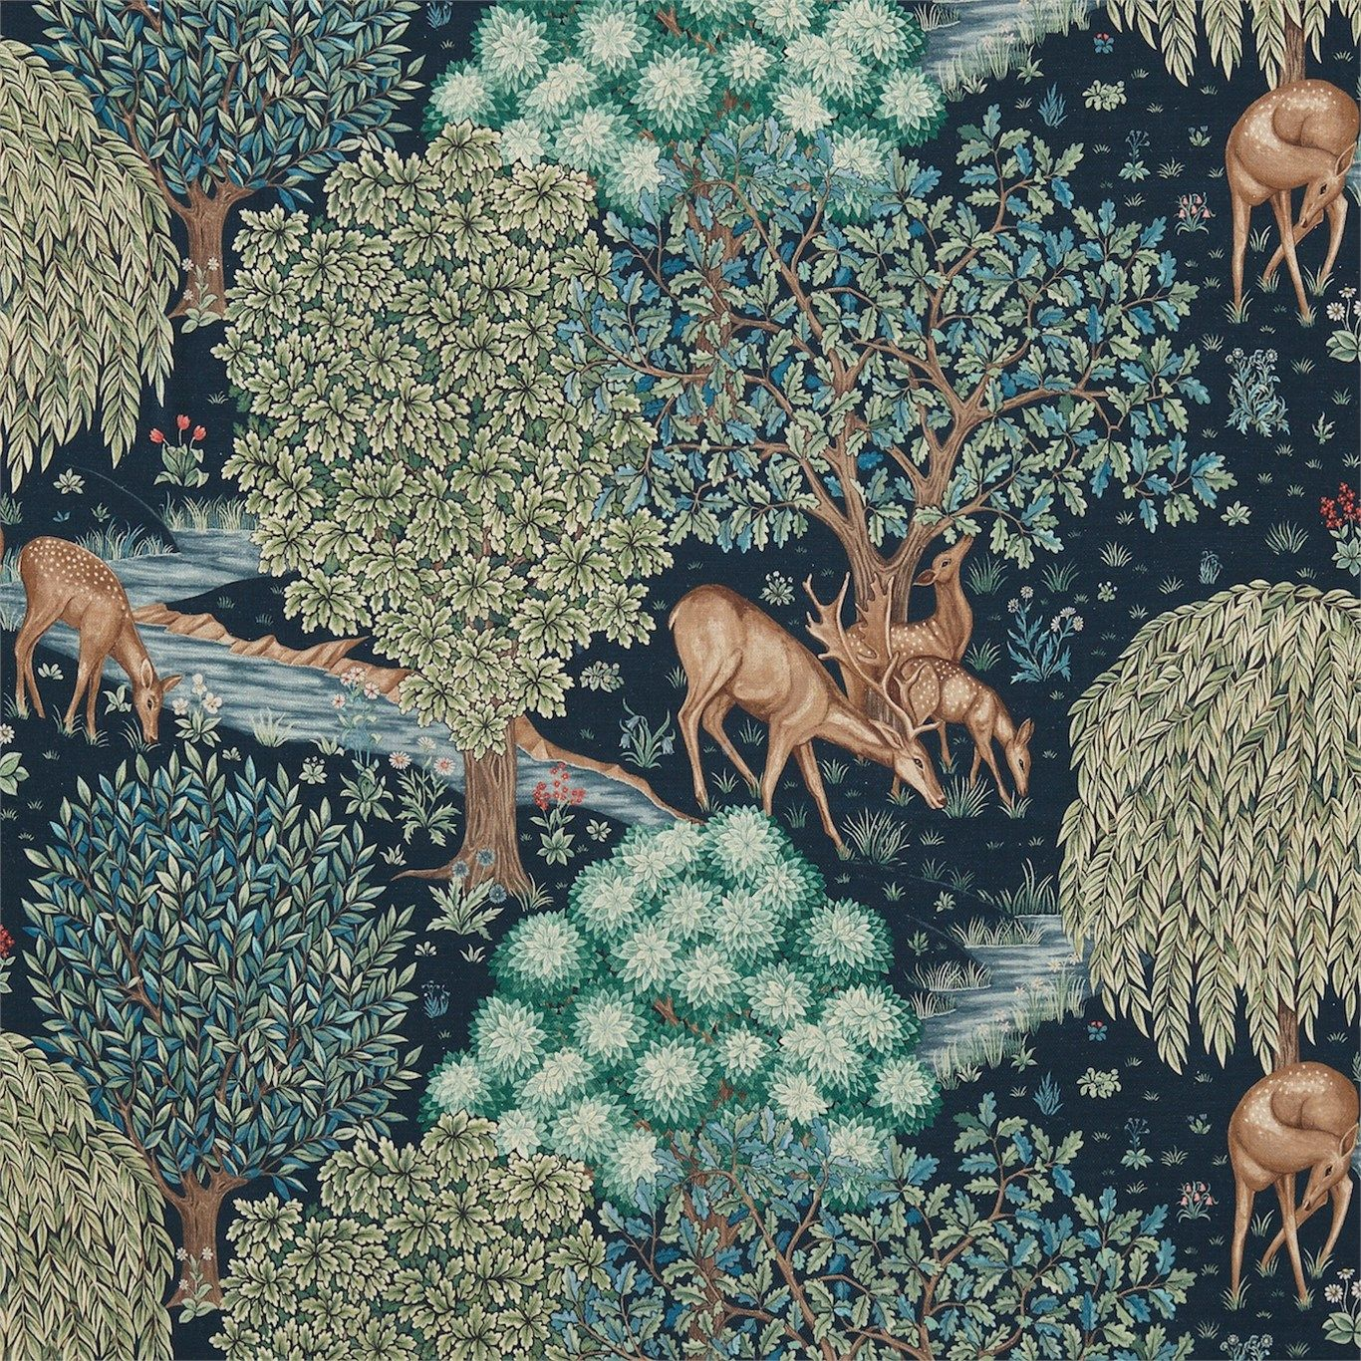

Morris & Co
Jane Burden Morris
Furniture and textile design
Formed 1862
Inspire people to feel closer to nature
William Morris
May Morris
Jenny Morris
Notes:
Slide Two
In 1862 William Morris built ‘Red House’ It was in this house ‘Morris, Marshall, Faulkner & Co’ was formed so he could design his own furniture and textiles because he couldn’t find any that he liked.
Later this became Morris and Company and the company still exists today producing wallpaper and textiles based on his timeless designs.

Slide 4

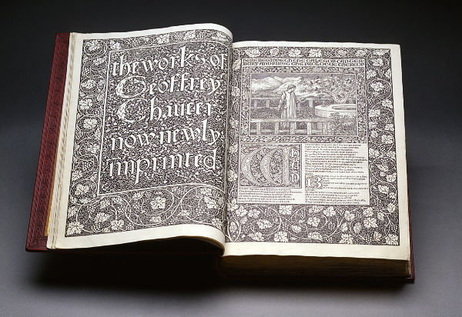
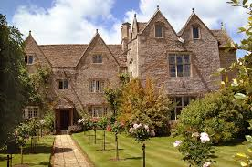
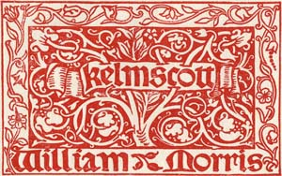
Kelmscott Press
Jane Burden Morris
Print house
Well known writers
Formed 1891
Made with own typefaces and paper printed by hand
Died 1896
William Morris
May Morris
Jenny Morris
Notes:
Slide Three
William Morris also founded the Kelmscott Press in Hammersmith in 1891.
The Kelmscott Press printed over 50 books written by himself and other well-known writers and poets like Tennyson, Rossetti and Swinburne.
The books were expensive, used his own typefaces and paper and were printed by hand.
The finest achievement of the Kelmscott Press was The Works of Geoffrey Chaucer who was a famous poet.
William Morris had asked Sydney Cockerell to continue the Kelmscott Press after he died. Cockerell closed the Press a year and a half after his death to preserve the integrity of Morris’s publications.
William Morris died of Tuberculosis in Hammersmith aged 65 years old on 3rd October 1896.

Slide 5
Thank you
Notes:
Welcome to my Powerpoint presentation on William Morris who was 19th Century most celebrated designer

