Slide 1
WILLIAM MORRIS
By Jacob Hammond

Slide 2
William was born in Victorian times
Born on 24th March 1834 in Walthamstow
Sadly passed away on 3rd October 1896 in Hammersmith,London.
He lived for 62 years

Slide 3
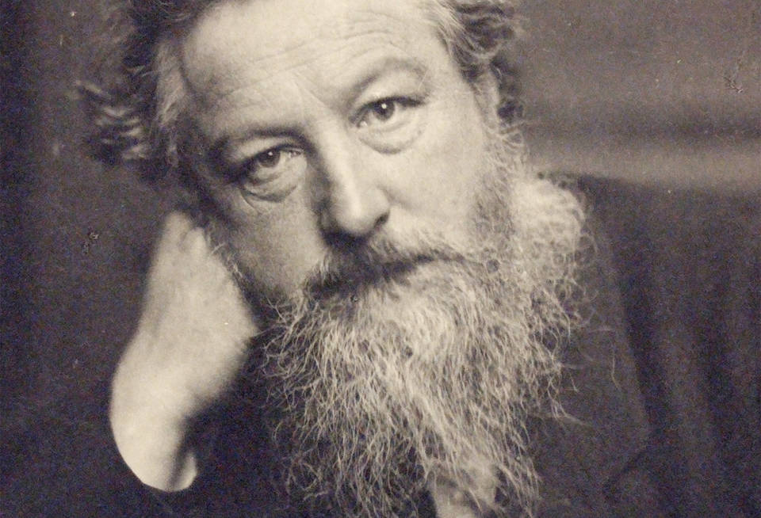
What Was He Famous For?
William Morris was a famous Victorian textile artist.
He was a poet , a novelist and he was also a socialist activist.
He also went to Oxford University where he studied as an architect.
His nick name was Topsy.

Slide 4
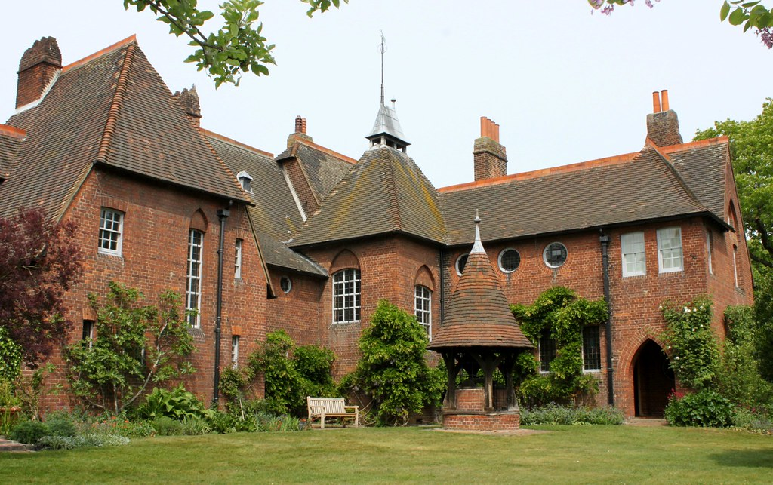
Where He Lived
In 1859 William married Jane Burden.
They had 2 daughters: Jenny and May Morris.
William and his wife lived in this house. The first 2 years
decorating the interior of their home.
William and Jane designed all of the interiors and decoration themselves.

Slide 5
Carrier of William Morris
In 1861, Morris and his friends have founded a design business Morris, Marshall, Faulkner and Co.
They were decorating of churches and houses.
Morris became very famous as a designer of repeating patterns for wallpapers and textile with patterns.
This was mainly based on a close observation of nature.
Morris even travelled to Iceland to get inspiration.

Slide 6
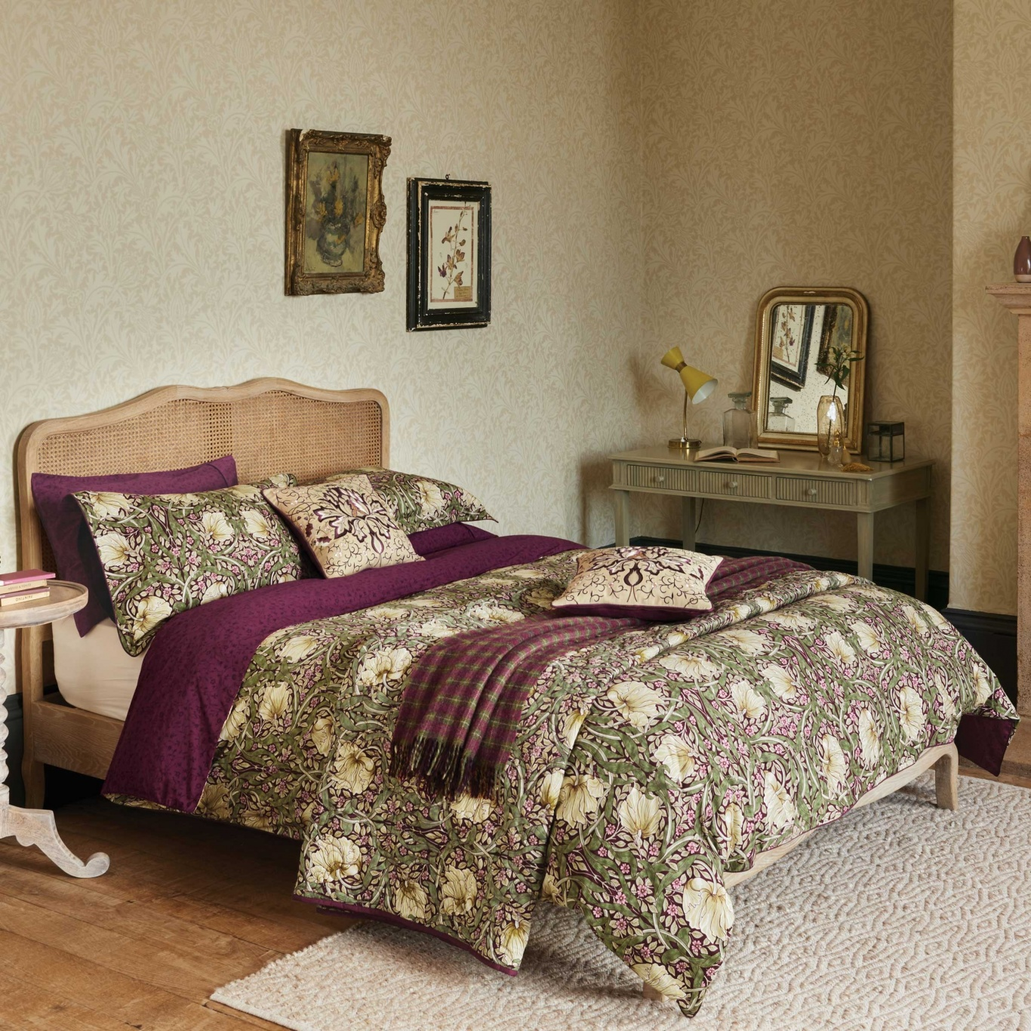
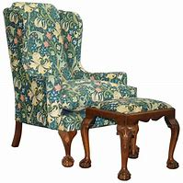
WILLIAM’S FURNISHING DESIGNS
William hated that Morris Marshal Faulkner was using machines to produce furnishing so he did some of his own

Slide 7
MORRIS AND CO
In 1875 Morris started a new company called Morris and Co.
This meant a lot to him for to take full artistic control.
This period was considered Morris’ most creative period as a pattern designer.
This was the most successful time in his career and Morris has been continuing to work being creative until his death in 1896.

Slide 8
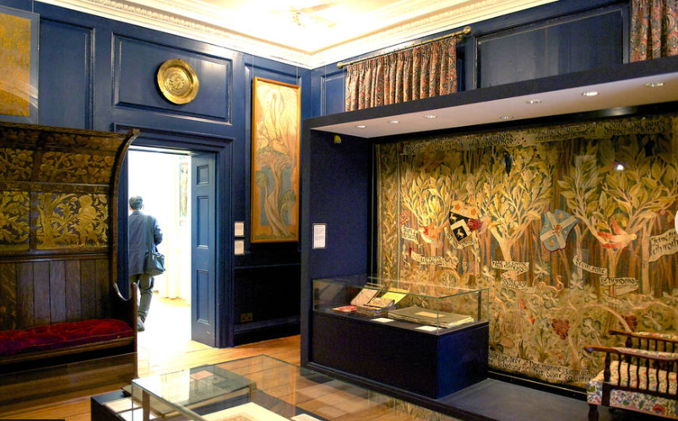
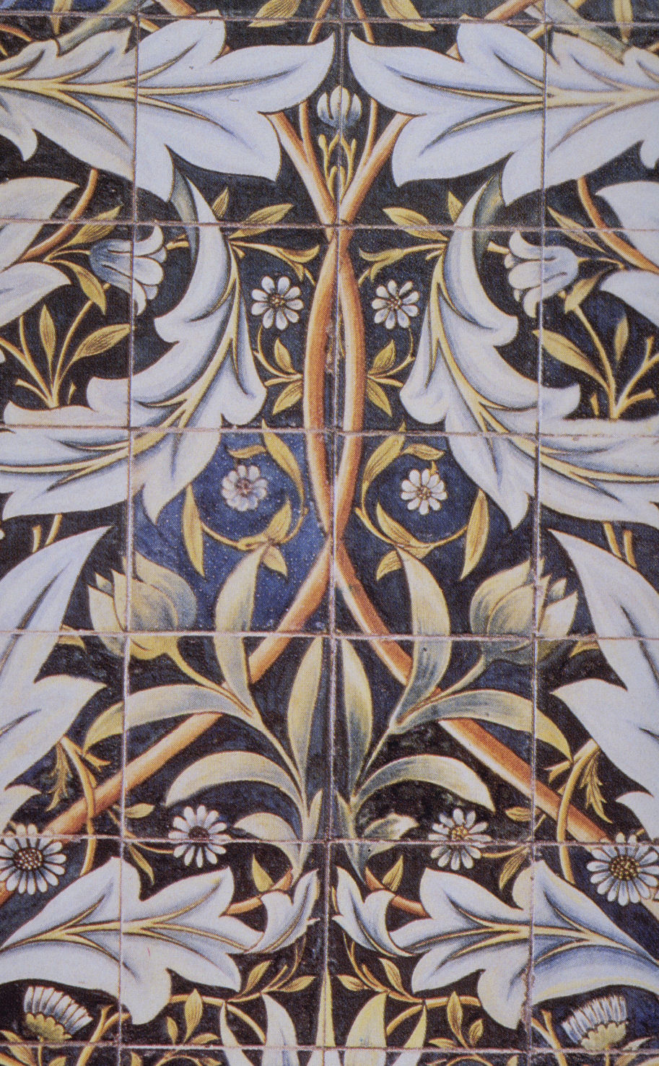
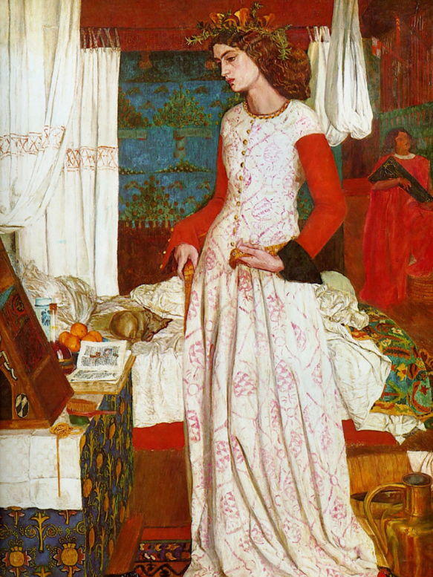
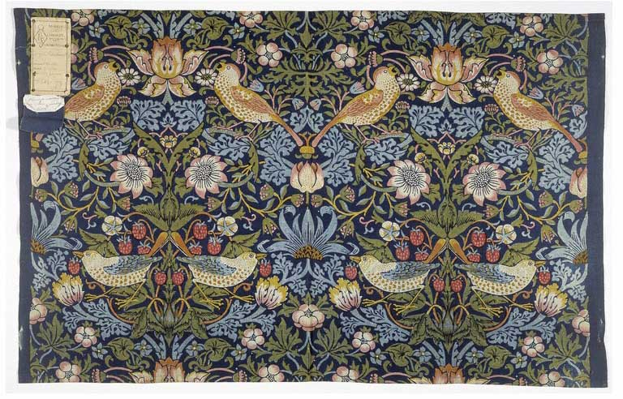
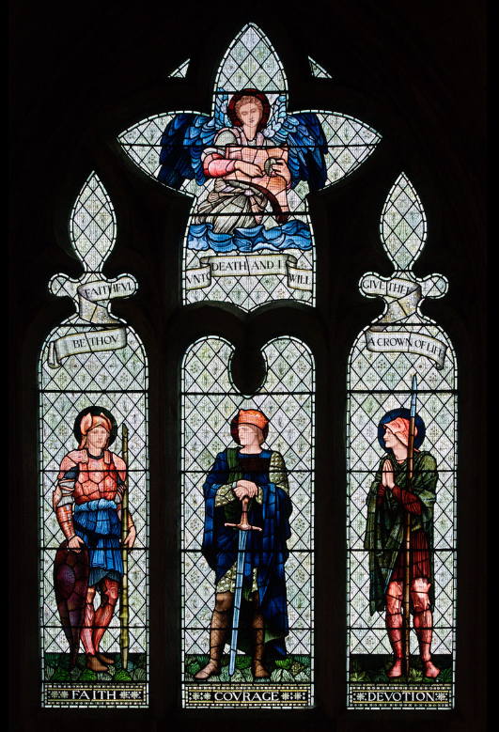
Creations of William Morris

