Slide 1

William Morris
By Olivia Winter

Slide 2

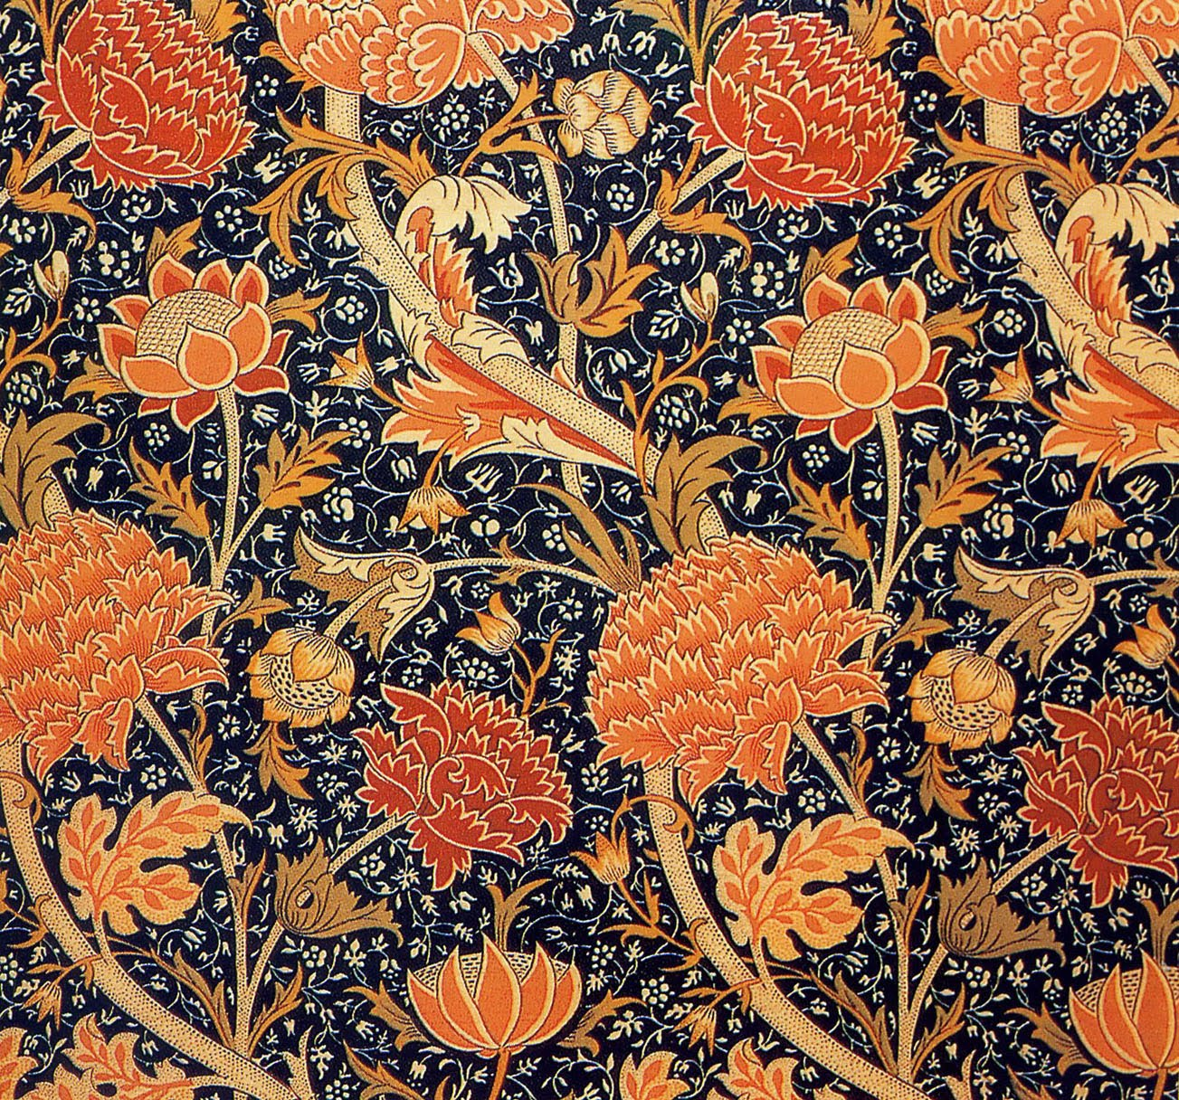
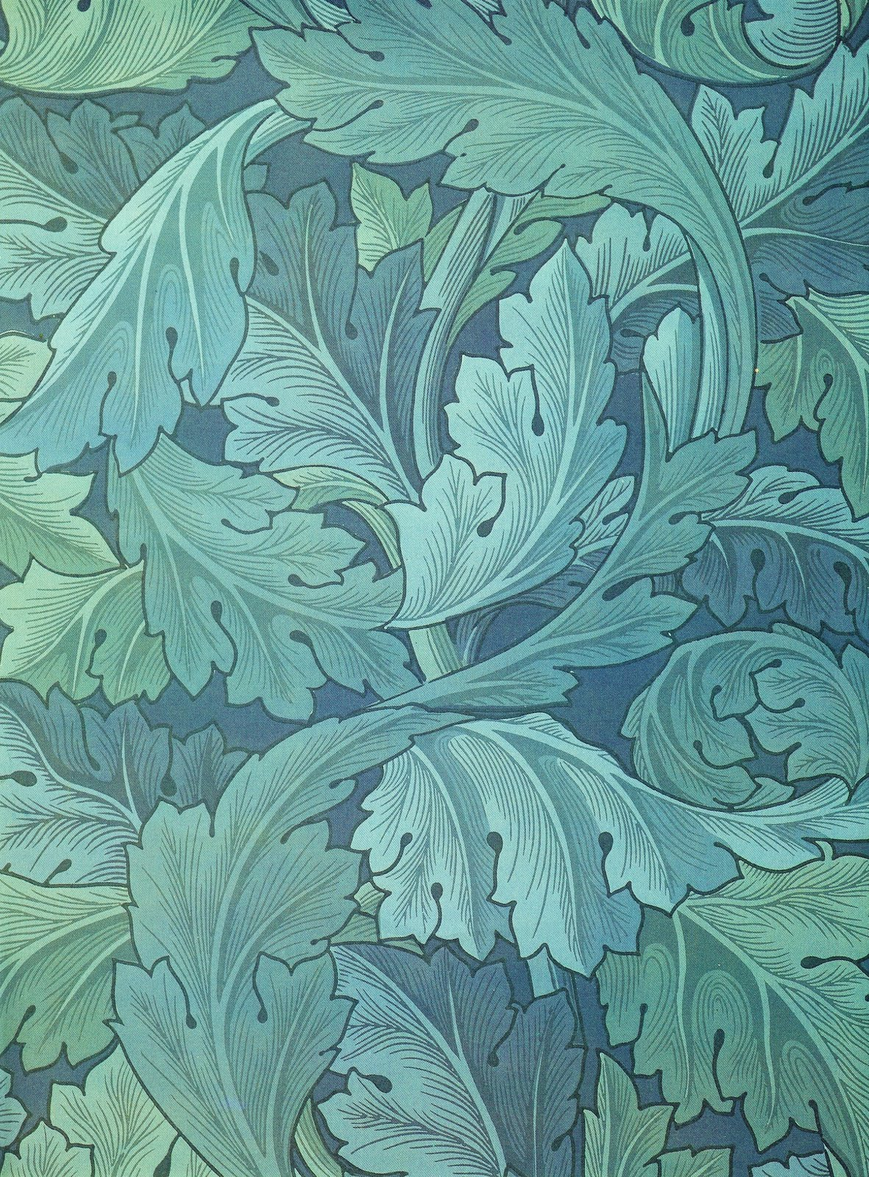

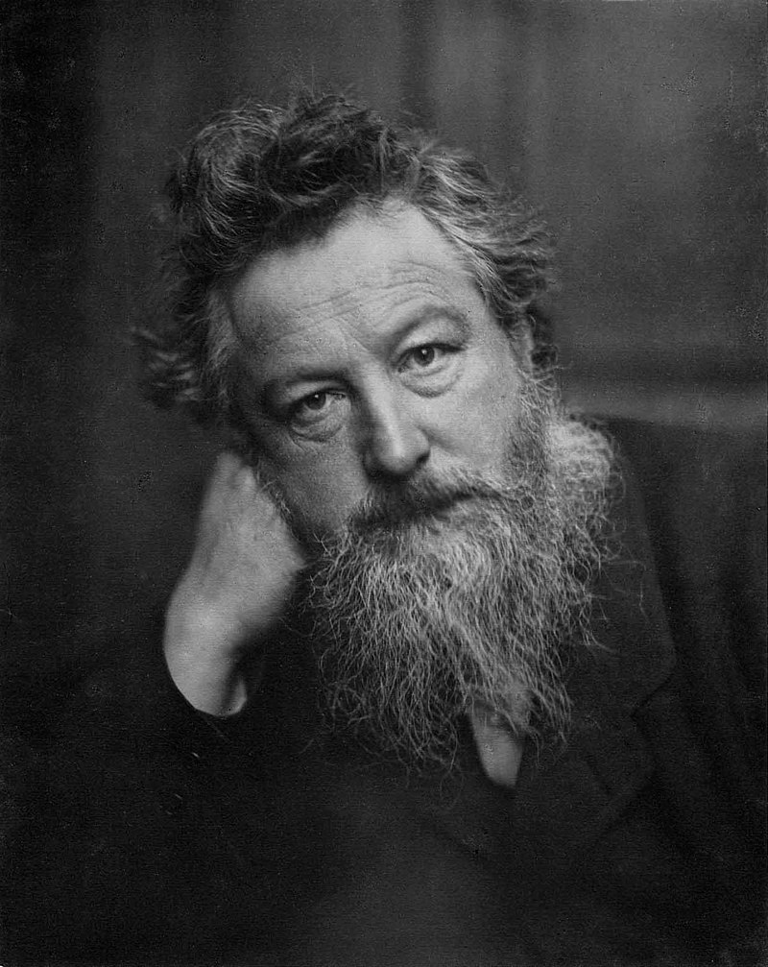

William Morris was an artist, designer, printer, typographer, bookbinder, craftsman, poet, writer and champion of socialist ideals. Like many designers of his time, Morris was skilled in a wide range of arts and crafts.

Slide 3
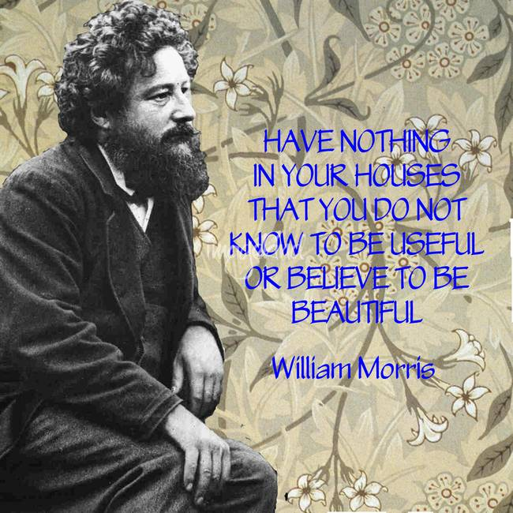
Key Facts
Born | 24.3.1834
Died | 3.10.1896
Occupation | Artist, designer, writer and socialist
Know for | Wallpaper and textile design, fantasy fiction and socialism.
Spouse | Jane Burden
Children | Jenny and May

Slide 4
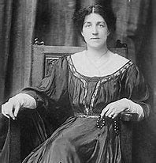
William Morris Timeline
1834 – Born.
1848 – Attends Marlborough School.
1852 – Attends Exeter College, Oxford.
1856 – Becomes an apprentice to Gothic revival architect.
1858 – His first Poetry book was published.
1859 – Marries Jane Burden and builds Red House.
1861 – Founded design firm partnership; Morris, Marshall, Faulkner & Co.
First daughter, Jenny was born.
1862 – Second daughter, May was born.
1884 – Founded the Socialist League.
1891 – Founded The Kelmscott Press.
1896 – Dies.
Jane Morris

Slide 5
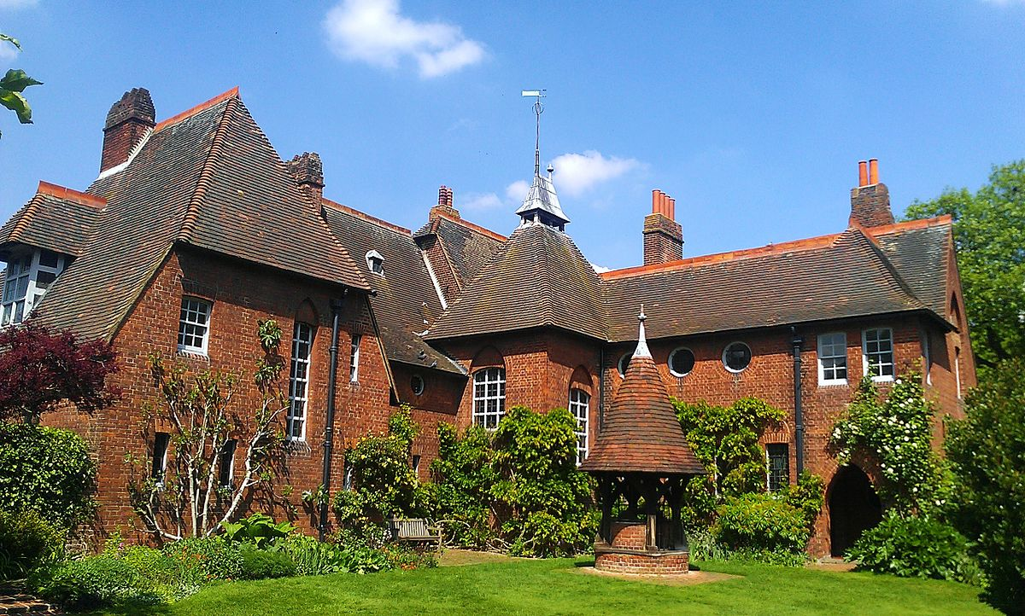
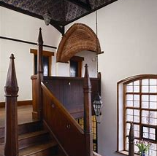
Red House
Red House was designed by Phillip Webb and William Morris and was Morris’ family home from 1860 for 5 years. Both his daughters, Jenny & May were born here. Red house was a center for Morris’ circle. Many friends stayed for weeks and worked on the interior.

Slide 6
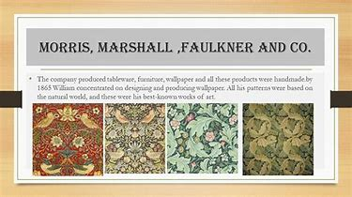

William Morris’s businesses
Morris, Marshall, Faulkner & Co. (1861–1875) was a furnishings and decorative arts manufacturer and retailer founded by the artist and designer William Morris with friends from the Pre-Raphaelites. Its successor was Morris & Co. (1875–1940) The firm's had an influence on the decoration of churches and houses into the early 20th century.

Slide 7


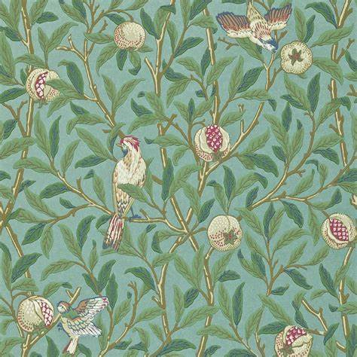


Morris Designs
William Morris was a leading member of the Arts and Crafts Movement. He is best known for his pattern designs, particularly on fabrics and wallpapers. By the mid 1860’s Morris was really focusing on designing wallpaper, his patterns were inspired by the natural world, here are some of his most famous designs.

Slide 8
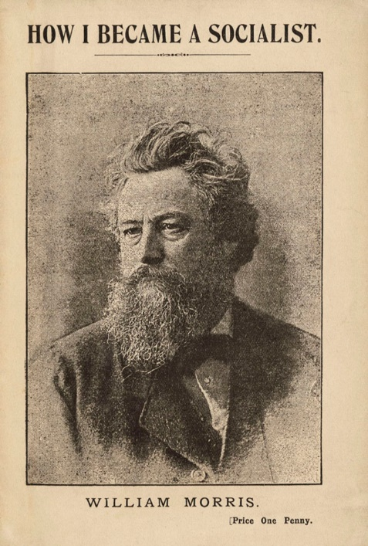
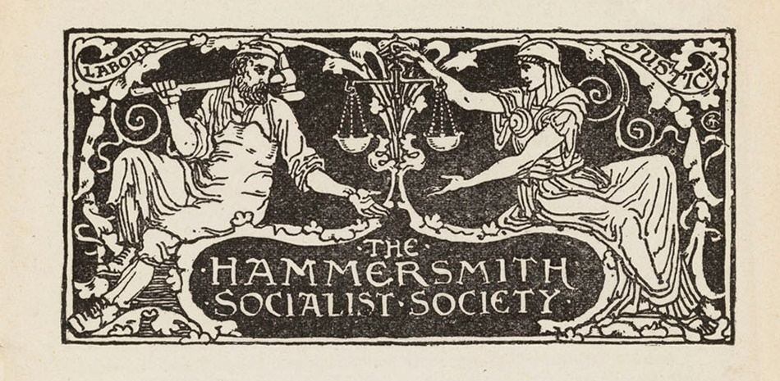
William Morris the Socialist
In 1883 Morris joined a political party called the Social Democratic Federation. He also helped to start a new party called the Socialist League.
The program of the SDF was strongly progressive, calling for (amongst other measures) a 48-hour workweek, the abolition of child labour, compulsory and free and education, equality for women, and the nationalisation of the means of production, distribution, and exchange by a democratic state.
Morris was against the injustice of capitalist society. He read and embraced the writings of Karl Marx and became a Marxist in the 1880s.

Slide 9
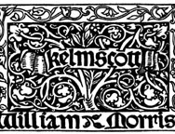
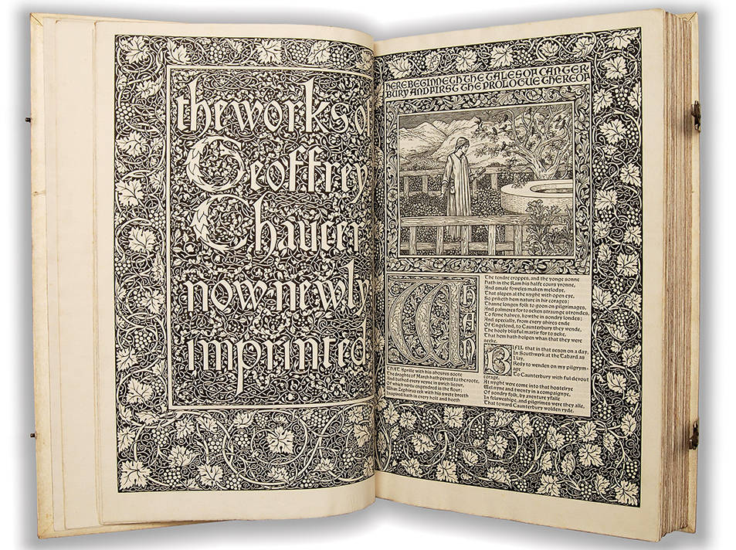
Kelmscott Press
In 1891 William Morris rented a cottage near Kelmscott House and set up three printing presses . He had long been interested in the printing and the binding books, and there, influenced by mediaeval illuminated manuscripts and the work of early printers such as Caxton, he designed and manufactured beautiful editions of over fifty books. The Works of Geoffrey Chaucer was one of the presses finest works.

Slide 10


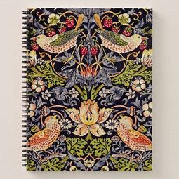
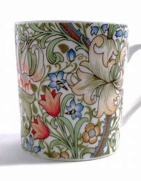
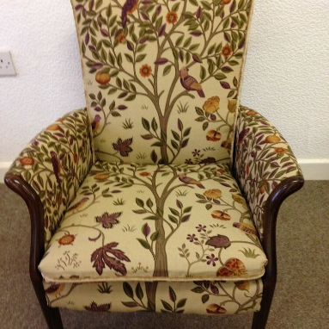
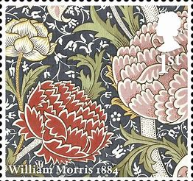
William Morris -
Still relevant and popular in 2020

