Slide 1
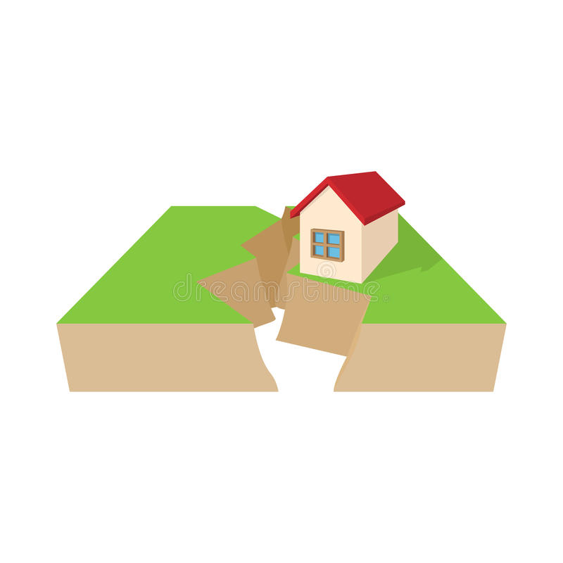
earthquakes
By Matilda and Sam

Slide 2
Earth’s structure
The crust is the piece that we can see.
Crust
It is the thickest part of earth and it lies below the crust.
Mantle
Outer core
The outer core is a fluid layer above the inner core.
core
Earths innermost part.
It is the hottest part.
The earth is made up of 4 different layers as shown in this diagram.

Slide 3
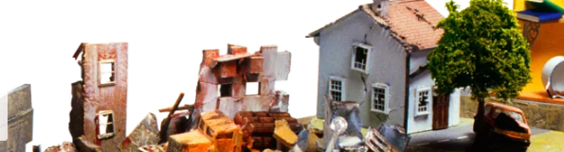
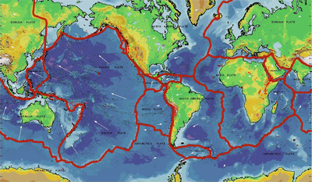
What are earthquakes?
Earthquakes are tremors in the ground. It happens when sections of earth’s outer shell called tectonic plates suddenly move and trigger vibrations inside earth. At earth’s surface, the vibrations turn into shaking, which may last from a few seconds to several minutes.
If an earthquake is beneath the ocean, it can create a huge tidal wave, called a tsunami.

Slide 4
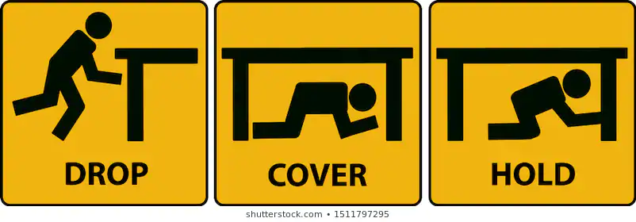
What to do in an earthquake?
This is a poster on how to drop, cover and hold.
Tips for earthquake drills:
Never run
Never panic
Never hold on to chairs
DROP,COVER,HOLD ON.

Slide 5
What causes earthquakes?
Earthquakes are created by tectonic plates rubbing together, colliding or moving apart.

Slide 6
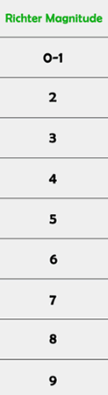
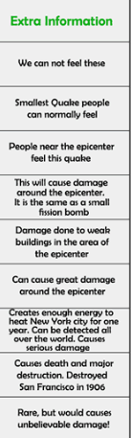
Richter scale diagram!
A Richter scale shows how much damage is done during an earthquake. A Richter scale is measured on a scale of 1 to 12. Did you know that if it goes up to 12 it will destroy everything!
This is what a Richter scale looks like.
One of the biggest earthquakes has been the Kobe earthquake.

Slide 7
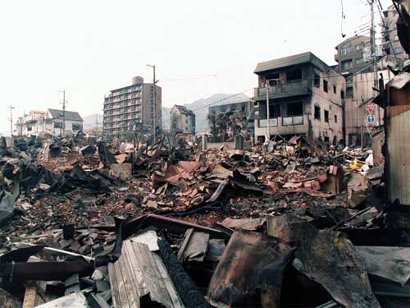
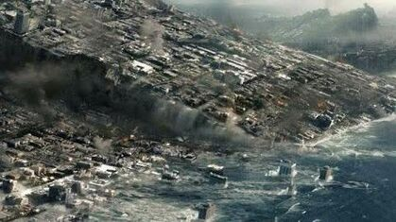
The Kobe earthquake
As you can see, this has been one of the most terrifying and dangerous earthquakes ever!

Slide 8
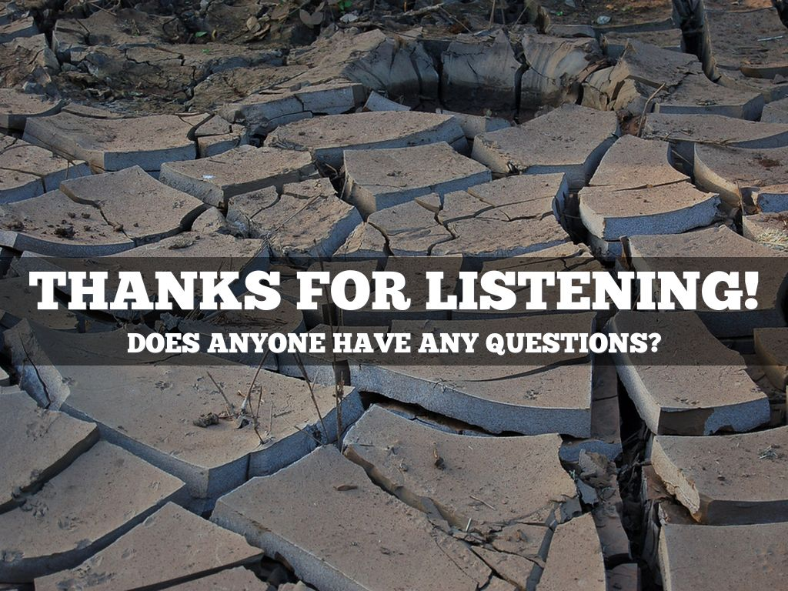
Thanks for listening

