Slide 1
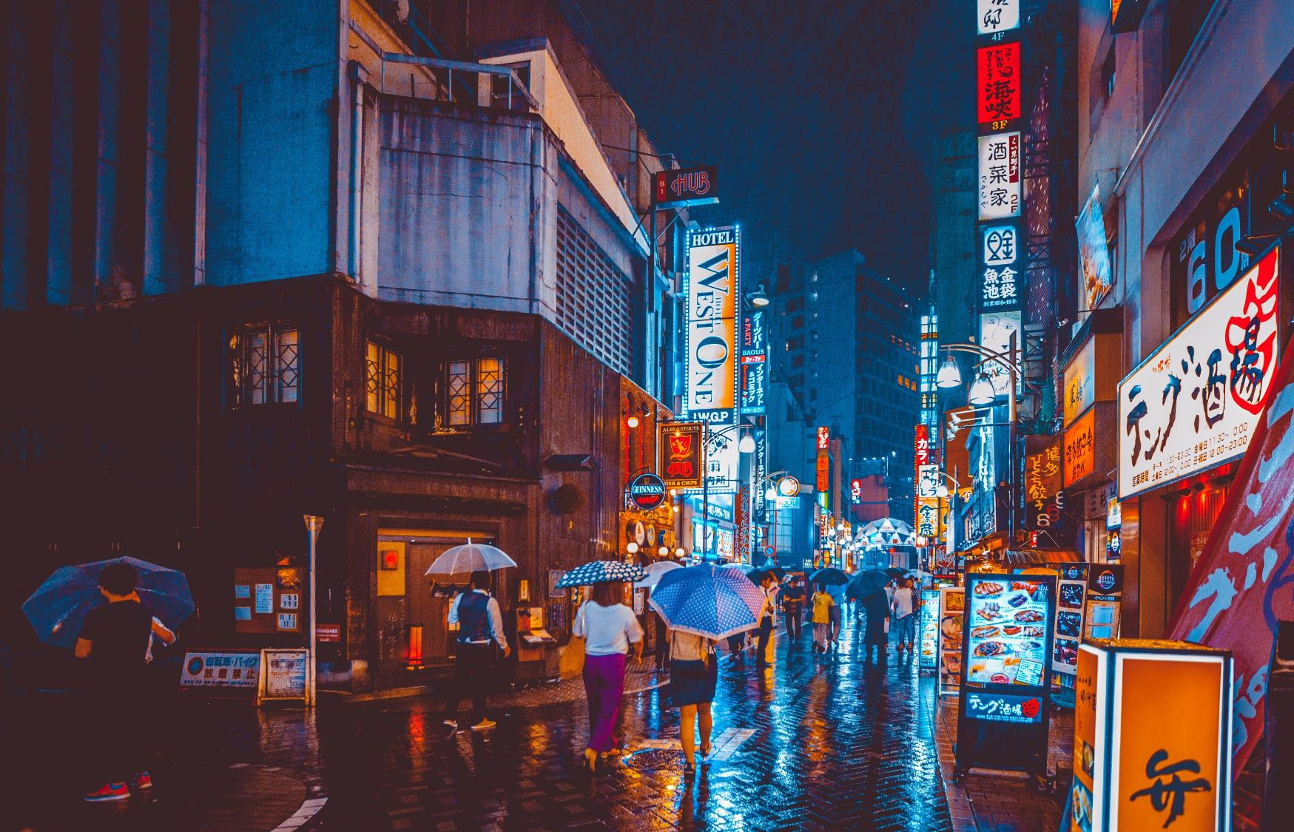
Earthquakes
By Evie and Elizabeth

Slide 2
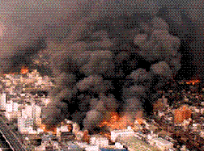
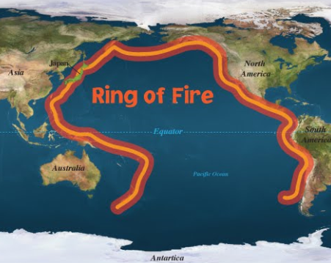
What are earthquakes?
An earthquake is the shaking and vibration of the earth’s crust due to the movement of tectonic plates. Earthquakes occur when tension is released from the inner crust. Earthquakes can happen along any plate at any time. The ring of fire shows the worst places that earthquakes will or have struck.
Here is the ring of fire!

Slide 3
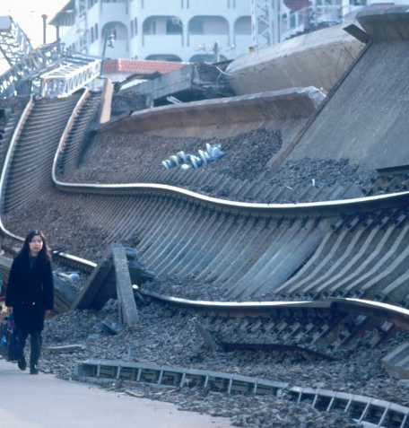
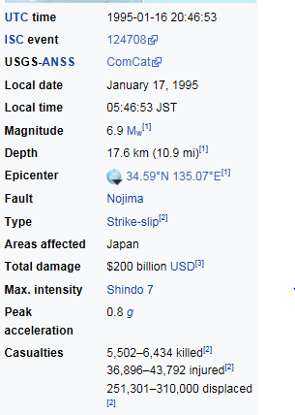
The most powerful….
Here is an example of one of the most powerful earthquakes to hit earth.
Here is the Kobe earthquake that hit Japan in 1995.It caused a lot of damage and 5502-6434 died and 36896-243792 were injured in the earthquake.
Here is a picture of after the earthquake happened.

Slide 4
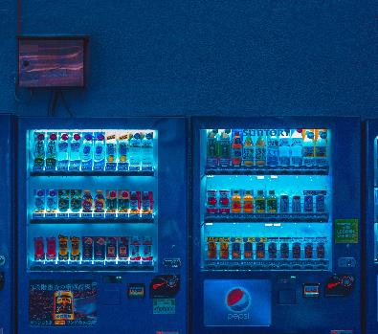
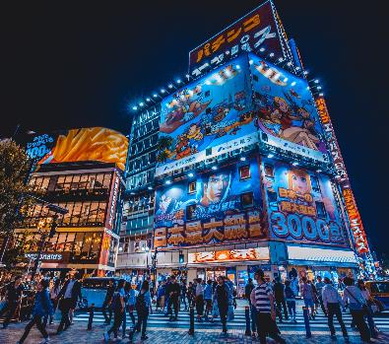


WHAT TO DO IN AN EARTHQUAKE!!
DROP TO THE FLOOR DON’T PANIC!
GET UNDER A TABLE (AND COVER YOUR HEAD IF YOU ARE OUTDOORS)!
HOLD ON TO A STURDY PIECE OF FURNITURE!

Slide 5
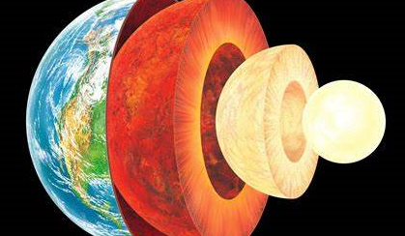
Layers of the earth.
The earth is made up of three layers the core, the mantle and the crust.

Slide 6
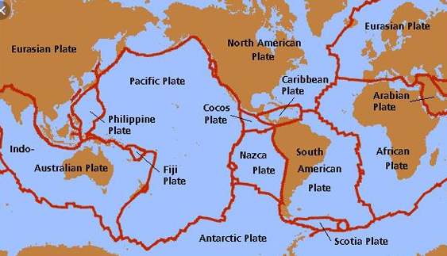
Tectonic plates
.
Tectonic plates are irregular shaped plates on which the continents and bodies of water rest. When the heat and pressure from the earth’s core pushes up, it causes the tectonic plates to push against each other, move away from each other or rub against each other.
Here is Japan! It is in the middle of four tectonic plates!

Slide 7
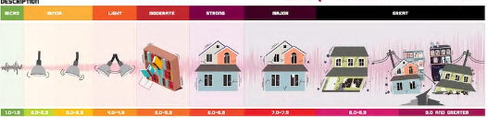
How are earthquakes measured?
Earthquakes are recorded on a Richter scale and here is a diagram of how bad they are in a scale.

Slide 8
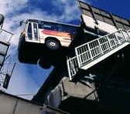

What damage do earthquakes cause?
Some earthquakes are very powerful and can wipeout cities in minutes. England has earthquakes, but most of them are so small that we can’t even feel them. Some countries earthquakes are very powerful but most of those are on the ring of fire. They are very dangerous and the most powerful earthquakes demolish everything that is nearby. There are certain things that you should do when you find yourself in a powerful earthquake. You should drop to the floor and get under a table and hold the legs of a sturdy piece of furniture and do not hold onto a chair in an earthquake!

Slide 9
They can cause more damage…..
.
Earthquakes can also cause tsunamis. If an earthquake is underwater, they will usually cause them because the earthquake would shake the earth, causing the water to create waves that can crash onto the surface of land, sending the water in a powerful wave.

Slide 10


Thanks for listening!

