Slide 1
earthquakes
By Ben and Dima

Slide 2
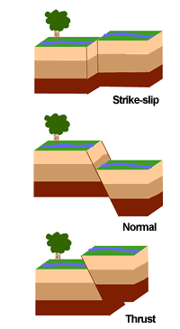
How does it happen?
Earthquakes are formed by the tectonic plates rubbing against each other and over lapping each other. They can also create hills, mountains and volcanoes.

Slide 3
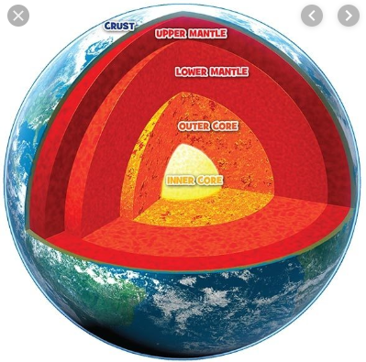
The earth’s four sections
There are four different types of the earth that help form the earthquakes; the Crust, Mantle, Inner Core and Outer Core which can even reach up to 10 000 degrees faron height.

Slide 4
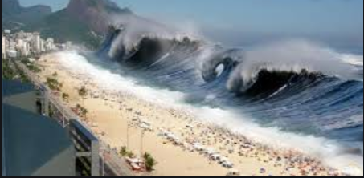
Fun fact!
Did you know that if the earthquake forms underneath water it creates a massive wave called a tsunami and they can wipe out large masses of land. here’s a picture of what it’s like.

Slide 5
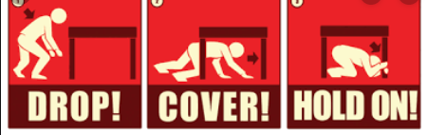
What to do in an earthquake
If you are ever in an earthquake there are three main rules to remember. You need to drop (on the floor), cover ( and protect your head ) and hold ( on to a sturdy table ).

Slide 6
What not to do in an earthquake
DO NOT PANNIC! It will only scare you.
DO NOT GO NEAR ANYTHING THAT COULD BREAK/ COLLAPSE.
DO NOT GO OUT ALLOWN! ALLWAYS HAVE A TRUSED ADDULT WITH YOU AT ALL TIMES!
DO NOT GO THROUGH THE BUILDING WITH OUT WEARING A HARD HELMET/ SOME PROTECTIVE GEAR ON YOUR HEAD!

Slide 7
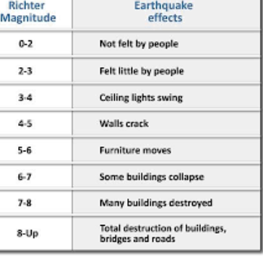
What Is a Richter scale
A Richter scale is a line that measures how bad an earthquake will be and if it reaches 12 ( The highest one ) it is total destruction. The biggest earthquake ever recorded was around 9.5 on the Richter scale.

Slide 8
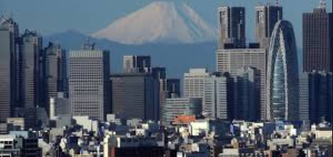
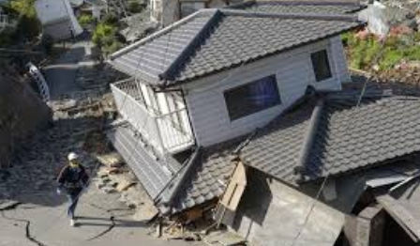
The wreckage of the earthquake
When It has had no earthquake
When It has had a bad earthquake

Slide 9
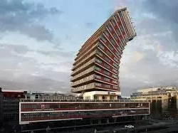
What they do to prevent this?
They create special buildings to absorb the shock and to move about to stay in one peace. If they didn’t have these buildings they would crumble into dust. They are made to wobble and move encase of earthquakes occur.

Slide 10
The ring of fire
The ring of fire is a tectonic plate that circles Japan which is why it is one of the most frequent places for earthquakes to occur.

Slide 11
Thank you for listening
OHIYOGOZAIMAS COREWA WATASHITACHI NO ASSEMBURI DESU

