Slide 1


Mini Police
Anti-Social Behaviour
By Ryan, Imogen, Abbie and Evie

Slide 2
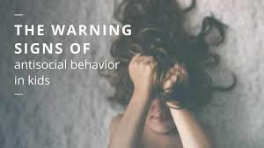
What is anti-social behaviour?
Anti-social behaviour is where people are not nice to other people. Sometimes people can be in groups and sometimes people can be alone. It is when you are upsetting someone in the community with your behaviour.
It could include:
Firework misuse
Littering
Causing damage to things (vandalism)
Being a horrible neighbour
graffiti

Slide 3
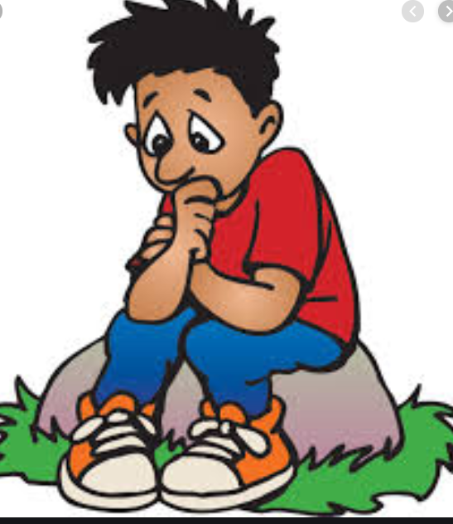
HOW DOES ANTI-SOCIAL BEHAVIOUR MAKE PEOPLE FEEL?
SCARED
Worried
Anxious
Upset
Frightened
sad
Like they don’t want to leave the house

Slide 4
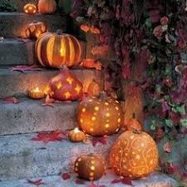
Halloween Anti-social behaviour
Anti-social behaviour is serious especially at Halloween.
This is because SOME people MIGHT THINK IT IS FUNNY TO throw eggs at people’s houses if you do not answer the door. It is not funny. IF YOU DID THIS IT WOULD BE ANTI-SOCIAL BEHAVIOUR and you could get in trouble with the police if you did this.
You have to be aware that you need to keep safe and stay with an adult at all times if you are trick or treating.
TRICK OR TREATERS CAN SCARE PEOPLE. ONLY GO TO HOUSES WHERE YOU KNOW THE PEOPLE WHO LIVE THERE AND THEY HAVE HALLOWEEN DECORATIONS ON DISPLAY.

Slide 5

Quiz time!!!!!
1) What is anti-social behaviour?
2) Who do you go with if you are trick or treating?
3) WHICH HOUSES SHOULD YOU GO TO AT HALLOWEEN?
4) WHAT SHOULD YOU WEAR WHEN TRICK OR TREATING?

Slide 6
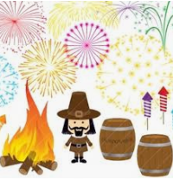
BONFIRE NIGHT SAFETY
ONLY ADULTS SHOULD TOUCH FIREWORKS AND LIGHT BONFIRES
STAY WELL BACK FROM FIREWORKS AND BONFIRES
NEVER THROW A FIREWORK AT SOMEONE
GO TO AN ORGANISED BONFIRE and fireworks display
Wear gloves to hold sparklers and put them in a bucket of water when you have finished with them

Slide 7
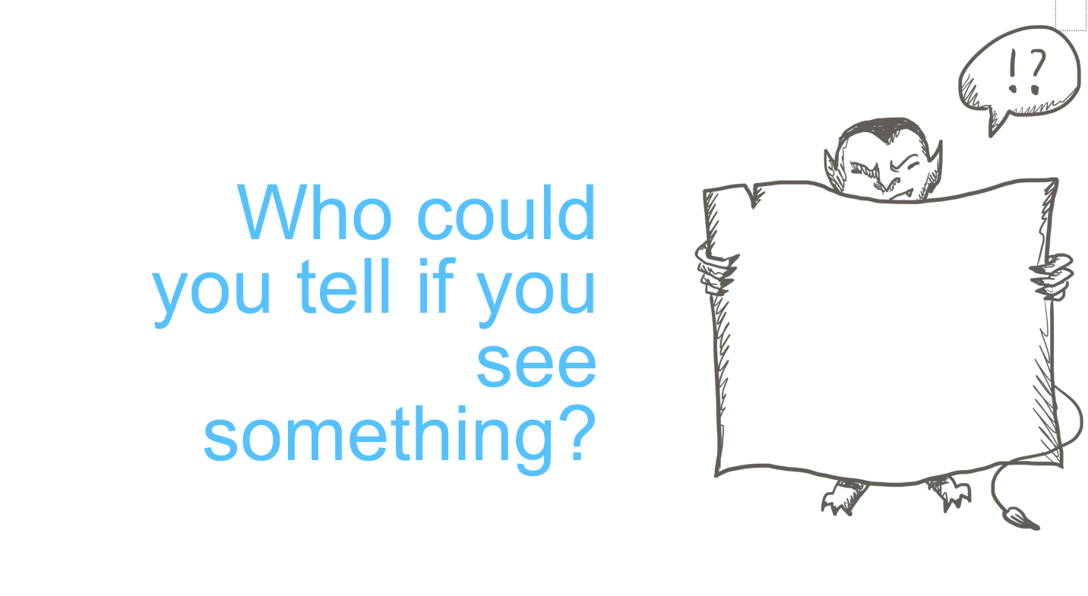

Slide 8
Tell your parents, school staff or trusted adult or REPORT IT TO THE POLICE ON 999 or 101.

Slide 9



Any questions??

Slide 10
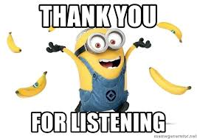
Thanks for listening!

