Slide 1
SOLAR SYSTEM
TYLER AND ALYSSA

Slide 2
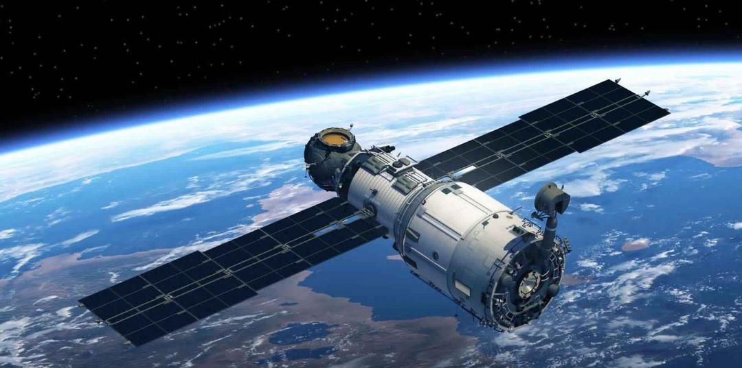
SATELLITE
The moon is Earth’s only natural satellite, together with it forms the Earth – Moon satellite system.
It is about one quarter of Earth in diameter.

Slide 3
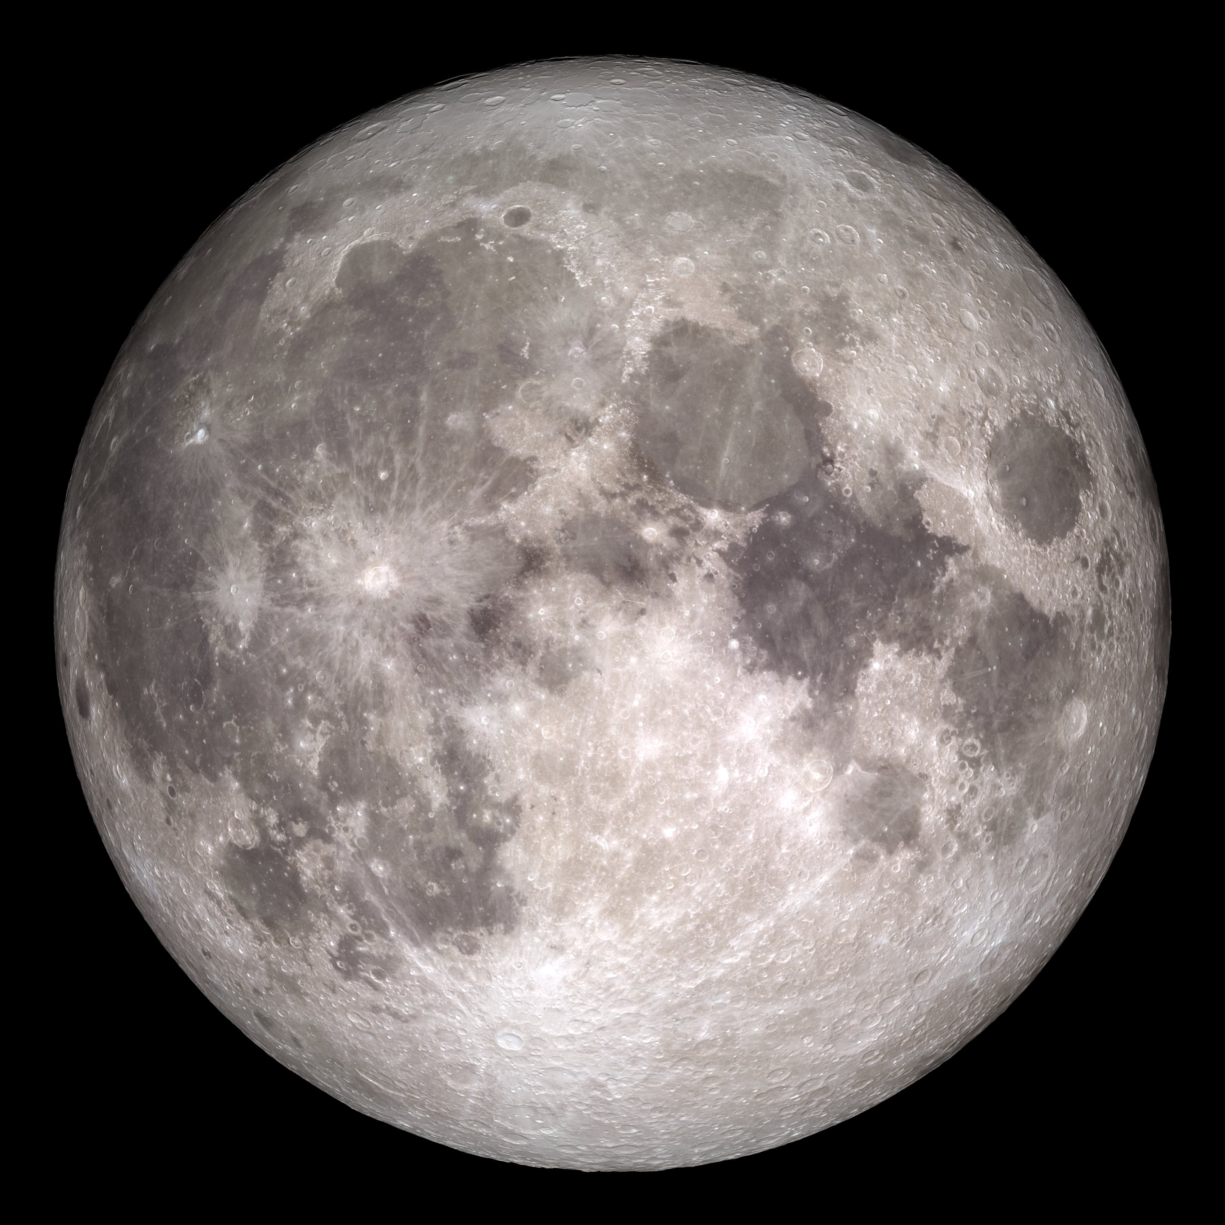
The moon
The moon is 224 degrees Fahrenheit average during the day but very cold at night -243 degrees average.

Slide 4
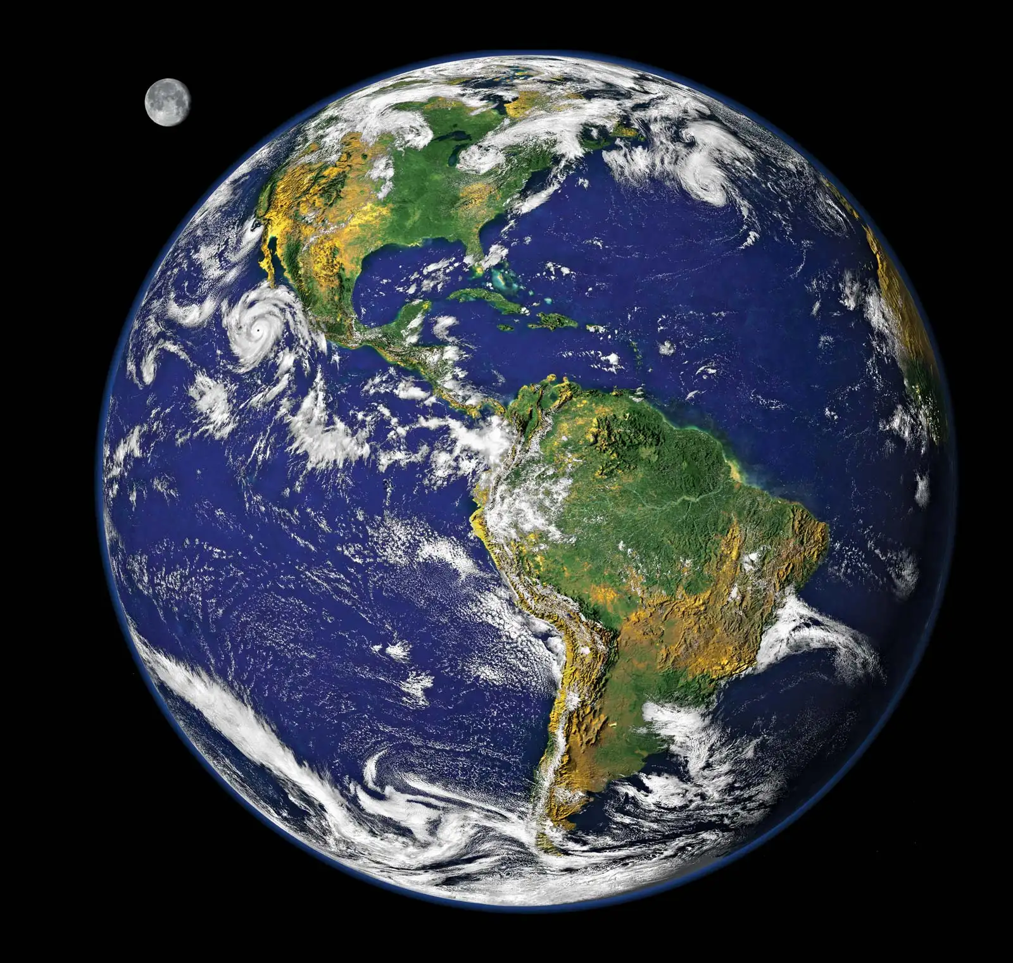
The Blue Planet
Earth, the third planet from the sun after Mercury and Venus , is referred to as The Blue planet because of how it looks from space. This is because over 2/3 of the Earth’s surface is covered.

Slide 5
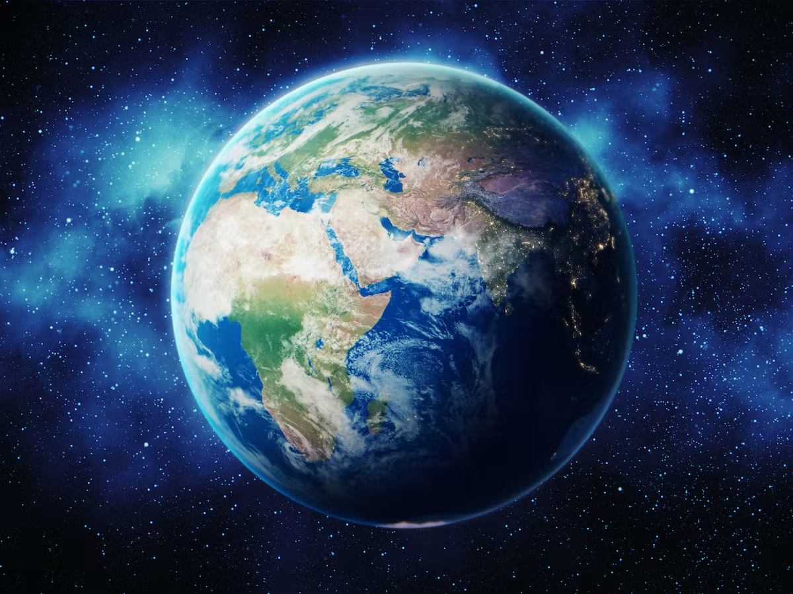
FUN FACTS ABOUT THE EARTH
Distance from Earth to sun – 150000000 km.
Surface temperature of earth 15 degrees c.
Age of Earth –Approximately 4.54billion years.
Diameter - 13000km

