Slide 1
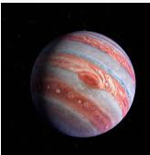
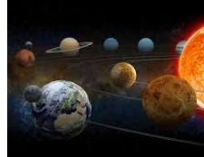
Space
The spectacular

Slide 2
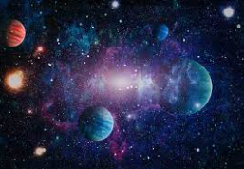
The planets in order
The thing that gives us daylight is the SUN which is a star .
The very next planet is Mercury the closest planet to the sun .
The next planet is venues the closest planet to Earth .
The next planet we should all know is Earth the planet we live on with oxygen and water to live .
Mars is the very next planet in our Solar System and it is very hot !
Jupiter the next planet but the first gas planet yet and one of the biggest !
Saturn is another gas planet in our solar system with water ice rings .
Uranus is again another gas planet but it has got gas rings like Saturn but with gas .
Neptune is the last planet in the Solar system .

Slide 3
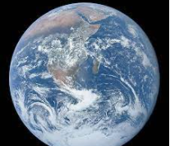
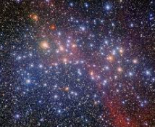
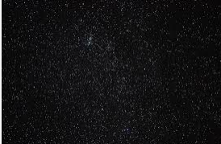
Fun facts
Fun fact number one Fun fact fact number two
The closest star to Earth there is a moon that is
Is the Alpha century . Called lo.

Slide 4
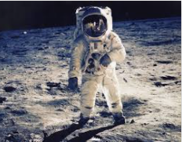
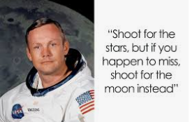
Who was the first Astronaut on the moon ???????
Neil Armstrong was the first person to step on the moon .

