Slide 1

The Solar system
By Diana and Declan

Slide 2
What is the Solar System?????
The Solar System is made up of 8 planets which are made of rocks and gas.
The 8 planets are: Mercury, Venus, Earth(Our home planet),Mars, Jupiter, Saturn, Uranus, Neptune there used to be a planet named Pluto but scientists figured out that it is actually a dwarf planet!
All the planets are being held by the Sun’s gravity.
The Solar system is 4.571 Billion years old!!
In this power point you will you learn all about the planets and more!

Slide 3
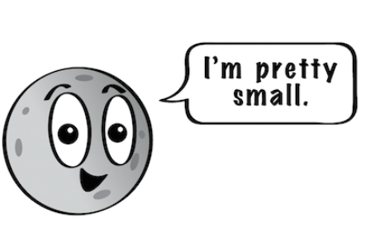
Mercury
Mercury is the closest planet to the sun.
Although it’s the closest planet to the sun its not actually the hottest. Its actually Venus.
It is the smallest planet in the Solar System.
Like Venus ,Earth and Mars Mercury is a rocky planet.
Mercury does not have ANY moons.

Slide 4
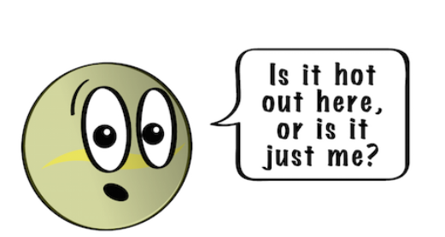
Venus
Although its only the second closest to the sun it is actually the hottest planet!!
Venus spins in the opposite direction of the Earth.
Venus has a thick atmosphere it traps heat and
that is what makes it so hot.
A day on Venus is lasts 243 Earth days.

Slide 5
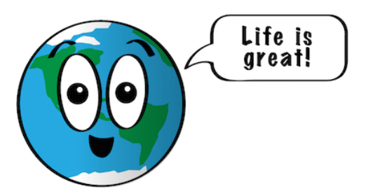
Earth
Earth is the planet we live on
Earth is 5th largest planet in the Solar System
The reason we live on Earth is because the atmosphere is just the right thickness to keep the planet warm.
A day on Earth is 24 hours
A year on Earth 365.25 days so every 4 years it’s a leap year and we get an extra day in the year.

Slide 6
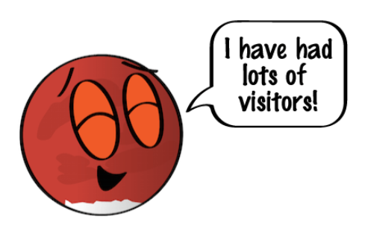
Mars
Mars has 2 moons their names Phobos and Deimos
It is a terrestrial planet
One day on Mars is 24.6 hours which is a little bigger than a day on Earth
One year on Mars lasts 687 days which is almost double than our year
Mars is the only planet we have sent rovers too

Slide 7
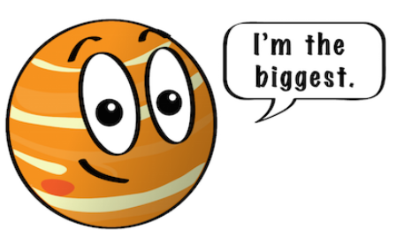
Jupiter
Jupiter is a gas giant
It is the biggest planet
It has been confirmed that Jupiter has 80 moons!
Just like Venus, Jupiter has a thick atmosphere
Jupiter actually has rings but they’re very hard to see
The longest time you can survive on Jupiter
is 0 seconds because its intense wind will
crush you to the floor.

Slide 8
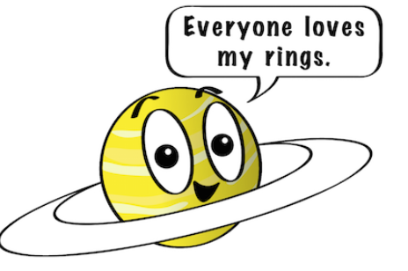
Saturn
Saturn is the 2nd largest planet in the Solar System
It is a gas giant just like Jupiter
It is made of hydrogen and helium
One day on Saturn is only 10,7 hours!
If you thought that was shocking a year on Saturn is the same as 29 Earth years!
Saturn has 53 moons!
It also has 29 moons that are unconfirmed.

Slide 9
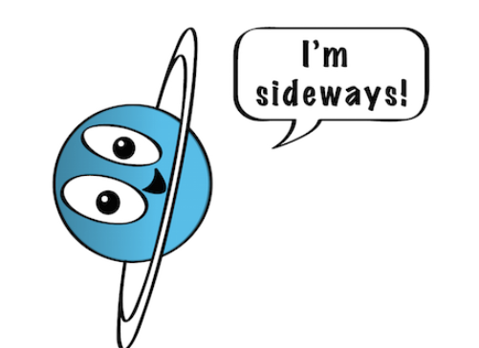
Uranus
Uranus is the coldest planet in our solar system.
Its an ice giant
It has 27 moons
It is a sideways planet
One day on Uranus is 17 hours and 14 minutes
One year in Uranus is the same as 84 years on
Earth.
Uranus was discovered in 1781 by William Herschel
In Great Britian.

Slide 10
Neptune
Like Uranus, Neptune is an ice giant.
Neptune has a very thick, windy atmosphere

