Slide 1
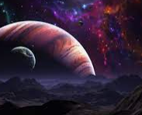
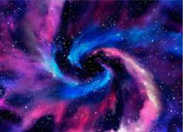
Our solar System
By Harriet and uliana

Slide 2
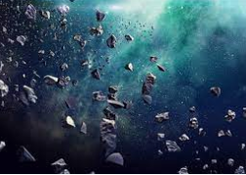
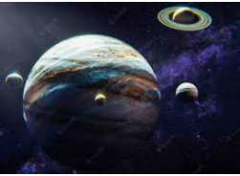
Facts about planets
Mercury is hot, but not too hot for ice
Venus doesn't have any moons and we aren't sure why
Mars had a thicker atmosphere in the past
Jupiter is a great comet catcher
No one knows how old Saturn's rings are
Uranus is more stormy than we thought
Neptune has supersonic winds

Slide 3
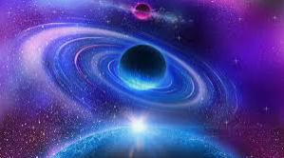
About space
The largest asteroid is about 965 km wide. The Sun’s surface area is 11,990 times the Earth’s size.
For years it was believed that Earth was the only planet in our solar system with liquid water. More recently NASA revealed its strongest evidence yet that there is intermittent running water on Mars, too!

Slide 4
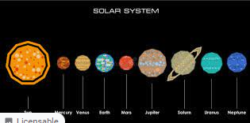
How to remember The order of the planets
The order of the planets are:
Mercury
Venus
Earth
Mars
Jupiter
Saturn
Uranus
Neptune

Slide 5
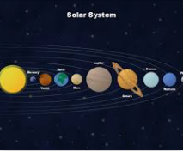
How to remember the planets continued
An easy way to remember the order of the planets is to use a mnemonic. A mnemonic is a tool that helps us remember certain facts or large amounts of information. My mnemonic to remember planets is:
Many
Very
Expensive
Mugs
Just
Stay
Under
Nets

Slide 6
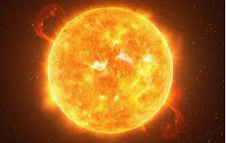
Facts about are wonderful sun
The closest star to Earth, it's the source of all the heat and light that makes flowers bloom, songbirds croon, and sunbathers swoon. Life wouldn't exist without it. It's also the centre of our solar system and by far its largest object. More than a million Earths would fit inside the sun!
The mass of the Sun is 500 times greater than that of all the planets around it.

Slide 7
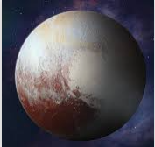
Why is Pluto a dwarf planet ?
Pluto is not a planet because a planet must: orbit the Sun; have sufficient mass to be round; not be a moon of another object; have removed small objects from the area around its orbit. In 2006 the IAS declared that Pluto had not cleared the area around its orbit, so it was reclassified as a dwarf planet.
Because it has not cleared the neighbourhood around its orbit, Pluto is considered a dwarf planet. It orbits in a disc-like zone beyond the orbit of Neptune called the Kuiper belt, a distant region populated with frozen bodies left over from the solar system's formation.

Slide 8
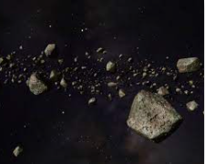
asteroids
Asteroids are small, rocky bodies that have been left over from the formation of the planets 4.5 billion years ago. They are often known as 'minor planets'. There are thought to be billions of these chunks of rock. Most of them lie in a doughnut-shaped 'main belt' between the orbits of Mars and Jupiter.

Slide 9


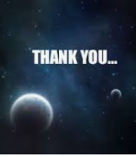
Thank you for watching our PowerPoint

