Slide 1
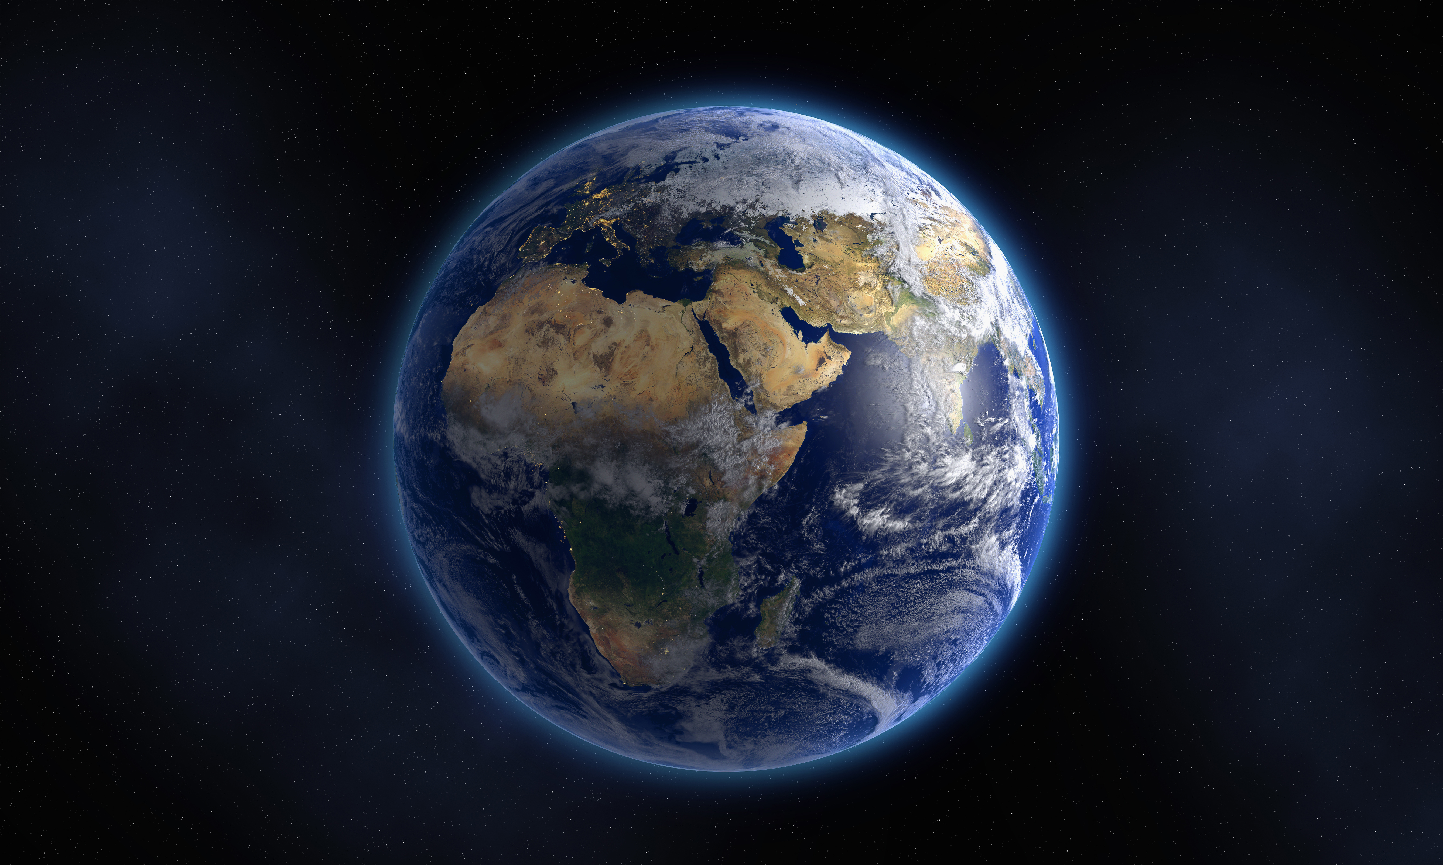
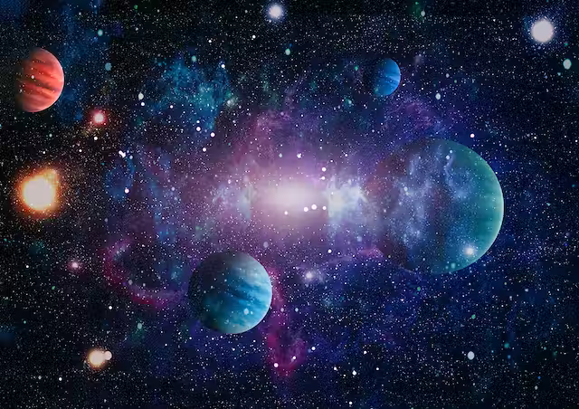
EARTH AND SPACE
☺JAKE AND EVA ☺

Slide 2
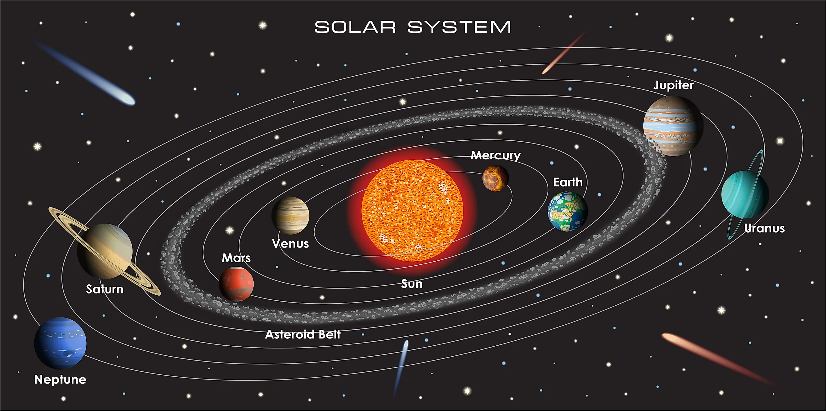
WHAT IS THE SOLAR SYSTERM ?
The Solar System was formed 4.6 billion years ago from a cloud of gas and dust called the solar nebula.
The Solar System is all the planets and other things in space that orbit (go around) our sun.
This is the order of the planets Mercury, Venus, Earth, Mars, Jupiter, Saturn, Uranus, Neptune.
The solar system is part of the Milky Way.

Slide 3
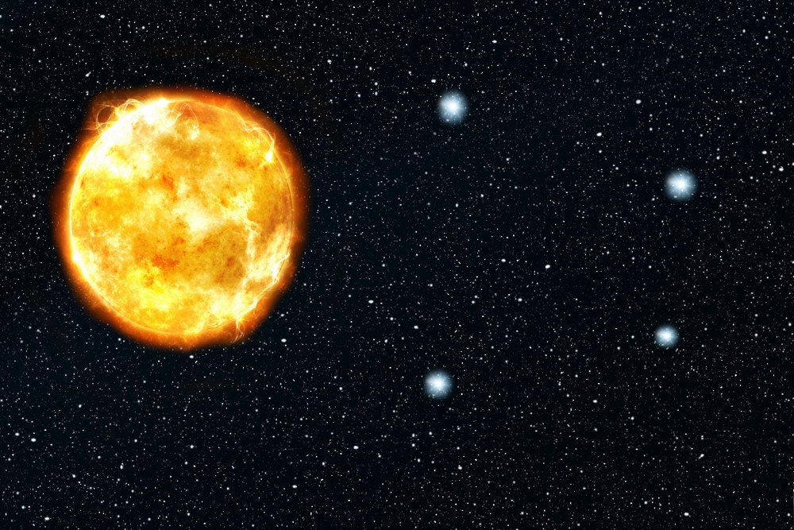
SUN AND STARS
The sun is a yellow dwarf star.
The sun is the biggest star.
There are over 200 sextillion stars in the milky way
Stars are made of hydrogen and helium.
The suns surface temperature is 5505˚C
Every star you see in the night sky is bigger and brighter than our sun

Slide 4
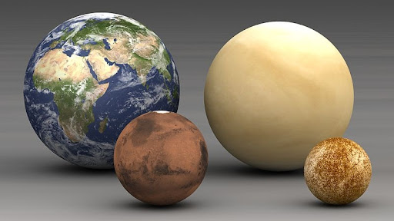
ROCKY PLANETS
There are 4 rocky planets which are Mercury, Venus, Earth and Mars.
They’re the 4 closest planets to the sun
They have a solid surface and a core which is mainly made of iron.
They are much smaller than the gas planets and rotate more slowly.
They are made of rocks and metals

Slide 5
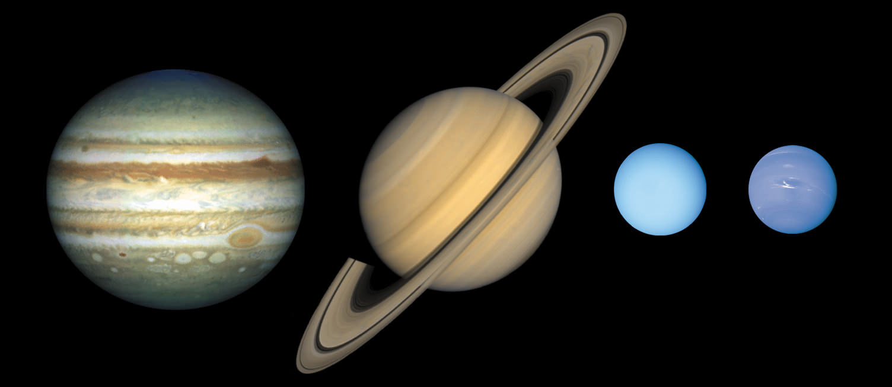
GAS Planets
The gas planets are Jupiter, Saturn, Uranus and Neptune.
They each have many moons.
They’re made of frozen hydrogen, ice-water, and ocean.
Water vapor is common in gas giants.
Jupiter has 80 moons
Saturn has 83 moons
Uranus has 27 moons
Neptune has 14 moons

Slide 6
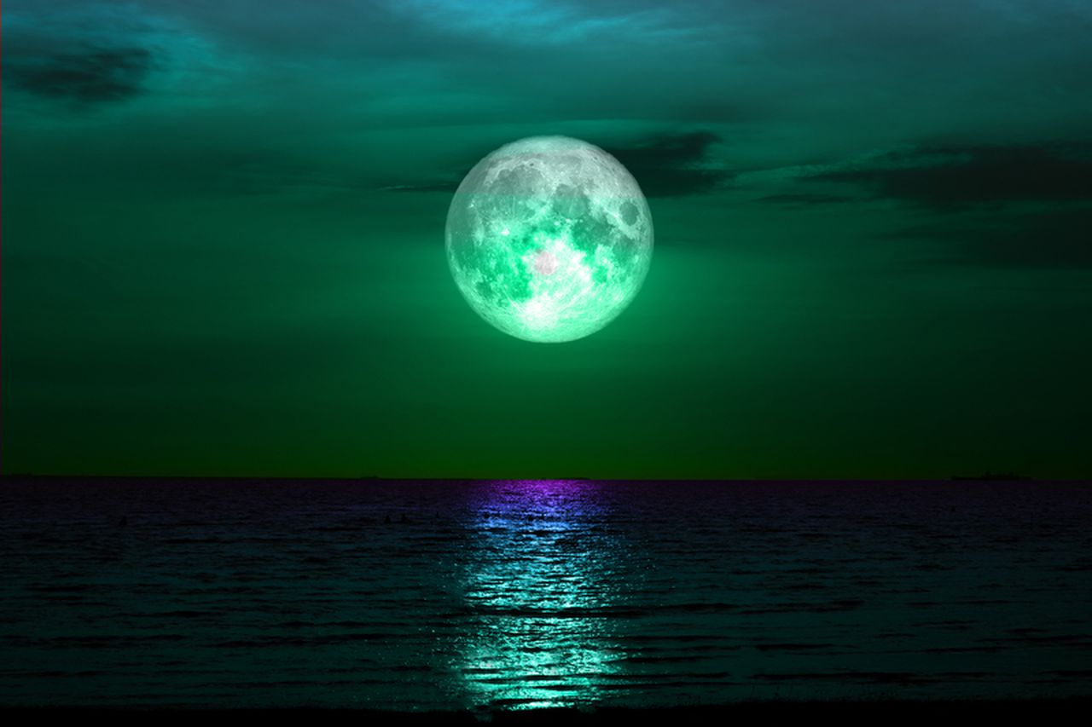
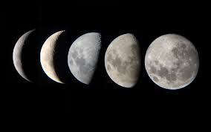
MOONS
They’re 181 moons.
The Moon has a very thin atmosphere called an exosphere.
The Moon has a very thin atmosphere called an exosphere.
Thee moon is 4.53 billion years old.
The Moon has a radius of 1.737 kilometres / 1.079 miles and a diameter of 3.474 km / 2.158 mi.
In full sunshine, temperatures on the Moon reach 127°C, way above boiling point.

