Slide 1
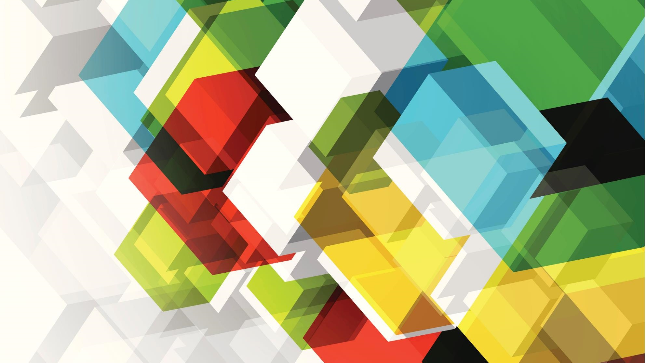
Solar System
From James and Lacey

Slide 2
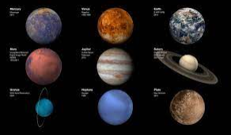
What is a Solar System?
A solar system is full of 8 planets and there is a planet called Pluto but that planet is not part of the solar system because the planet is too small. The 8 planets are called Mercury, Venus, Earth, Mars, Jupiter(the biggest planet), Uranus and Neptune. Jupiter has a size of over 100 000km. The Sun has so much energy because the solar energy created by nuclear fusion that takes place in the sun. Pluto isn’t the only dwarf planet, there are two other planets called Eris and Ceres that are also a dwarf planet.

Slide 3
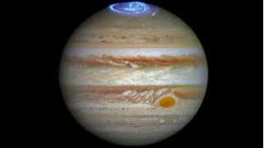
Did You Know?
Did you know that Jupiter is the largest planet because It has the largest foundation to attract matter as a protoplanet. Did you also know that you can use a mnemonic to remember the planets.

Slide 4
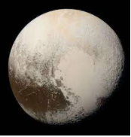
Facts about Pluto!
Mysterious Pluto is too small and far away to see clearly. It gets so little sunlight that its air freezes in winter. Its year is 248 earth years – a person born here would not live to a single year old. Pluto has one moon.

Slide 5
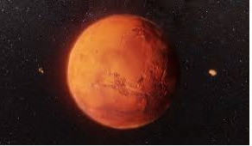
What is the Red Planet?
Mars is the only red planet.
Mars had water in the ancient times.
Mars had a thicker atmosphere.
Mars can kill an unprotected astronaut quickly.
Mars is red because of the rusty irony ground.
Mars has huge dust storms which last for months and can cover the entire planet.
Mars has two moons and they`re called Phobos and Deimos.

Slide 6
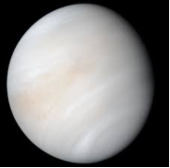
Facts about Venus
Venus is Earths ugly sister. Its size and structure are similar to Earths, but the air is poisonous and the surface is far too hot to support life. Venus spins around so slow that its “days” is longer than its “years”.

Slide 7

THANK YOU FOR LISTENING
FROM JAMES AND LACEY.

