Slide 1
Earth and space
By Lottie Thornley and zack Thompson

Slide 2
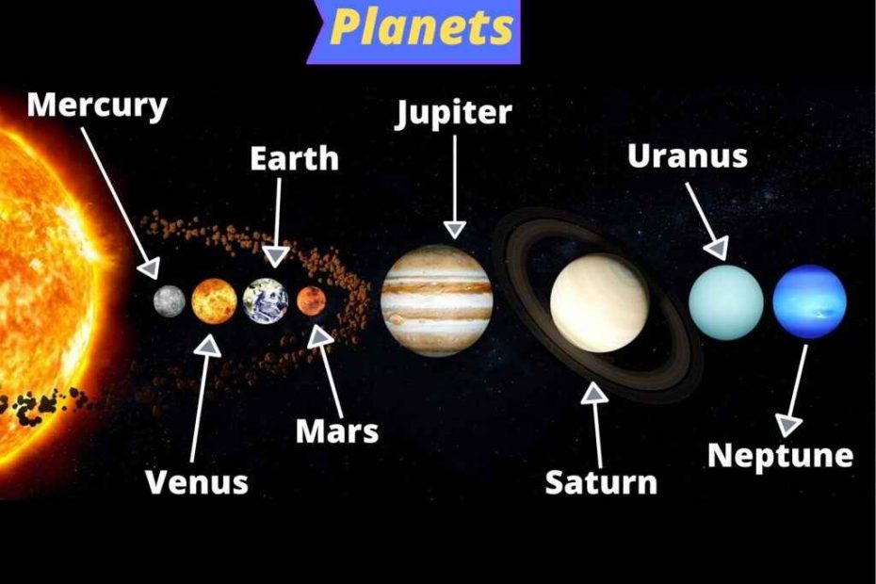
Order of the planets
1st Sun
2nd Mercury
3rd Venus
4th Earth
5th Mars
6th Jupiter
7th Saturn
8th Uranus
9th Neptune
There are 8 planets however , they orbit around the sun.

Slide 3
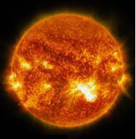
The sun
The sun is 300 000 times bigger than earth
The sun is a huge ball of fire and lava it’s 5505 degrees hot . If you go near the sun you will burn . It takes 8minutes for the heat of the sun to be felt .

Slide 4
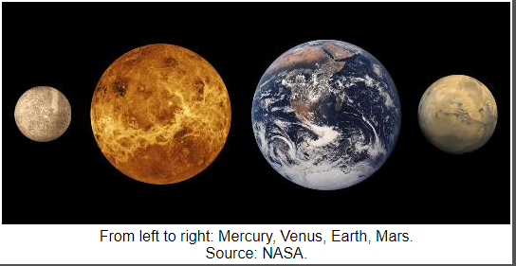
Mercury
Mercury has 0 moons , the diameter is 3031 miles away (4879km).Now that Pluto is no longer a planet Mercury is now classified as the smallest planet in the Solar System . Mercury is a rocky planet with an iron core . It’s actually closer to the size of the Earths moon .

Slide 5
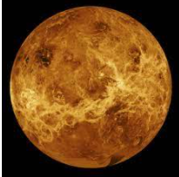
Venus
Venus is the 2nd planet from the sun . A day on Earth is longer than a year . Venus is hotter than Mercury despite being further away from the sun . Unlike the other planets in the Solar System , Venus obits clockwise on it’s axis . Venus is the 2nd brightest planet after the moon .

Slide 6
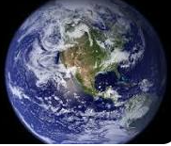
Earth
Earth is our home planet it is a world like no others . The radius = 3,959 miles .
Earth is the 5th the largest planet in or Solar System . The Earth orbits the sun at 67,000mph . The earth is not a perfect sphere . We are the 3rd rock from the sun . Earth also has a waistline . Our amazing planet has been around for quite some time .

Slide 7
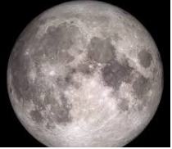
Moon
The moon is a dusty ball of rock with a diameter of 3,476 km . The moon is about ¼ of the Earth’s size . The moon formed about 4.51 billion years ago . The moon began with an explosive collision . You always see the same side of the moon . The moon used to look a lot bigger .

Slide 8
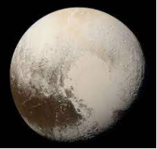
Fun fact !
Pluto is now called a dwarf planet since it is so small.

Slide 9
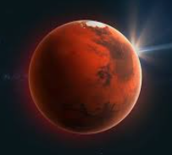
Mars
Mars is the outermost rocky planets , Mars is smaller than both Earth and Venus , and considerably colder . Mars is half the size of the Earth and the 4th planet from the sun . It takes nearly 2 years to orbit the sun . Every few years the planet appears particularly bright for a month or two in the midnight sky, when it is at its closest point to the Earth .

Slide 10
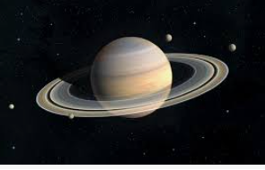
Saturn
Saturn is the Solar System’s 2nd biggest planet . A ball of mainly hydrogen and helium gas , like Jupiter it bulges outwards at its centre because it spins so quickly on its axis . Its is the least dense of all the planets .

Slide 11
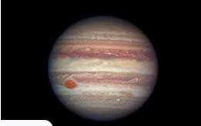
Jupiter
Jupiter is the Solar System’s biggest planet – it is so large that more than a thousand Earths could fit inside it ! It is made up mainly of hydrogen and helium gas .

Slide 12
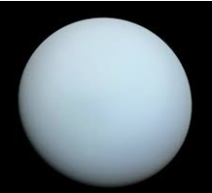
Uranus
During the early 19th century , astronomers discovered that Uranus took an unusual path around the sun . This should only be caused by another planet , further out in space , tugging on it to chance its orbit .

Slide 13


Thank you for listening

