Slide 1
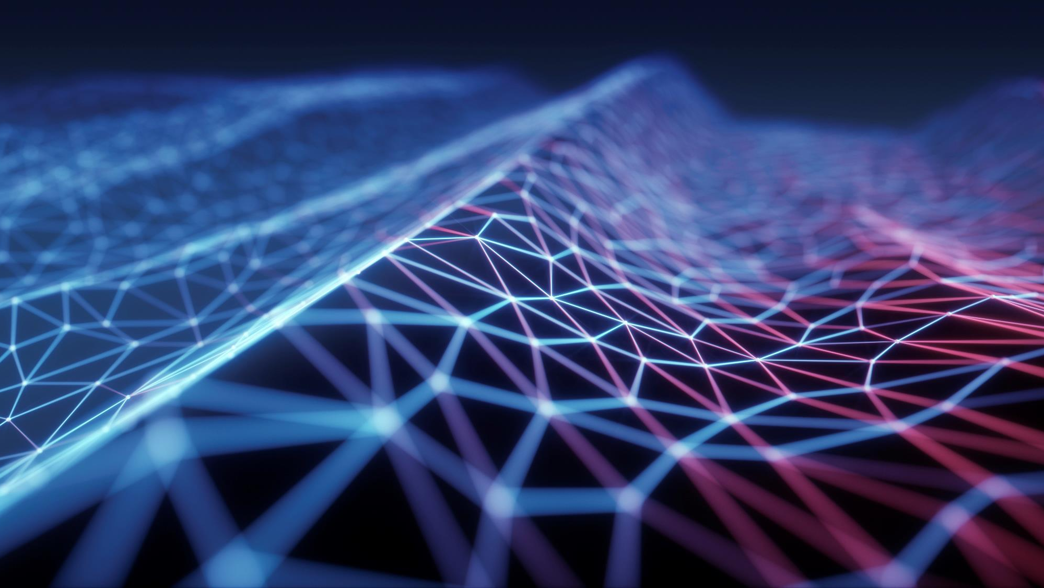
SPACE
BY LUCA AND JACK
Notes:
1

Slide 2
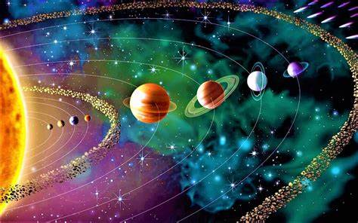
What Is The Solar System?
The solar system is a complex system of the Sun, Planets, Dwarf Planets, Asteroids and many other things all held together by the suns gravitational pull. There are eight planets in our solar system including Mercury, Venus, Earth, Mars, Jupiter, Saturn, Uranus, Neptune. In-between Mars and Jupiter is the Asteroid belt. In the Asteroid belt holds Asteroids (obviously), dust, and a Dwarf planet called Ceres.

Slide 3
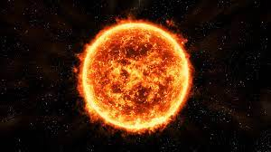
THE SUN
The Sun is all the colours mixed together so it appears white to our eyes. Unlike the planets the Sun is a star that is composed of 70% hydrogen and 28% helium. It is also 109 times wider and 330,000 times as massive than Earth. The difference between the Sun’s diameter measured aquatically and between the poles is about 10 km, which is almost a perfect spherical shape. There is a gravitational attraction at the core of the Sun that produces immense pressure. Also, it has hydrogen atoms that get compressed and fuse together, increasing the temperature up to 15 degrees Celsius at the core.

Slide 4
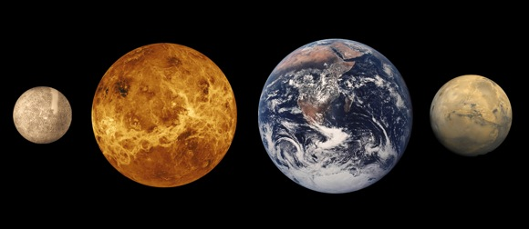
TERRESTRIAL PLANETS
Mercury is a small, rocky airless world with an extreme climate. It s also the smallest planet in the solar system.
Venus is a rocky planet with extreme temperatures that reach 470 degrees Celsius (890 degrees Fahrenheit).
Earth is a rocky planet with almost the exact mass as Venus. It is also the only known planet to hold life.
Mars is the second smallest terrestrial planet and is under investigation to see if humans can survive in its atmosphere.

Slide 5
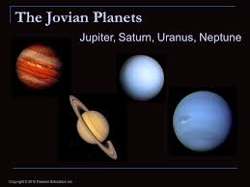
JOVIAN PLANETS
Jupiter is the first Jovian planet. It is also the biggest planet in the solar system.

Slide 6

DID YOU KNOW?
Did you know that recently, scientists have discovered that there could be a ninth planet? NASA’s computers have discovered sound waves coming from far beyond Neptune but no-one/nothing has seen it yet.

Slide 7
THANK YOU FOR LISTENING
WE’RE SORRY THAT WE DIDN’T GET TO FINISH THE SLIDE ☺

