Slide 1
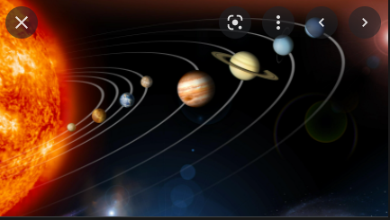
Solar system
By Samuel and Jenna ☺

Slide 2
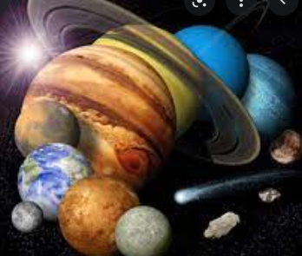
What is the solar system?
Made out of rocks and gas 4.7 billion years ago.
The eight planets that make up the solar system are Mercury, Venus, Earth, Mars, Jupiter, Saturn, Uranus and Neptune.
The planets orbit in circles around the Sun.
The closest planet to the Sun is Mercury and the farthest is Neptune.
The whole universe has at least 100 billion galaxies in it and one of those galaxies has our solar system in it.
Our Galaxy is the Milky Way.
The solar system is made up of 7 different planets.

Slide 3
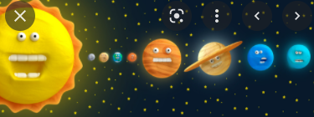
FUN FACTS!!!!!!!
You can’t stand on Uranus
The whole of Mars is as cold as the South Pole.
Saturn’s rings are 90% water.
Jupiter’s largest moon has a salty ocean that contains more water than Earth.

Slide 4
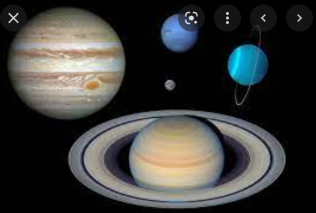
Gas planets
Gas Planets have layers of gas and liquid.
The gas planets are Jupiter, Saturn, Uranus and Neptune.
They have a small rocky core.
They have a ring of dust and debris.
Usually gas planets are cold.

Slide 5
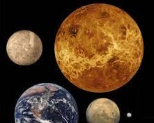
Rocky Planets
The rocky planets are Mercury, Venus, Earth and Mars.
They are made out of rocks and metals.
They have a solid surface and a core which is mainly made out of iron.
They are much smaller than gas planets.

Slide 6
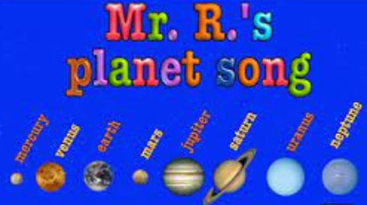
Solar System mnemonics
My Mercury
Very Venus
Excellent Earth
Mother Mars
Just Jupiter
Served Saturn
Us Uranus
Nachos Neptune

Slide 7
Thank you ☺

