Slide 1
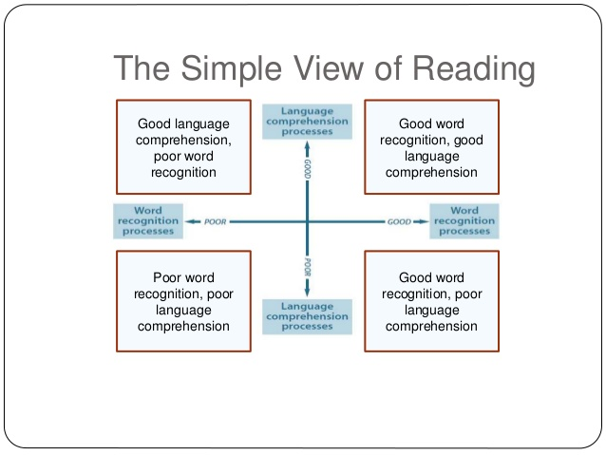

Slide 2
Reading comprehension is a highly interactive process. It draws on general knowledge of vocabulary as well as on our experience of the world. This in turn enables us to increase our knowledge in these areas.

Slide 3
Pamela waltzed through the final of the dance contest and the audience’s cheers brought her to the stage for an encore. “Every step she takes is so perfect and graceful, ” Alesha said grudgingly, as she watched Pamela dance.
Notes:
Read extract. Talk to person next to you about which word in this passage is the most important in taking meaning? If a child does not understand the word ‘grudgingly’ their whole experience and meaning taken from this extract will be incorrect.

Slide 4
Pamela waltzed through the final of the dance contest and the audience’s cheers brought her to the stage for an encore. “Every step she takes is so perfect and graceful, ” Alesha said grudgingly, as she watched Pamela dance.
Notes:
Really important that we are continuously thinking about what children will need to know in order to understand and take meaning from texts. Really important that we are actively teaching and introducing new vocabulary at the child’s level in order to further their understanding.

Slide 5
Reading the pictures
What do you think you know about this text? Do you know anything about the characters, the setting, the theme and the plot?
Notes:
Use the opening page from the Frog Prince Continued or another illustration of your choice

Slide 6
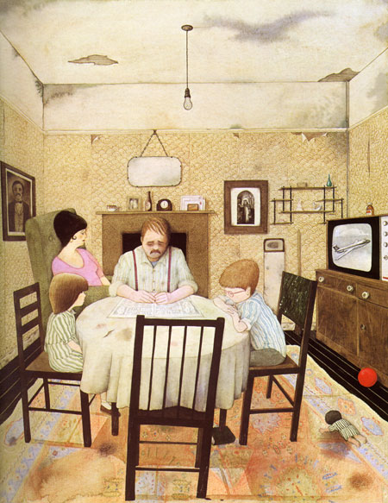
Notes:
Anthony Browne – Hansel and Gretel

Slide 7
Checking Understanding
Before reading a book:
- Why did you choose this book?
- What could this book be about?
During reading a book:
- Tell me what is happening in the pictures
- What might happen next?
- How might the story end?
- What does.....mean?
After reading a book:
- What happened in the story?
- What was your favourite part? Why?
- What sort of a character is...?
- How might you have changed the story?

Slide 8
Questioning Skills
Ask open questions:
Who?
What?
Where?
When?
How?
Why?
Why do you think that?

Slide 9
Higher Ability Readers
Reading on, between and beyond the lines (inference)
Authors show – not tell.

Slide 10

What does the film maker show us?
What does the film maker suggest?

Slide 11
For the third night in a row, Zac cried himself
to sleep. He had never been happy since he
moved into Year 6 a month ago. But, now that
Bruiser and his cronies had started singling Zac
out, it was worse than ever.
Questions:
Who was making Zac particularly unhappy?
How long is it since Zac started a new class?
How old is Zac?
What time of year is it?
How does the writer imply that Bruiser is someone who
bullies?

Slide 12

"The more that you read, the more things you will know. The more you learn, the more places you'll go."
— Dr. Seuss,

Slide 13

Questions?

