Slide 1
Solar system
By shivam and Harry

Slide 2
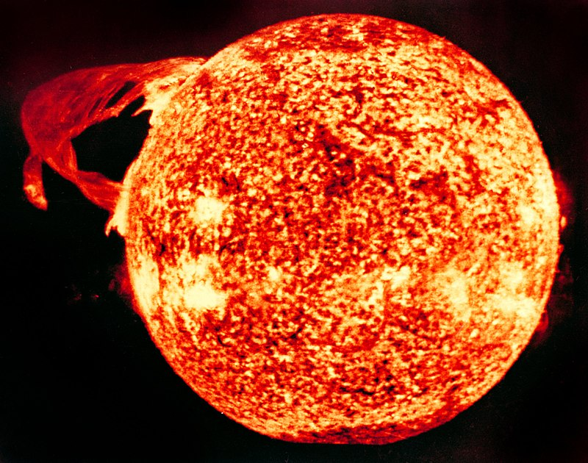
Making energy-the Sun
The sun makes energy by using two gasses called hydrogen and helium. It takes about eight minutes for the heat to get to us .Energy is released from the Sun’s core/the middle of the Sun. It takes 170 000 years for the energy to move from the core to the convection zone !!
Fun Fact
The Photosphere is the Sun’s surface and the energy gets here in big forms of bubbles, HOW WEIRD!!!

Slide 3
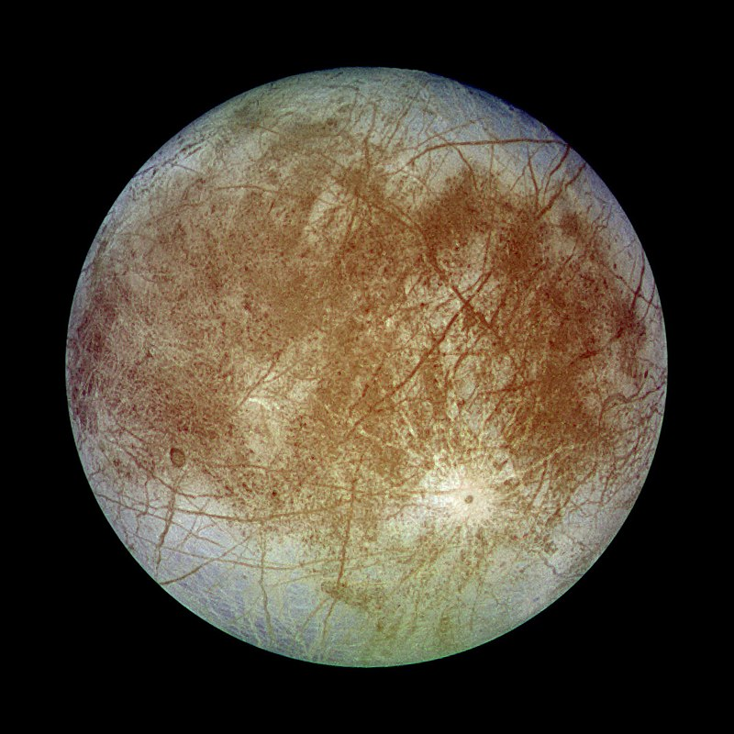
JUPITER’S JOVIAN MOON
Jupiter’s jovian moon has over 100 active volcanoes. These send fumes of sulfir up to 190 miles or 300km into the air . The big circle on Jupiter is actually a big storm that’s been there for milleniums/1000s of years. It also has 78 other moons. Some of the are even unknown to scientists! Jupiter is also the biggest planet. All the planets can fit in Jupiter and a day lasts 9 hours and 55 minutes on Jupiter.

Slide 4
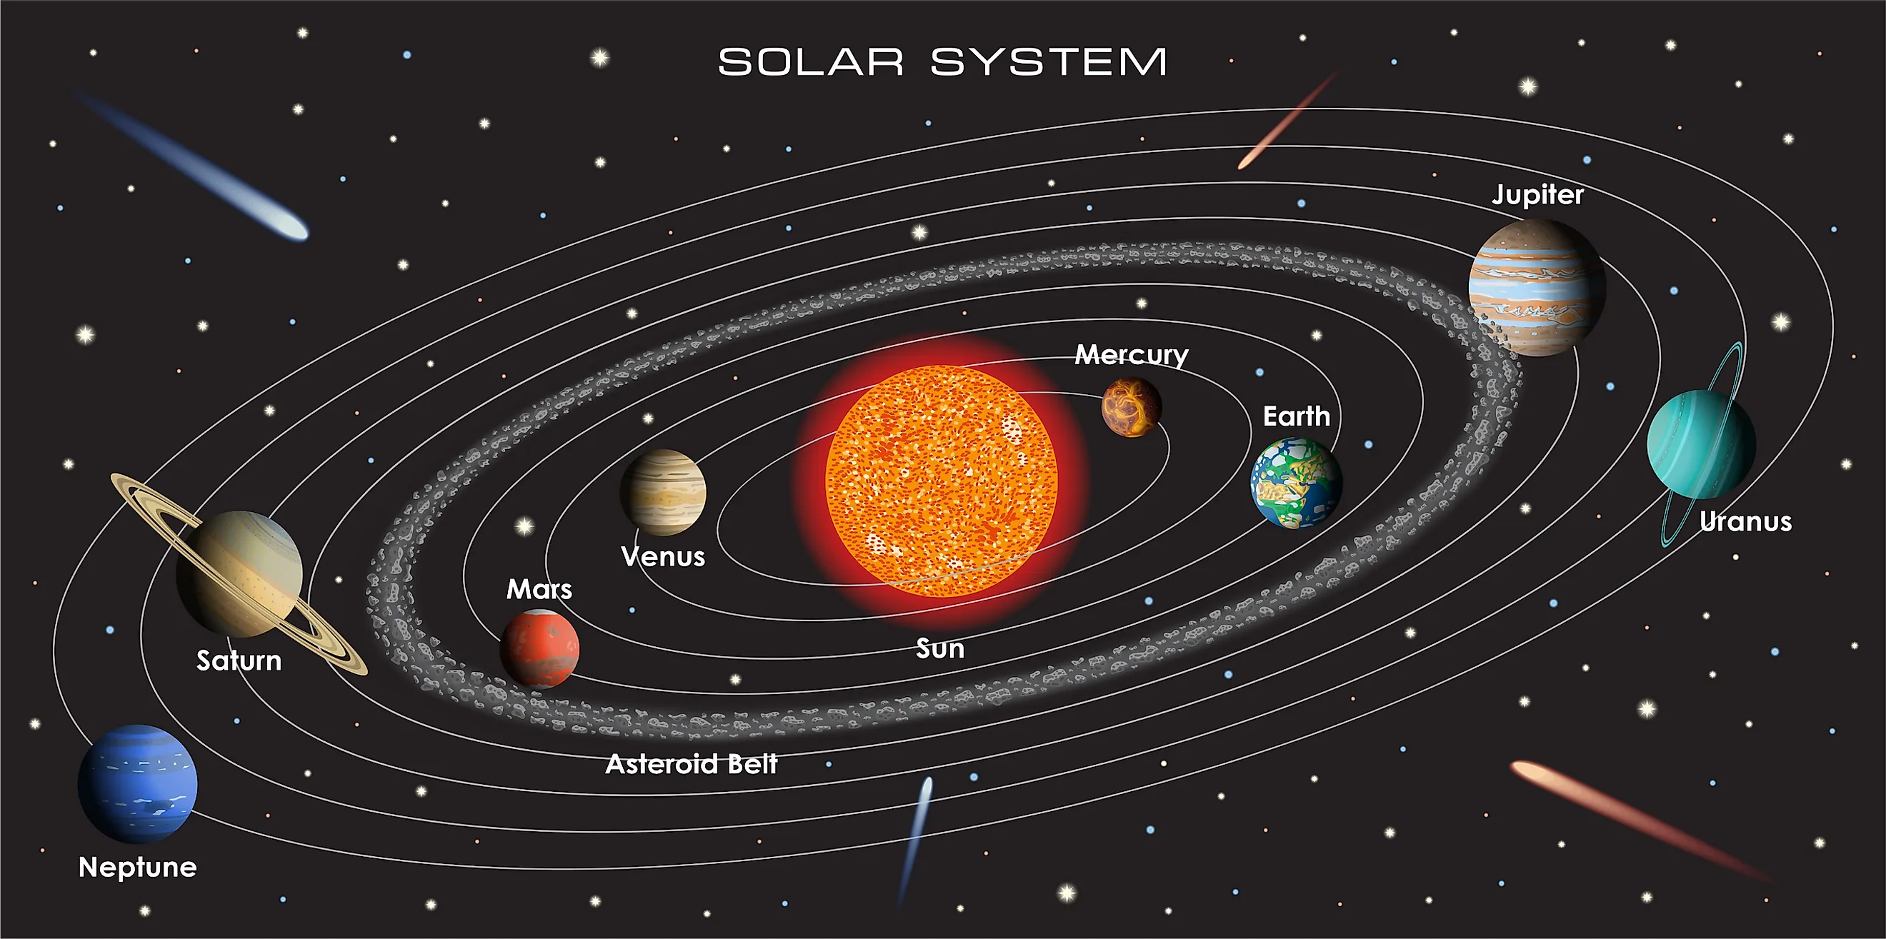
SOLAR SYSTEM
The solar system is made up of 8 planets and the sun which is a yellow dwarf star. The sun is made up of 7 colours red, orange, yellow, green, blue, indigo and violet. The first 4 planets are made of rock. The other 4 are made of gas. The first 4 planets are Mercury, Venus, Earth and Mars. The last 4 are Jupiter, Saturn, Uranus and Neptune.

Slide 5
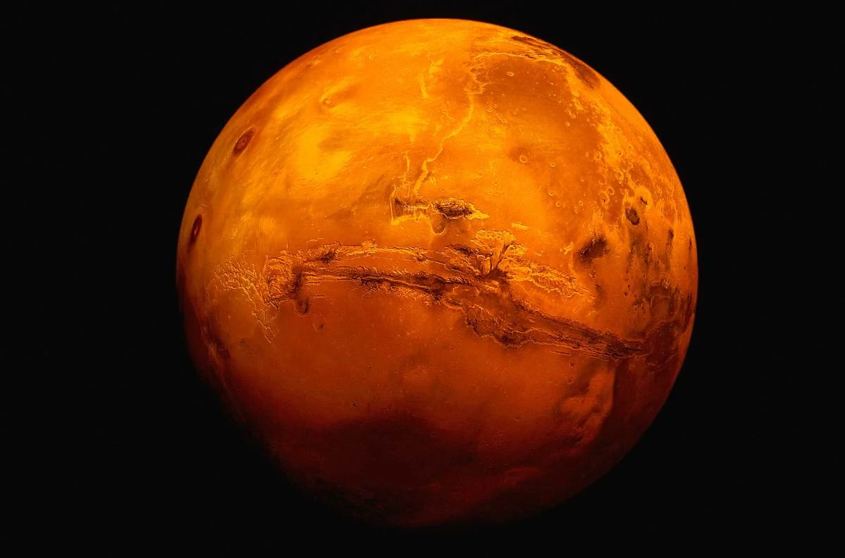
Mars
Mars is the outermost of the rocky planets. Mars is smaller than both Earth and Venus, and considerably colder. But with its thin atmosphere, icy polar caps and pattern of days and seasons, the Red Planet is the most Earth-like of the solar system’s other worlds, and the most likely to harbour life.

Slide 6
THANK YOU FOR LISTENING!!!
I hope you learned something that you didn’t know

