Slide 1
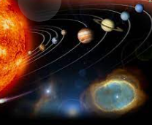
our SOLAR SYSTEM

Slide 2
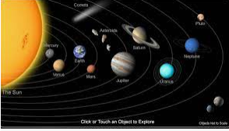
WHAT IS THE SOLAR SYSTEM?
Planets held in a gravitational field traveling around the sun

Slide 3
How many planets are there ?
8 planets including the sun

Slide 4
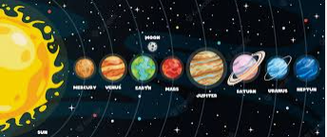
What are all the planets called ?
MERCURY
VENUS
EARTH
MARS
JUPITER
URANUS
NEPTUNE
SUN

Slide 5

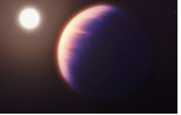
HOW WAS THE SOLAR SYSTEM MADE?
FORMED 4.7 BILLION YEARS AGO
MADE OF LOOSE CLOUD OF GAS AND DUST
GRAVITY PULLED THE CLOUD TOGETHER INTO CLUMPS TO FORM PLANETS

Slide 6
FACTS ABOUT THE SUN
SUFACE TEMPERATURE 5505 O C
DISTANCE TO THE EARTH : 149.6 Million km
RADIUS 696342 KM
Circumference 4 366 813 km
Mass 1 989 000 000 000 000 000 000 000 000 000 kg
The sun gives us all the light and heat.
The sun will end in 4.5 billion years

Slide 7
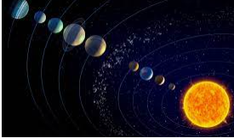
Did you know?
Jupiter is the biggest planet it is 139,820 km
Mercury is the smallest planet .
Our Galaxy is called the Milky Way and the Sun is one of the hundreds of billions of stars in the galaxy.
PLUTO is too small to be a planet is still in are system but no one counts it as a planet .

