Slide 1

Welcome to Barn Owls!
By Sam

Slide 2


What is a school day like in Barn Owls?
It’s amazing! Far better than any other class! You get to learn and have fun at the same time! Mrs Wood, Mrs Sharman and Mrs Jones are really kind, helpful and approachable. The last 2 years have been hard for all of us, including the teaching staff, but they have supported and helped us, and have made it possible to learn well at home.

Slide 3
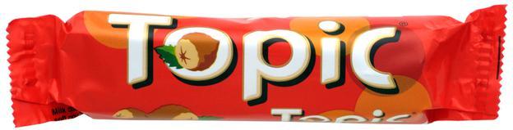
What topics will you cover next year?
You are going to cover loads of amazing topics including:
Ancient Egypt
The Victorians
Japan
Many, many more

Slide 4

Expectations.
Barn Owls are expected to work hard, complete their homework on time and read every evening. However Barn Owls get to do really cool stuff too. You will (usually) get to go on cool trips and enjoy golden afternoons.

Slide 5


Hope you enjoyed!

