Slide 1

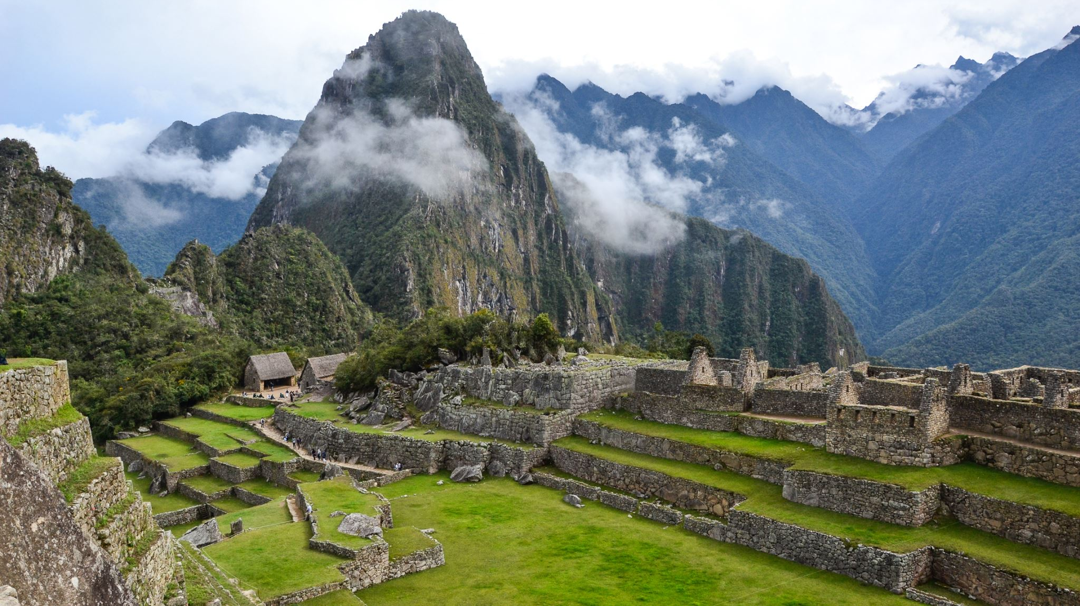
VIKINGS

Slide 2
The Viking longships
Longships were a type of specialised Scandinavian warships that have a long history in Scandinavian, with their existence being archaeologically proven and documented from at least the fourth century BC.

Slide 3
Were did Vikings come from?
The Vikings originated from the area that became modern-day Denmark, Sweden and Norway. They settled in England, Ireland, Scotland, Wales, Iceland, Greenland, North America, parts of the European mainland and among other places.

Slide 4
When were the Vikings in Britain?
The Vikings entered Great Britain borders between 8th and 11th centuries, when Norsemen from Scandinavia travelled to Britain Ireland to settle, trade or raid

