Slide 1
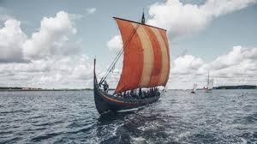
The Vikings
By Poppy Staff

Slide 2
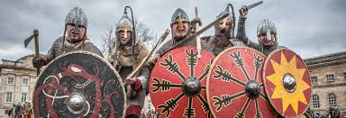
When were the Vikings in Britain?
The Vikings came to Britain about 1000 years ago.
The first attacks on the monasteries were at Lindisfarne in 793.

Slide 3
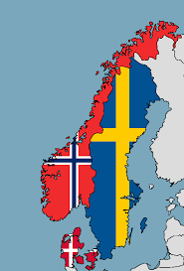
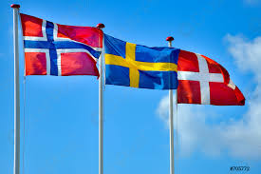
Where did they come from?
The Vikings were Norse people.
They came from Scandinavia.
Scandinavia was Norway, Sweden and Denmark.

Slide 4
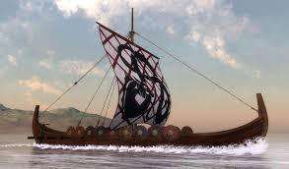
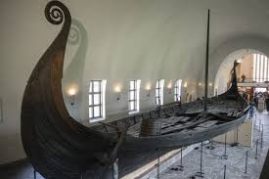
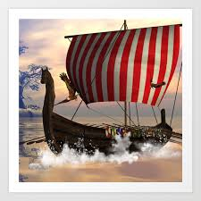
How did they get to Britain?
They came to Britain by the sea in boats called Longships.
Their Longships held up to 100 people.

