Slide 1
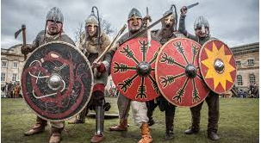
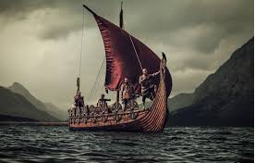
The Vikings
By Enija

Slide 2
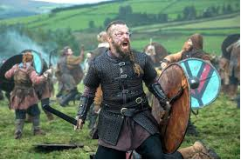
Who were the Vikings?
The Vikings were great explorers. They went as far as Russia and their aim was to take over nearly every country in the world.

Slide 3
When were the Vikings in Britain?
The vicious Vikings were in Britain 1 thousand years ago from 793AD to 1066AD. (1066AD was when the Normans took over so it was the end for the Vikings.)

Slide 4
Where did the Vikings come from?
The Vikings came from Scandinavia and in Scandinavia the places there were:
Sweden
Norway
Denmark

Slide 5
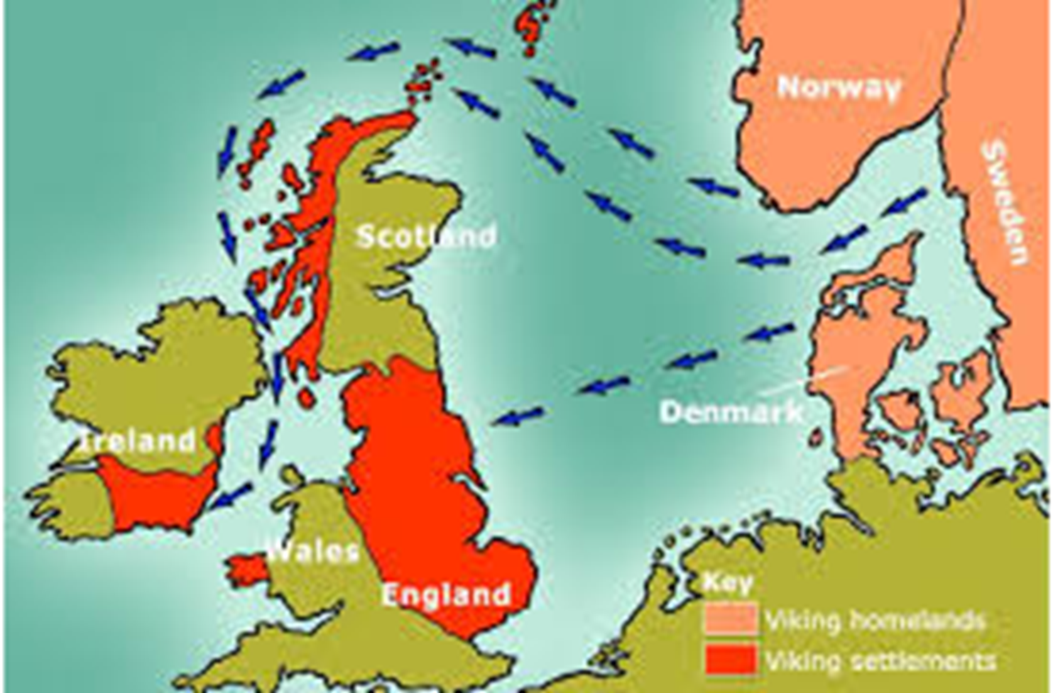
How did the Vikings get to Britain?
They came in big wooden boats with big oars and also they had no respect for anyone at all!

Slide 6


Slide 7
I hope you enjoined learning about Vikings!
Hope to see you next time!
Bye!

