Slide 1
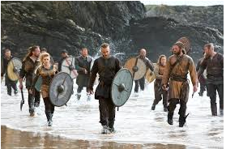
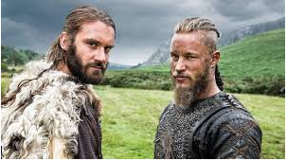
The villainous Vikings
By Erin W

Slide 2
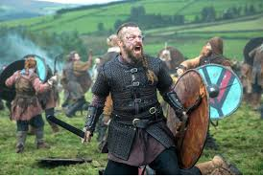
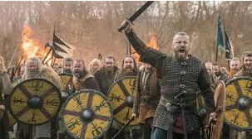
Who were the villainous Vikings?
You may be wondering, who even were the Vikings? Well, the Vikings were ruthless explores who travelled to Britain in order to make a new start. At first, only the younger brothers and all children who were girls came to Britain because it used to be that only the older brother (not sister) got all of the glory and even had lots of money and lots of wives. The word Viking also means pirate raid and that makes sense as they were sort of raiders.

Slide 3
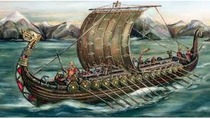
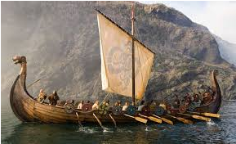
Where did these people come from and how?
The villainous Vikings came to Britain from Scandinavia which we now know as Sweden, Norway and Denmark. They came an extremely long way but not on a speed boat or any electric powered boat, they just came on a wooden boat with oars.

Slide 4
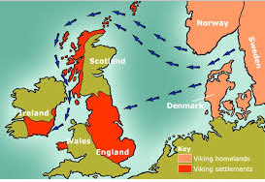
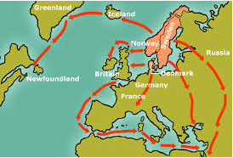
When did they come to Britain?
They came to Britain in 793 AD and in 1066 the Viking era was drowned in a sea of Normans coming to defeat them once and for all!!! This battle was called The Battle Of Stamford Bridge and was the start of the Norman era. As I said, at first, only the younger brothers and all child girls came but then more and more Vikings came over the sea to Britain.

Slide 5
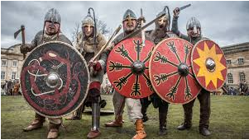
Did you know?
Whether you believe it or not, the Vikings do not actually wear horned helmets. So did they wear chicken helmets, sword helmets or cup helmets you are asking. Well, they actually wore only normal helmets with nothing sticking out of it at all. Just normal helmets.

Slide 6


Thanks for watching!!!!!!!!!!!!!!!
Thank you for watching this PowerPoint. I used up the whole afternoon of Thursday 28th of January doing this and really hope you can learn a lot and take this information in as you grow older and leave school. Still keep this in your brain and impress your mates with it later on in your life.

