Slide 1
The Vicious Vikings
By Ewan

Slide 2
Who were the Vikings?
The Vikings where people that wanted to take over England and they travelled everywhere by boat and the Vikings where around over 1,000 years ago and then they were taken over by the Normans around 1066AD

Slide 3
When were the Vikings in Britain?
The Vikings came to England in 1019 and they came by boat from there own country which was Scandinavia.

Slide 4
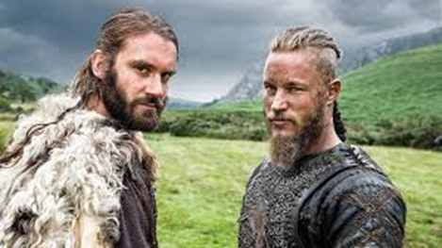
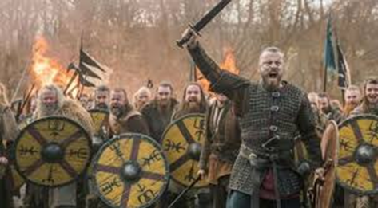
Where did they come from?
The Vikings came from Scandinavia. There are three key countries in Scandanavia which are Norway, Denmark and Sweden.

Slide 5
Did You know?
That Vikings mean pirate raid?
Did you know that it took them about 3 to 4 days to row to Scotland?

Slide 6
The Vikings split up. Some went to England from Denmark, some went to Scotland from Sweden and some went to Wales from Norway

Slide 7
How did they get to Britain?
The vicious Vikings came to England by boat.
Did you know that there boats were called longships?

Slide 8
Here are some of the pictures
Of the Vikings

Slide 9
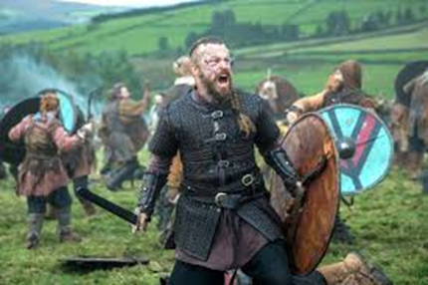
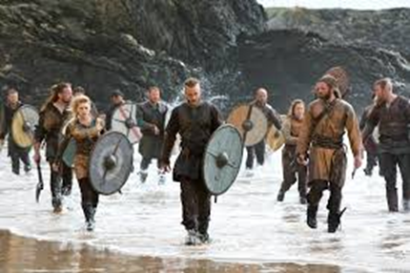
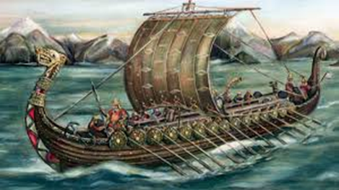
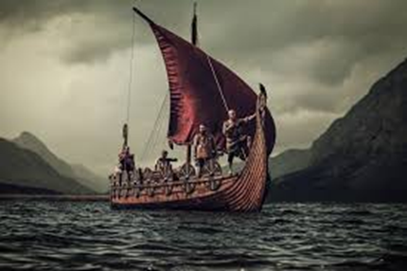
Some of these Vikings are very vicious.

Slide 10
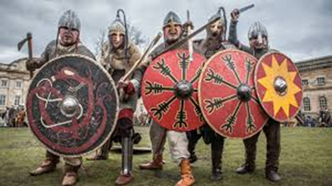
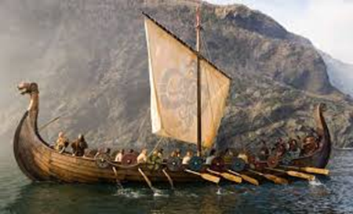
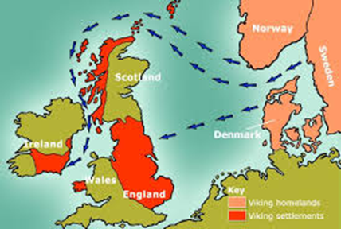
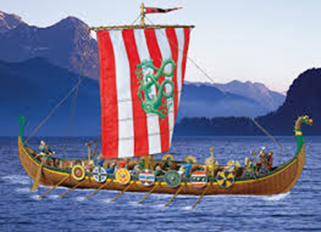
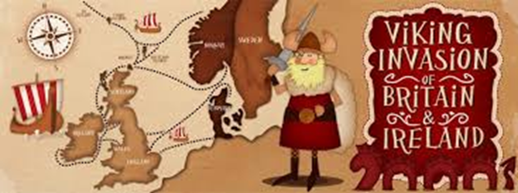
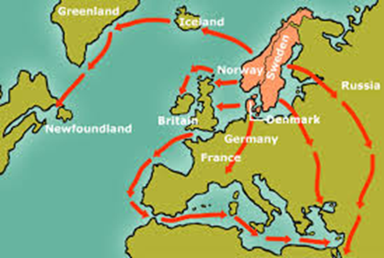

Slide 11
THANKS FOR WATCHING
I hope you enjoyed my presentation

